Slide 1


OTA 2G&3G Modernization Project
Site Photos
Subcontractor: MGNIC
Site ID: O22X027
Installation/Swap Date: 20/06/2016
Name: HAICHEUR HADJER
Department: Documentation (OTA Project)
Mail: haicheur.hadjer@zte.com.cn

Slide 2
Work Done ( Please to list bellow the work items done on the site)
SITE IDENTIFICATION
SITE VIEW OUTDOOR
SITE VIEW INDOOR
SITE BEFORE SWAP ANTENNAS
SITE AFTER SWAP ANTENNAS
NEW POWER SUPLLY,BATTERY,NOT B
PROTECTION
SITE CLEAN
….

Slide 3
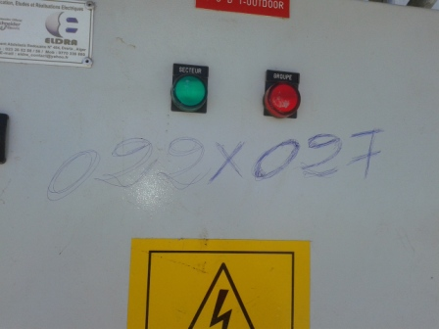
Site Identification
Paste the Picture here

Slide 4
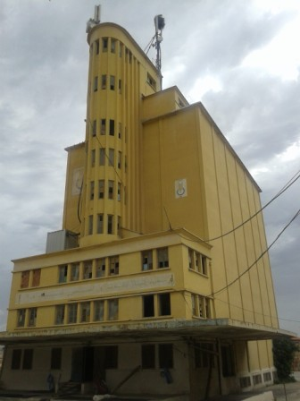
Site View outdoor
Paste the Picture here

Slide 5
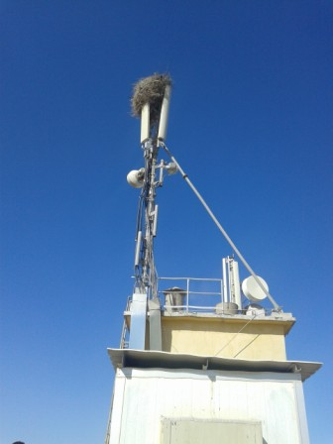
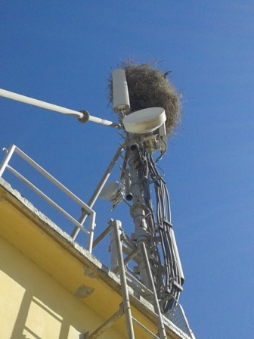
Site View outdoor

Slide 6
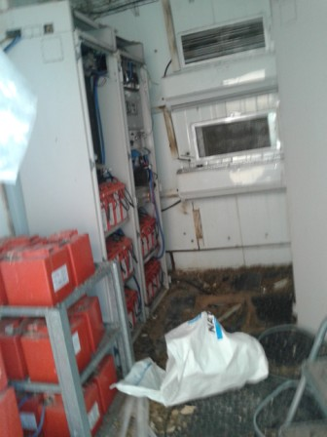
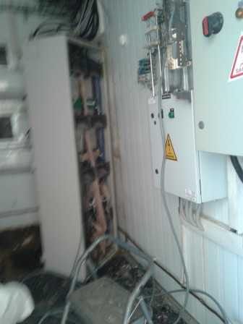
Site View Indoor
Paste the Picture here

Slide 7
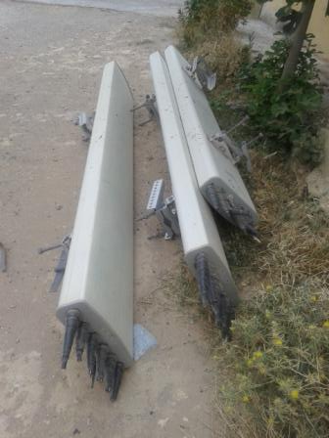
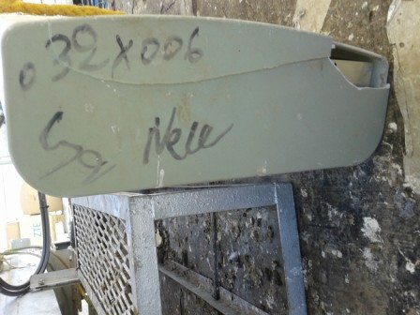
Antennas delivered
Paste the Picture here
Notes:
Bad State of the antennas

Slide 8
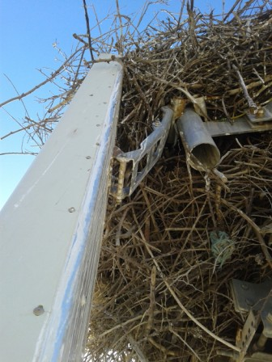
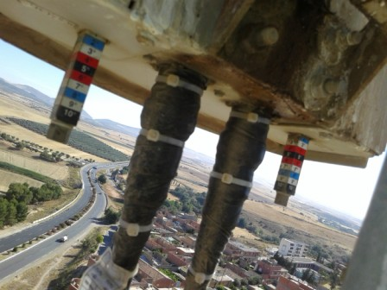
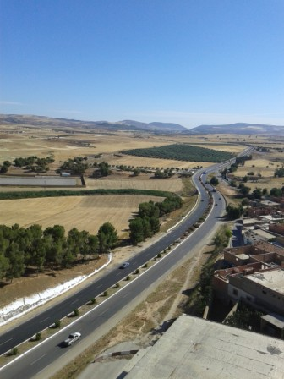
Antenna Sector 1

Slide 9
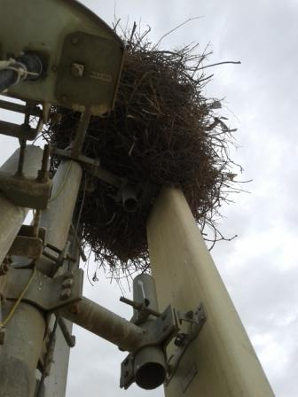
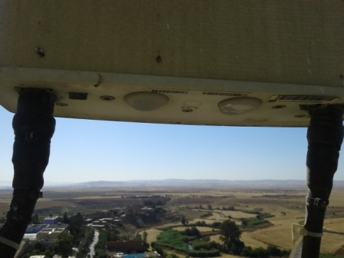
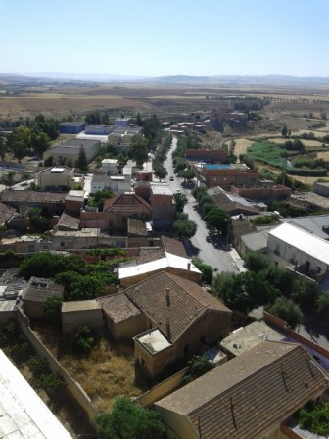
Antenna Sector 2

Slide 10
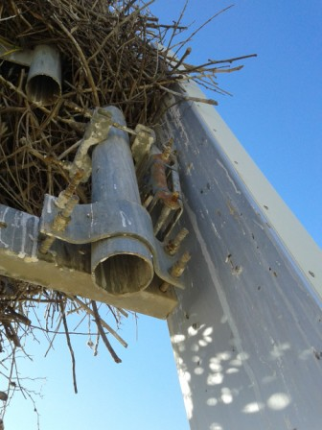
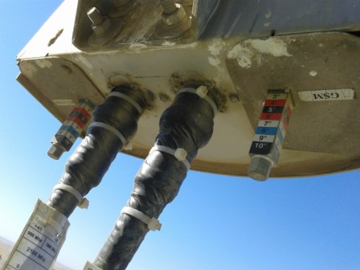
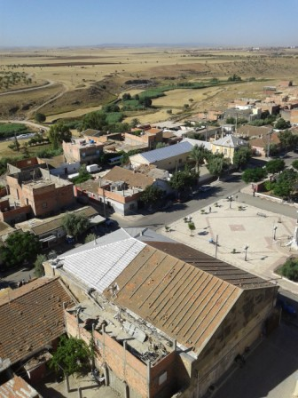
Antenna Sector 3

Slide 11
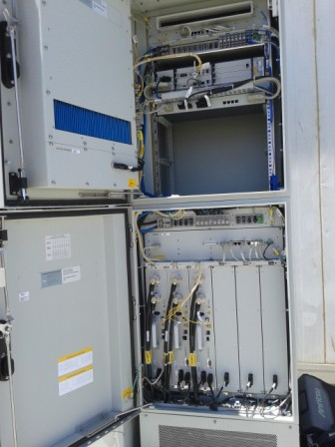
BTS/NodeB Cabinet
Paste the Picture here

Slide 12
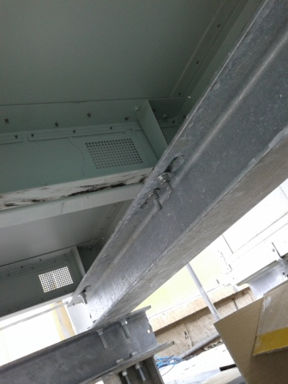
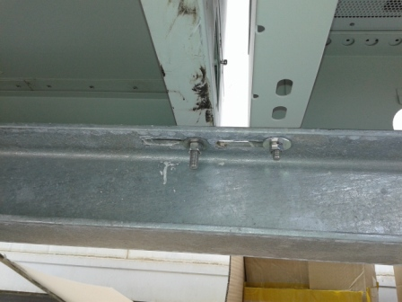
BTS/NodeB Cabinet fixation
Paste the Picture here

Slide 13
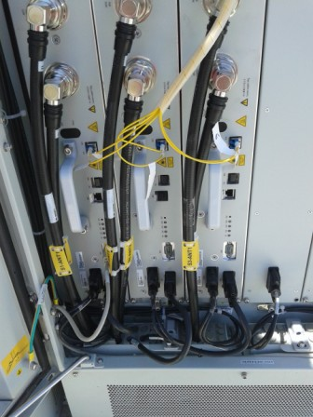
Indoor Jumpers + label
Paste the Picture here

Slide 14
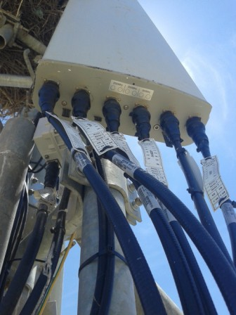
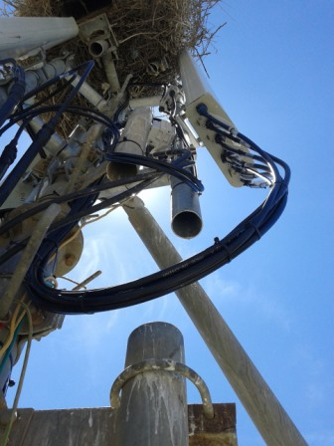
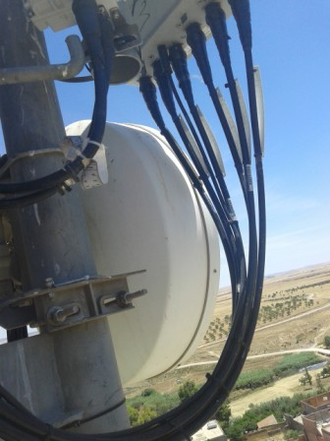
Outdoor Jumpers
Paste the Picture here

Slide 15
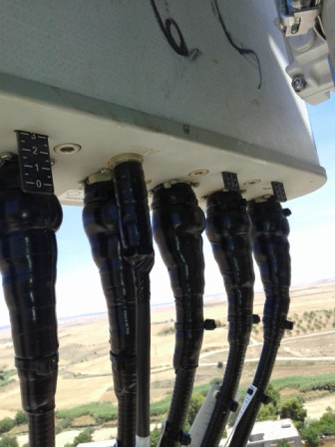
Outdoor Jumpers
Paste the Picture here

Slide 16
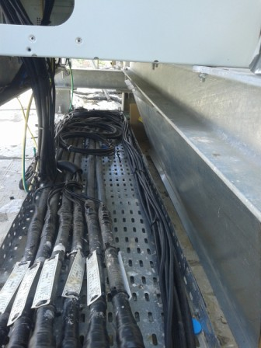
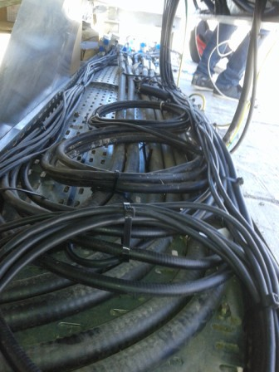
Cable Tray
Paste the Picture here

Slide 17
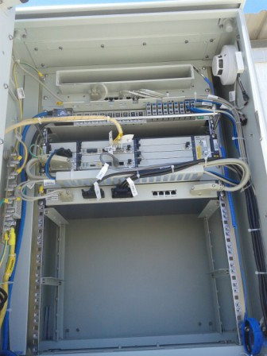
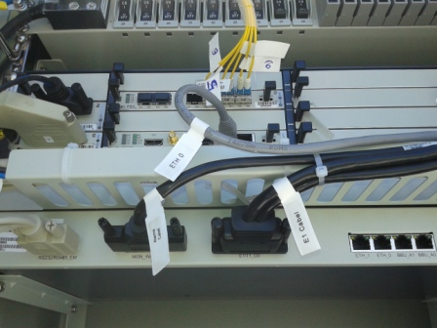
BBU (Connectivity and labeling)
Paste the Picture here

Slide 18
RSU/RRU
Paste the Picture here

Slide 19
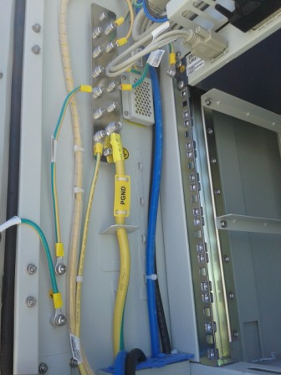
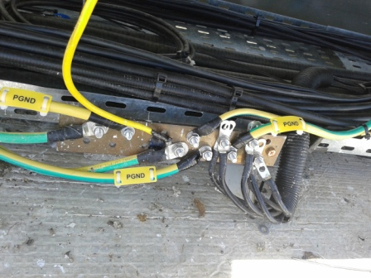
Grounding / Grounding Bar (Indoor and/or Outdoor)
Paste the Picture here

Slide 20
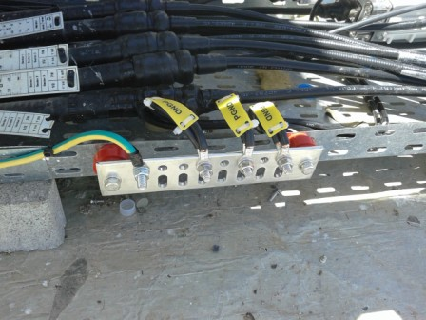
Grounding / Grounding Bar (Indoor and/or Outdoor)
Paste the Picture here

Slide 21
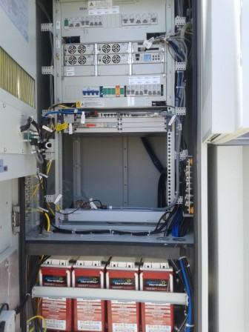
Power Supply
Paste the Picture here

Slide 22
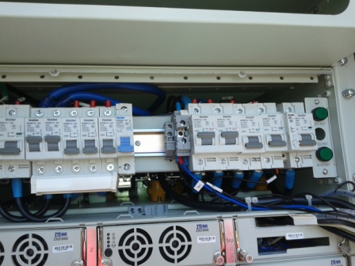
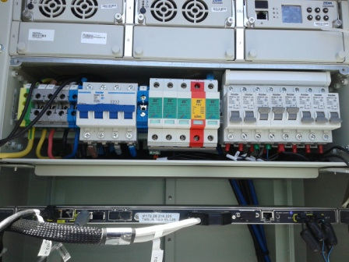
DC Breaker
Paste the Picture here

Slide 23
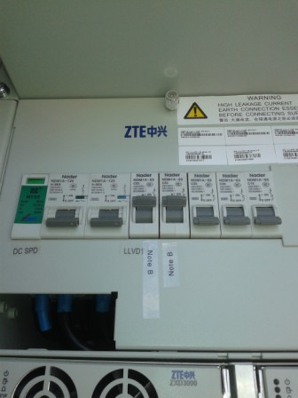
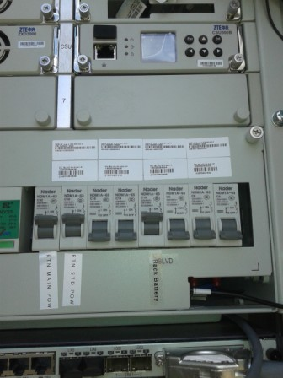
Labeling DC Breaker PS

Slide 24
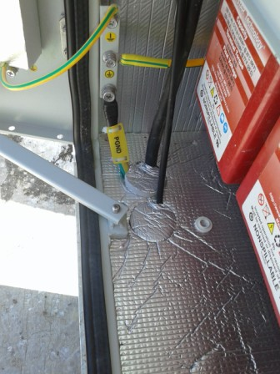
Grounding Power Suplly

Slide 25
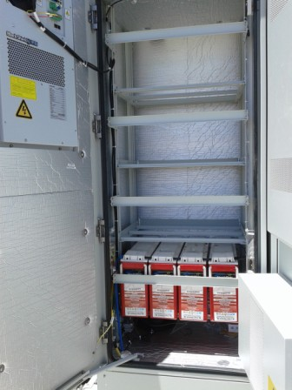
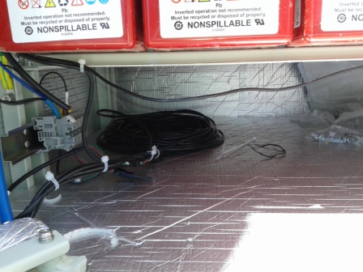
Batteries,Alarme batteries
Paste the Picture here

Slide 26
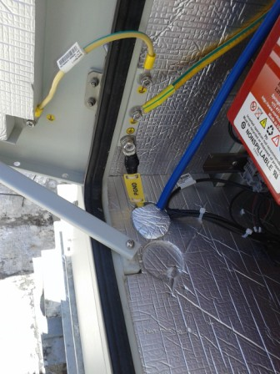
Grounding Batteries

Slide 27
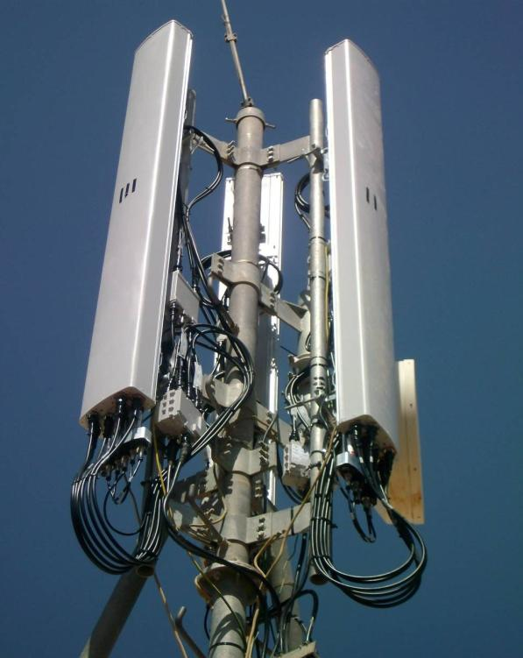
Antennas
Paste the Picture here

Slide 28
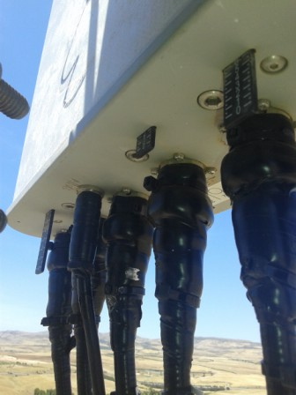
Antenna Sector 1 (Feeder,Waterproofing,label)
Paste the Picture here

Slide 29
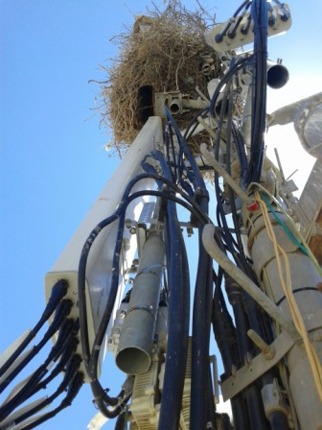
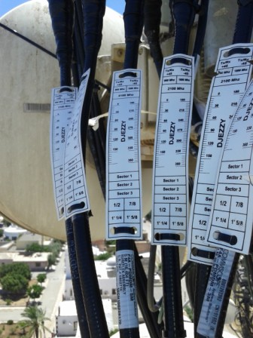
Antenna Sector 2(Feeder,Waterproofing,label)
Paste the Picture here

Slide 30
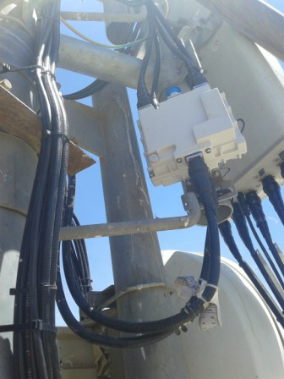
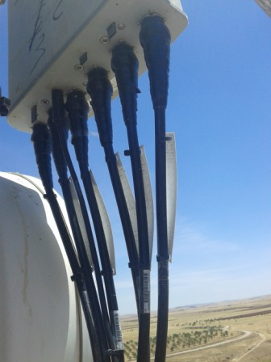
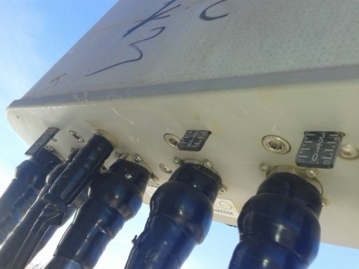
Antenna Sector 3(Feeder,Waterproofing,label)
Paste the Picture here

Slide 31
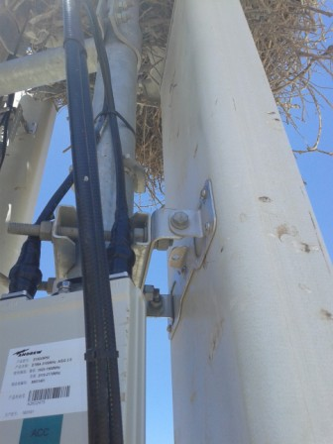
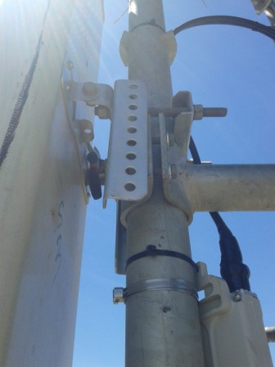
Antenna Bracket
Paste the Picture here

Slide 32
Triplexer S1 S2 S3(Waterproofing+Label)
Paste the Picture here

Slide 33

TMA
Paste the Picture here

Slide 34


Protection

Slide 35

Cleanup
Paste the Picture here

Slide 36

H-Bar
Paste the Picture here

Slide 37

Site View Outdoor After Swap Antennas

Slide 38
Others
Paste the Picture here

