Slide 1


OTA 2G&3G Modernization Project
Site Photos
Subcontractor: MGNIC
Site ID: C36X064
Installation/Swap Date: 26/06/2016
Name: HAICHEUR HADJER
Department: Documentation (OTA Project)
Mail: haicheur.hadjer@zte.com.cn

Slide 2
Work Done ( Please to list bellow the work items done on the site)
Site view intdoor
Not B Cabinet
Power Suplly
Rack battery
Grounding
Labeling Indoor/Outdoor
View Genrale after
….

Slide 3
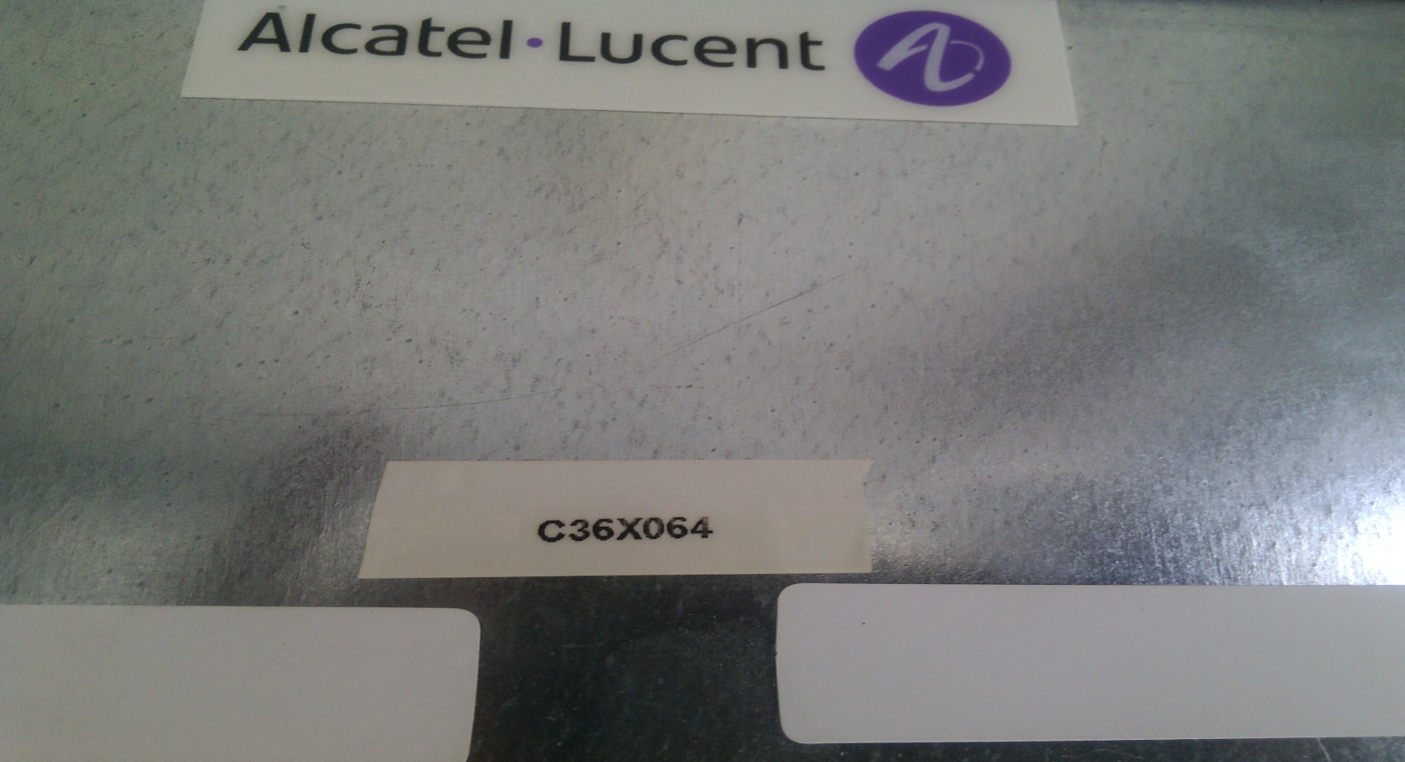
Site Identification
Paste the Picture here

Slide 4
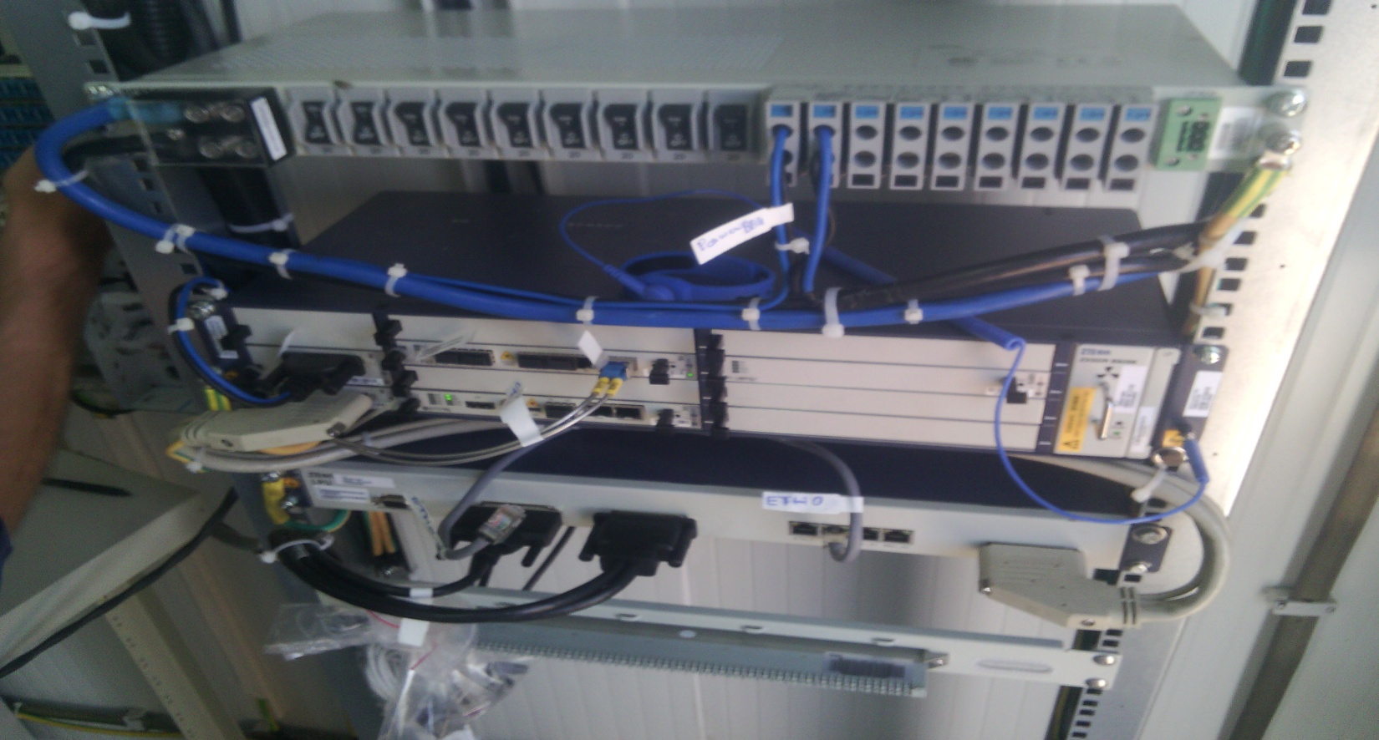
Site View INdoor
Paste the Picture here

Slide 5
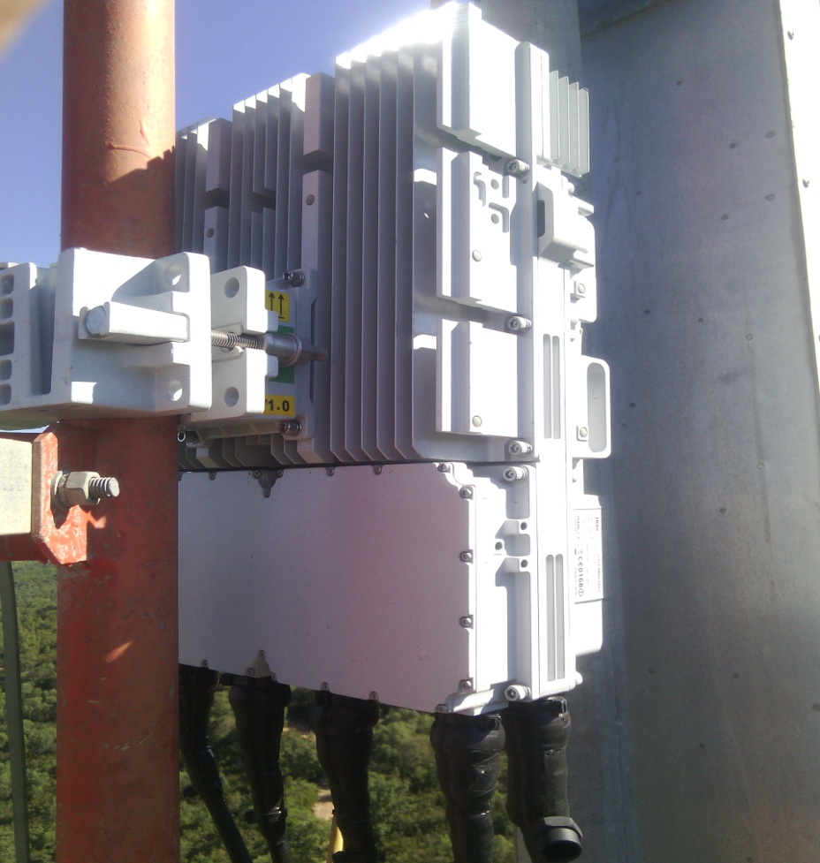
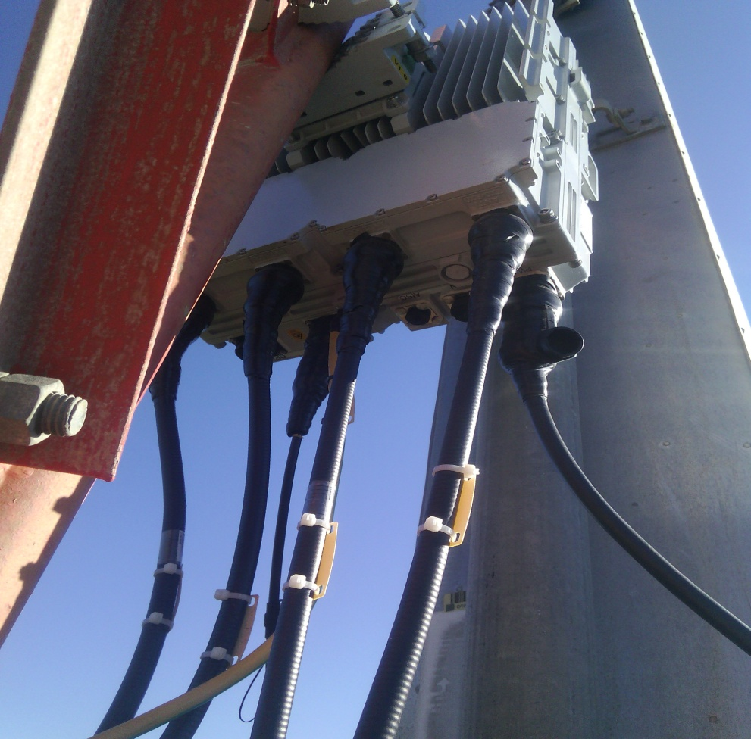
View OF Jumper RRU/after swap
Paste the Picture here

Slide 6

BBU Cabinet
Paste the Picture here

Slide 7
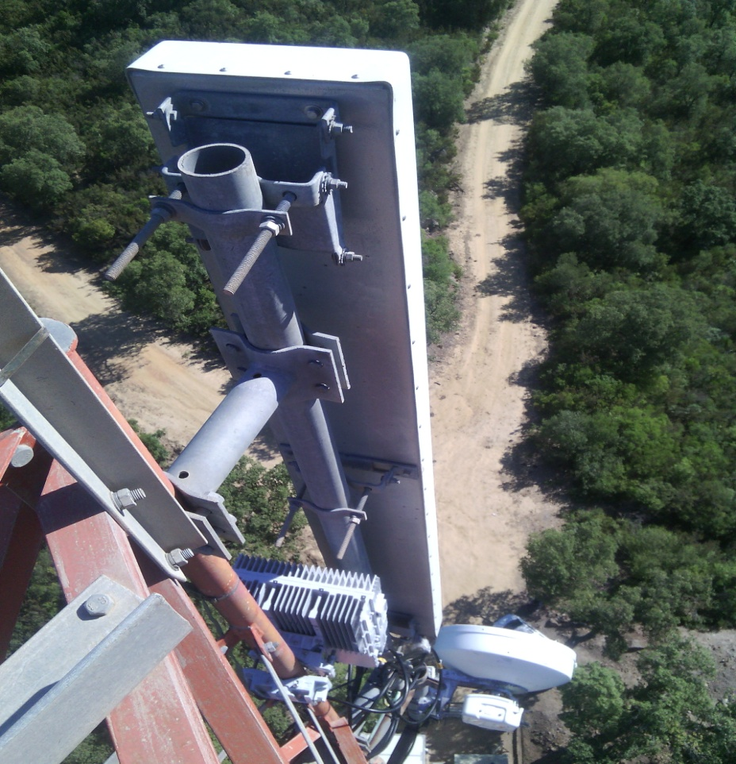
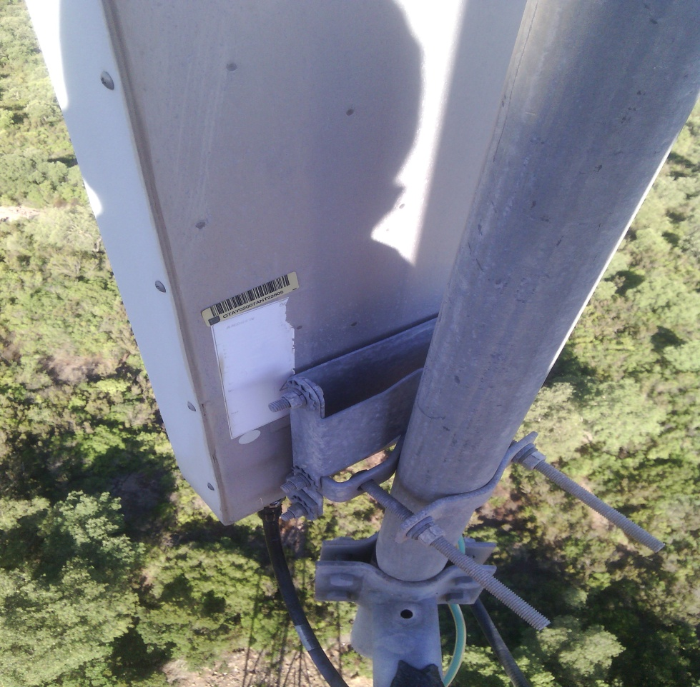
antina Jumpers + label
Paste the Picture here

Slide 8

BBU (Connectivity and labeling)
Paste the Picture here

Slide 9
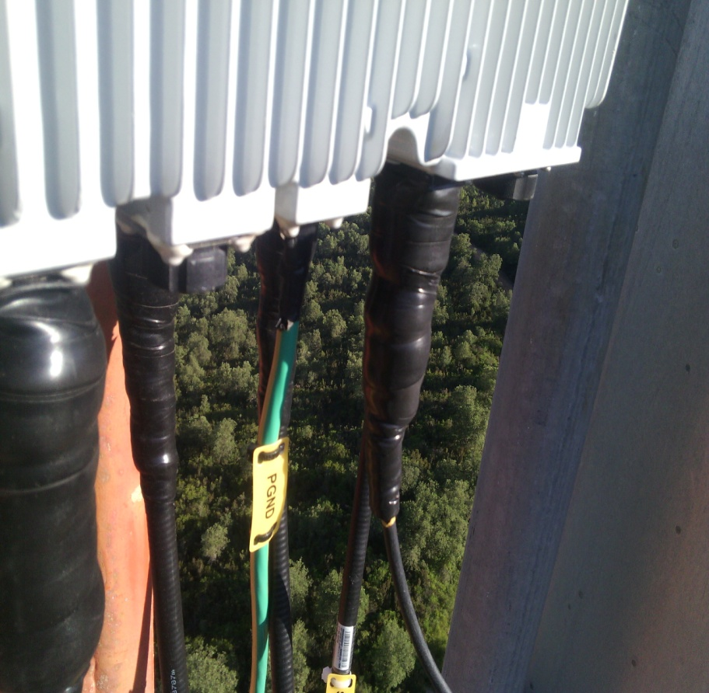
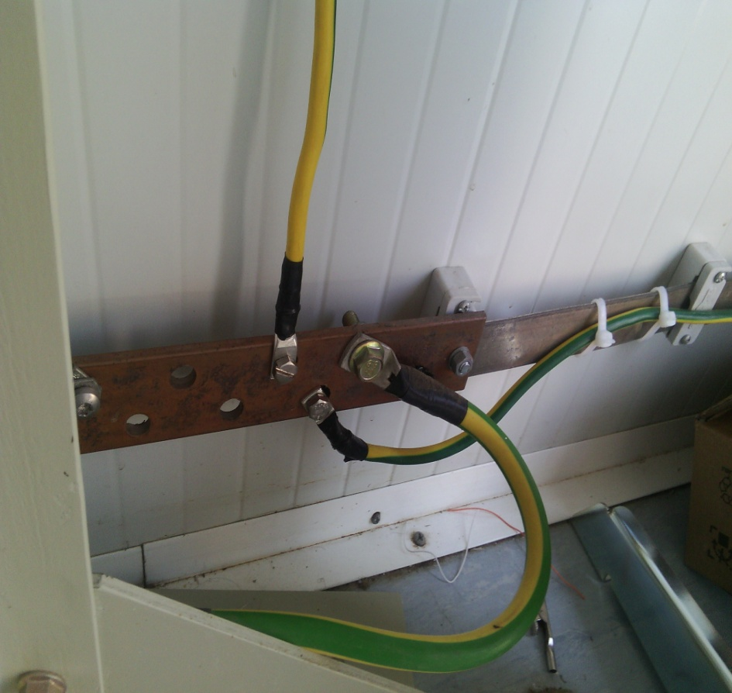
Grounding / Grounding (Indoor and/or Outdoor)
Paste the Picture here

Slide 10
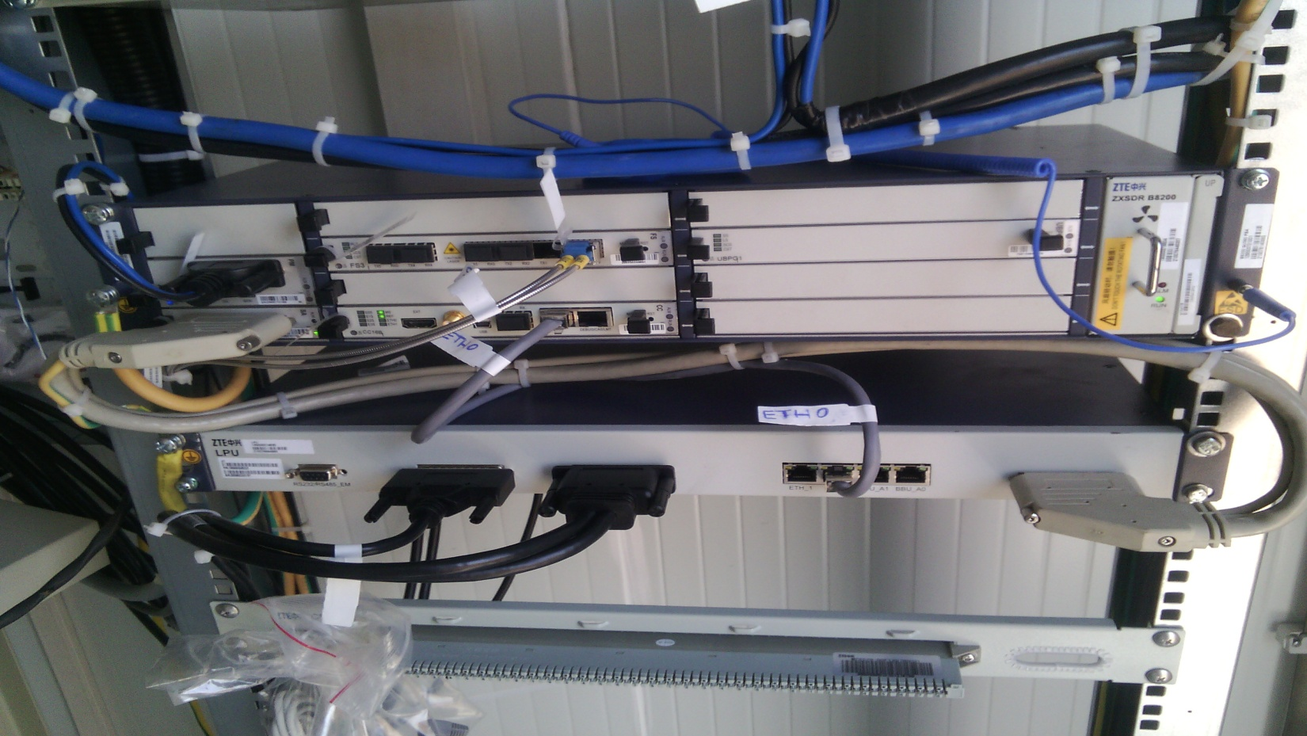
Power Supply
Paste the Picture here

Slide 11
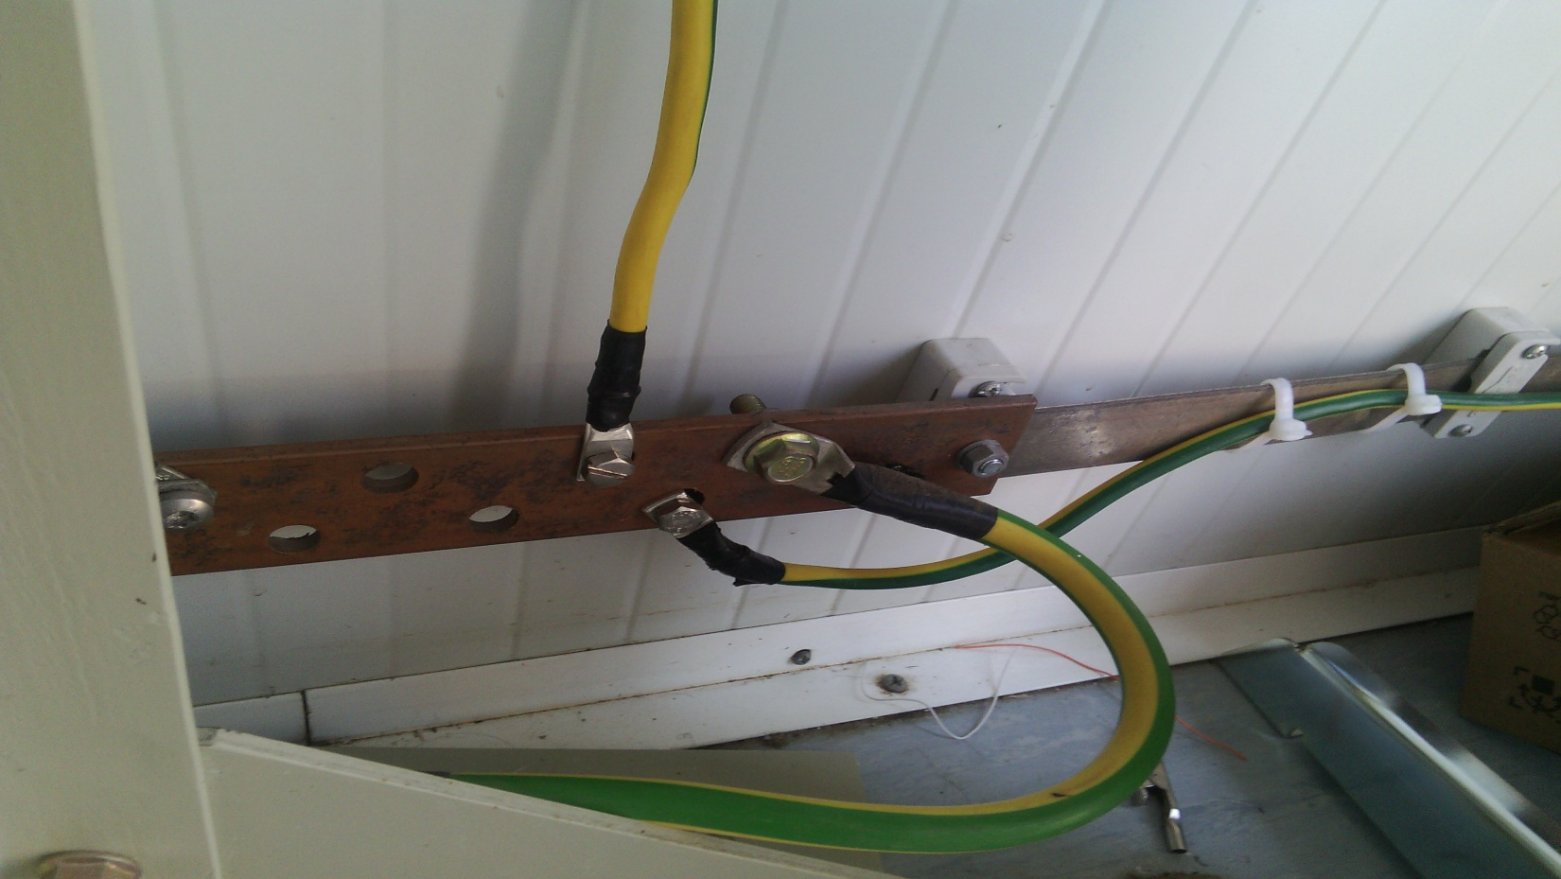
Grounding Rack Battery

Slide 12
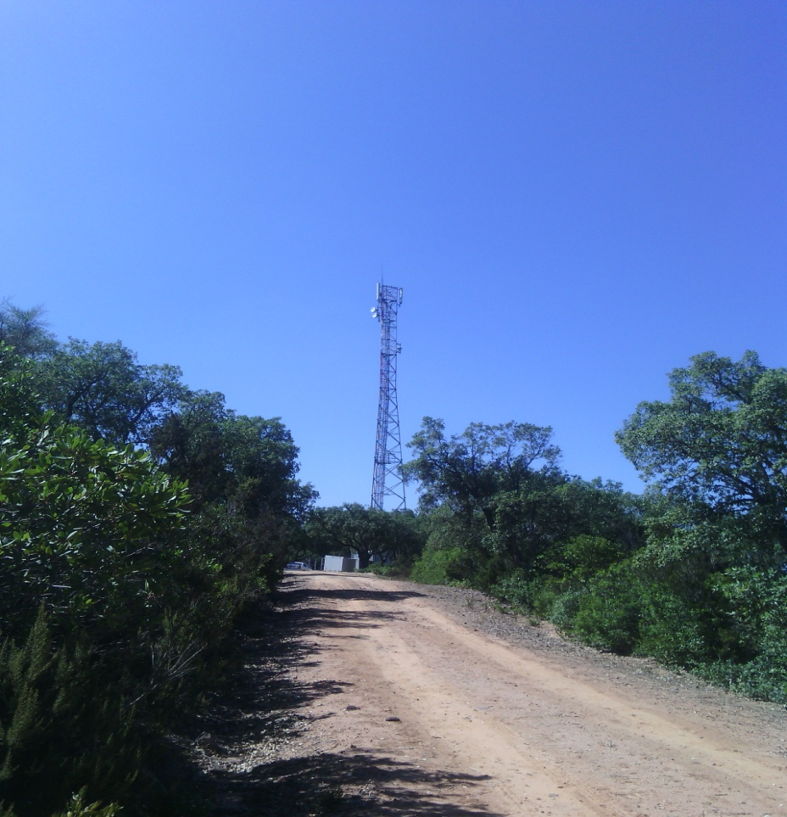
View general of site

Slide 13
Notes:
Les antennes sont desinstallés d’un autre site avec le même code site O13X131

