Slide 1


OTA 2G&3G Modernization Project Site Photos Subcontractor: MGNIC Site ID: C36X093 Installation/Swap Date: 28/06/2016
Name: HAICHEUR HADJER
Department: Documentation (OTA Project)
Mail: haicheur.hadjer@zte.com.cn

Slide 2
Work Done ( Please to list bellow the work items done on the site)
Site view outdoor
Not B Cabinet
Power Suplly
Rack battery
Grounding
Labeling Indoor/Outdoor
View Genrale after
….

Slide 3
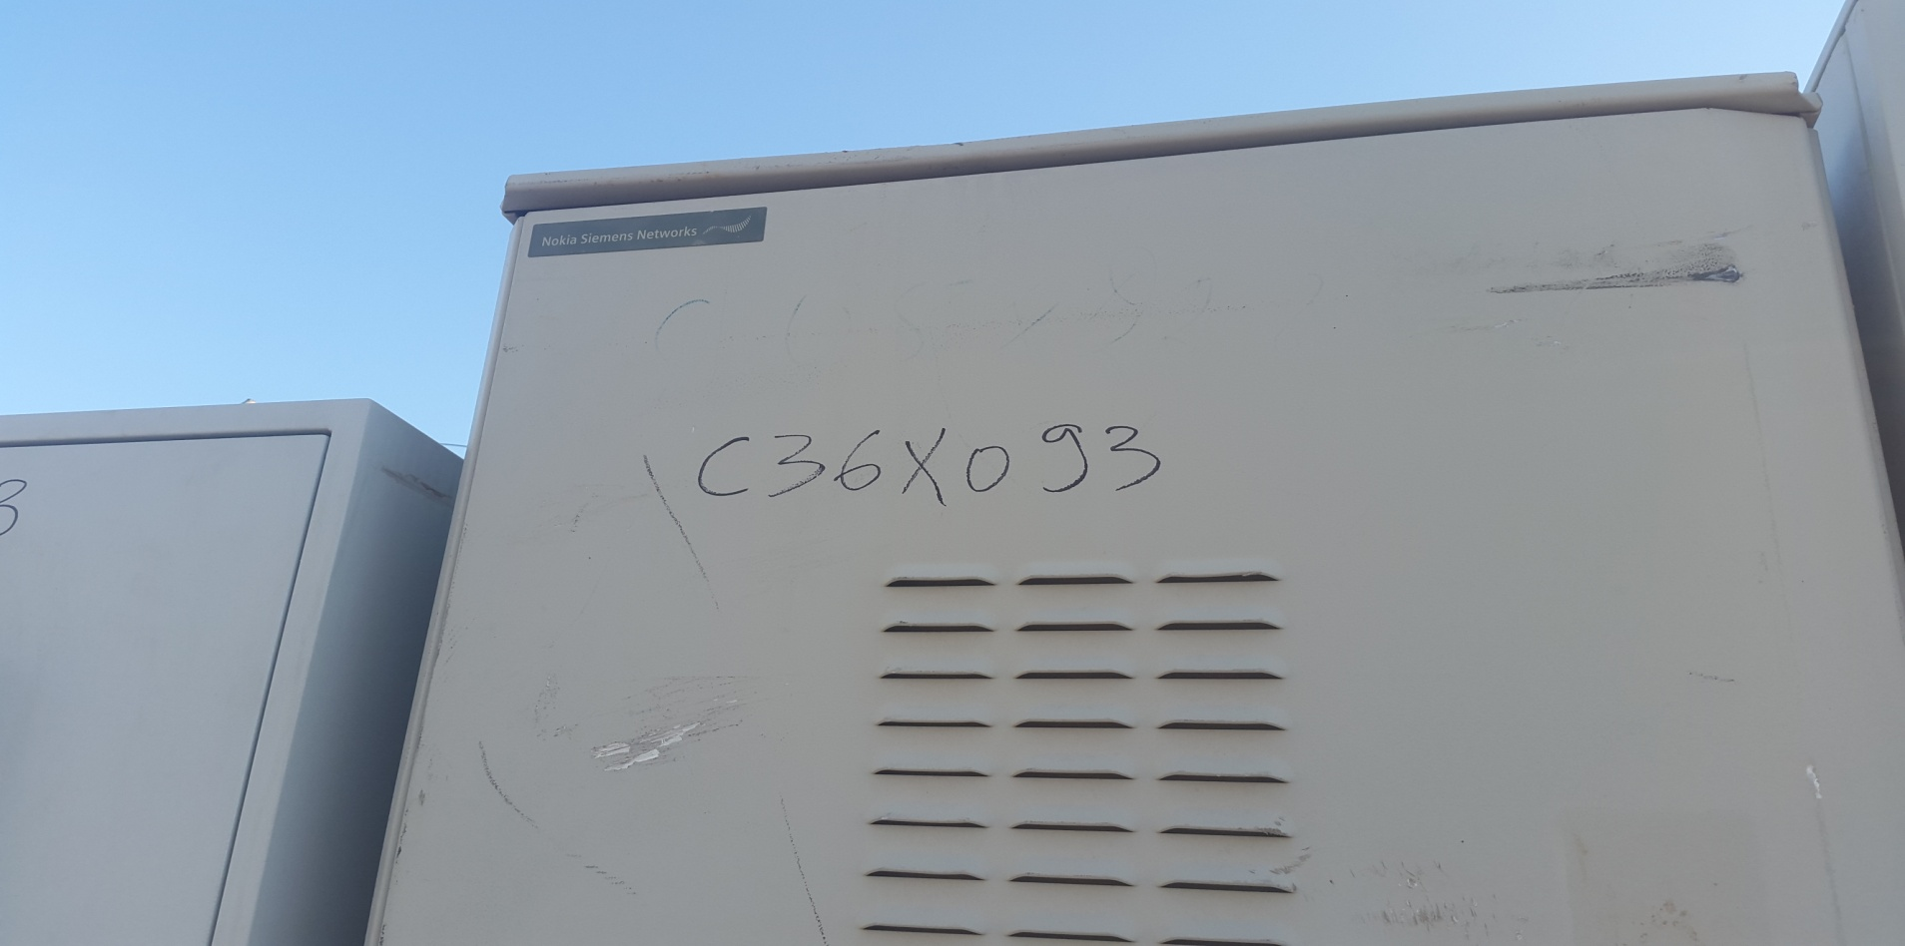
Site Identification
Paste the Picture here

Slide 4
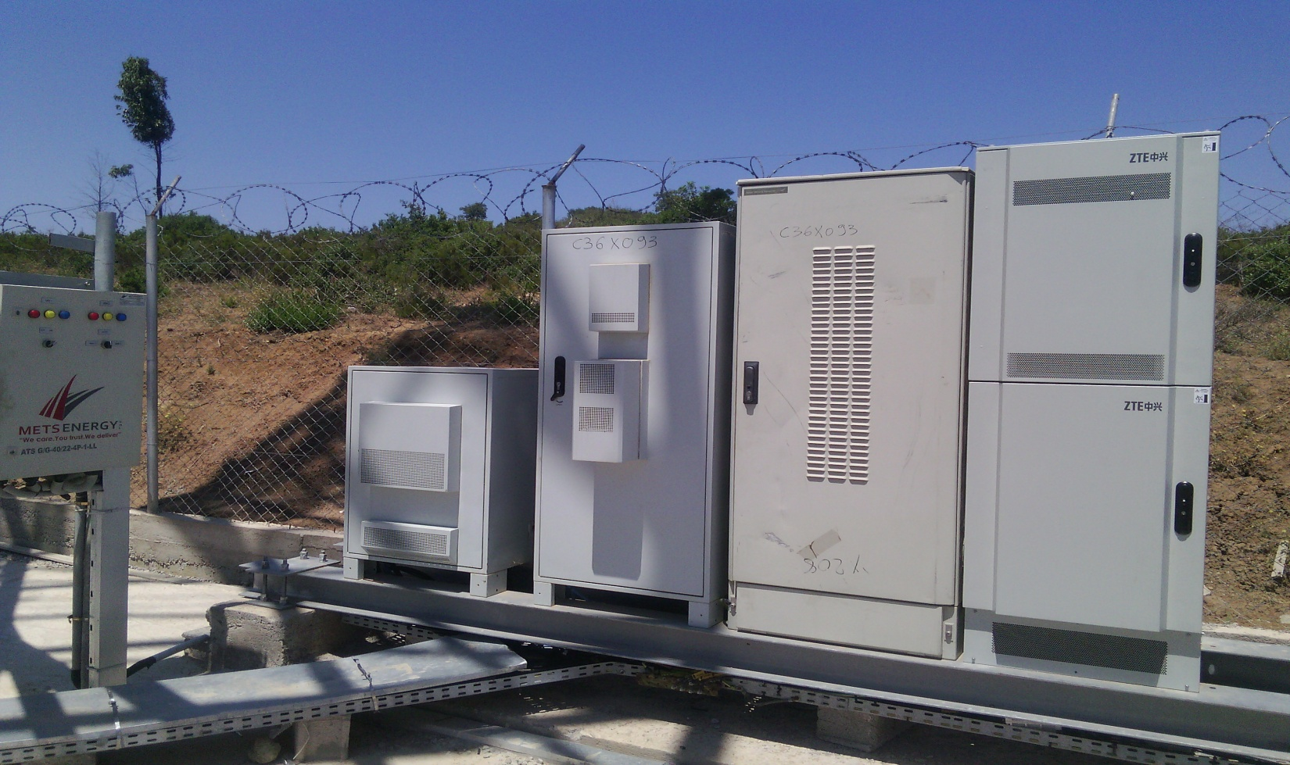
Site View outdoor
Paste the Picture here

Slide 5
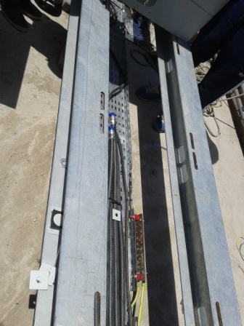
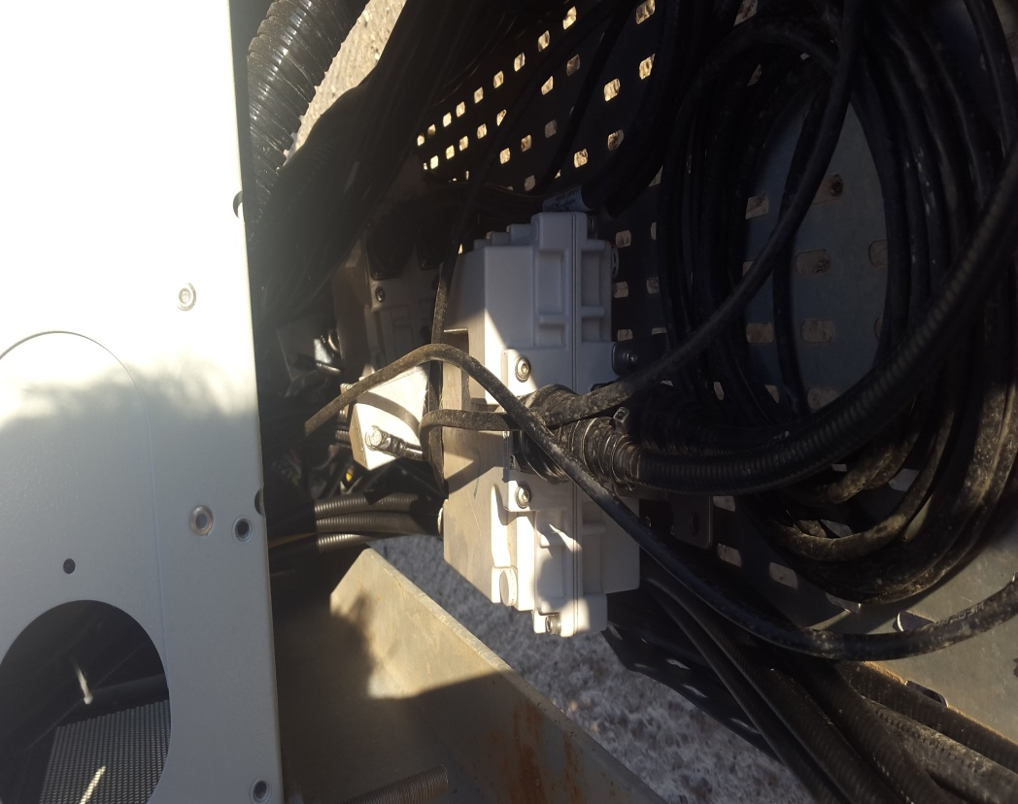
Site View outdoor
Paste the Picture here

Slide 6
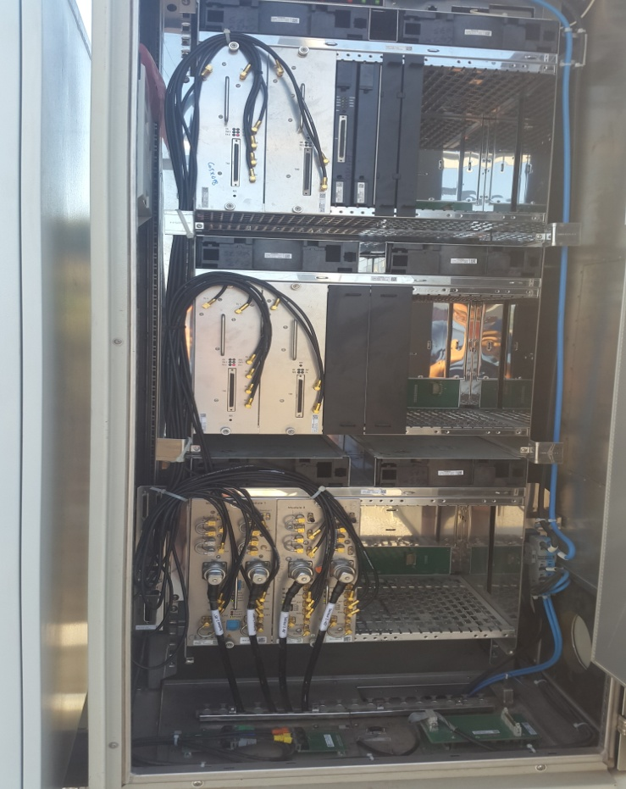
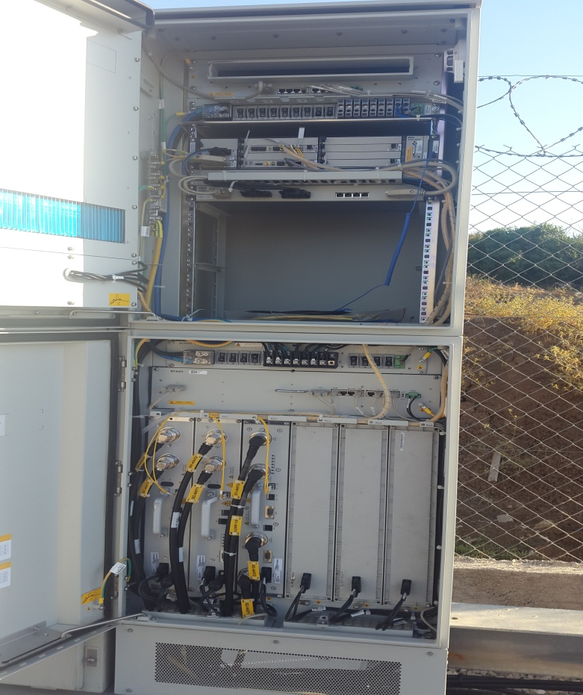
Node B Cabinet BEFOUR /after
Paste the Picture here

Slide 7
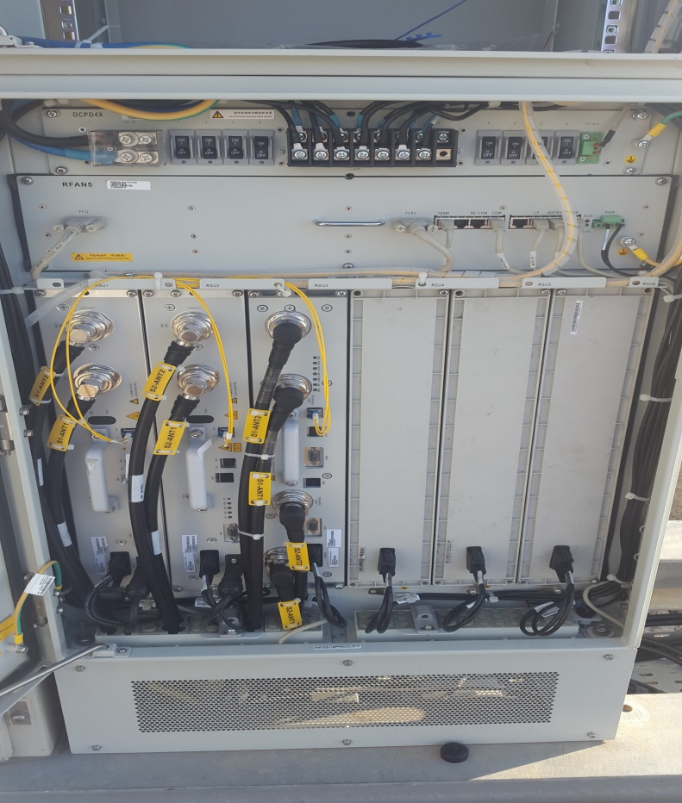
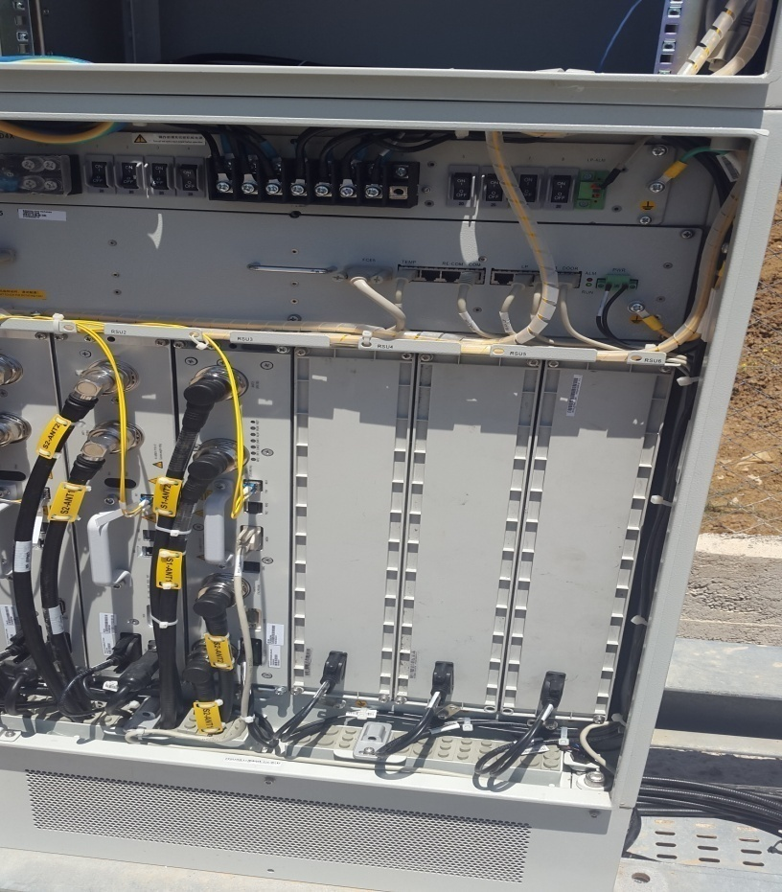
Indoor Jumpers + label
Paste the Picture here

Slide 8
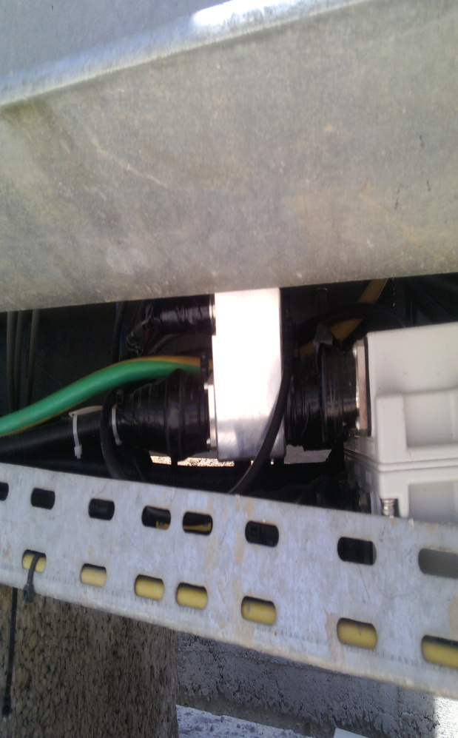
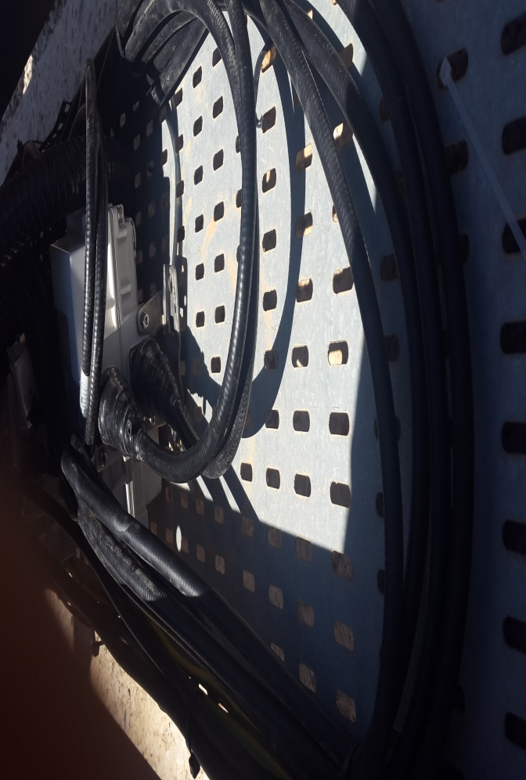
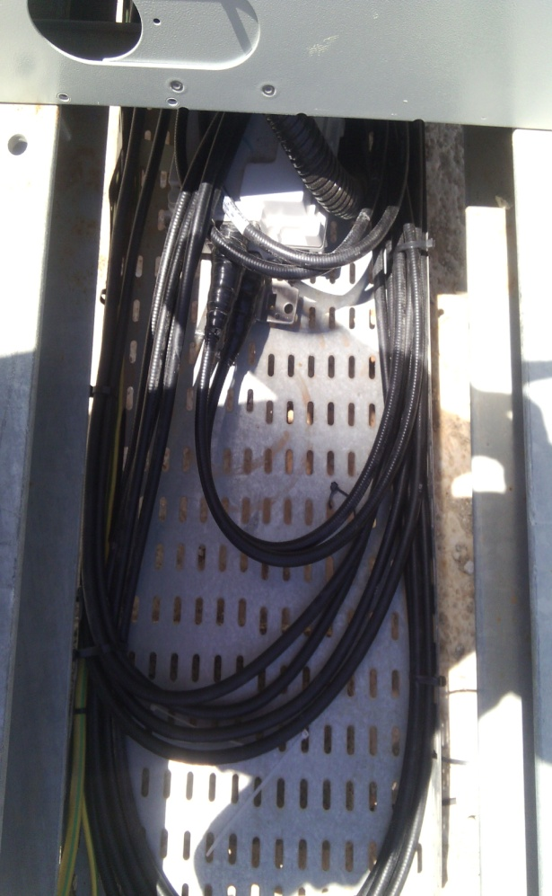
triplixeur Jumpers
Paste the Picture here

Slide 9

Cable Tray
Paste the Picture here

Slide 10
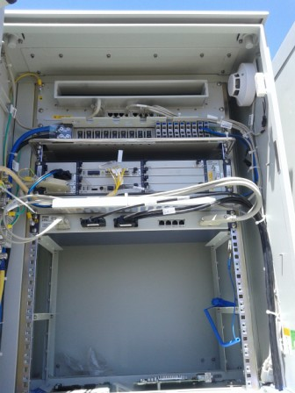
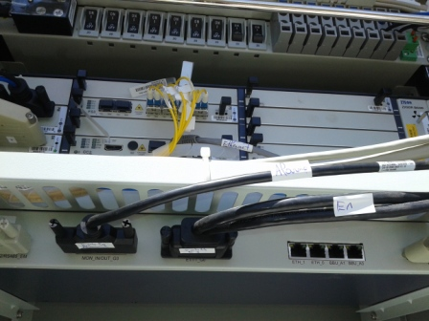
BBU (Connectivity and labeling)
Paste the Picture here

Slide 11
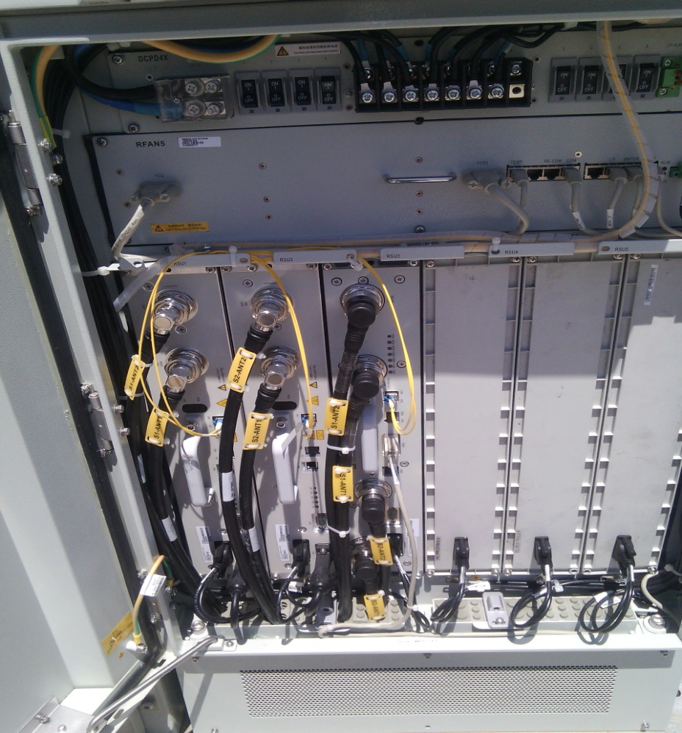
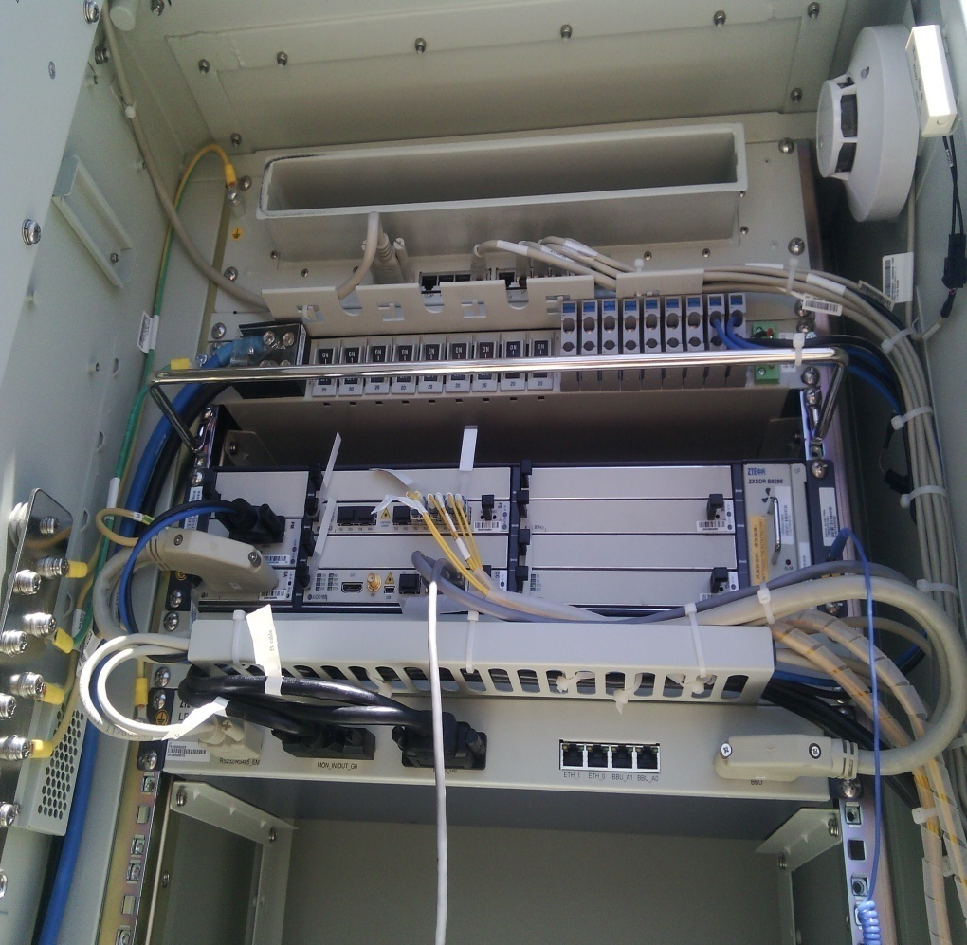
RSU/RRU
Paste the Picture here

Slide 12
SOFT OF THE NODE B

Slide 13
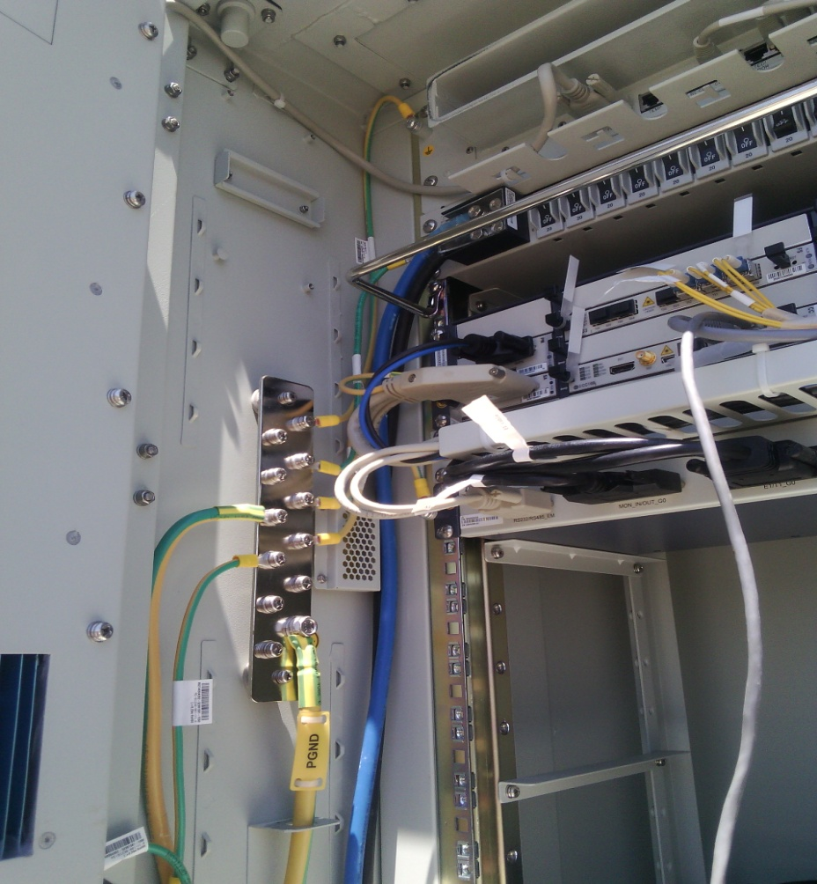
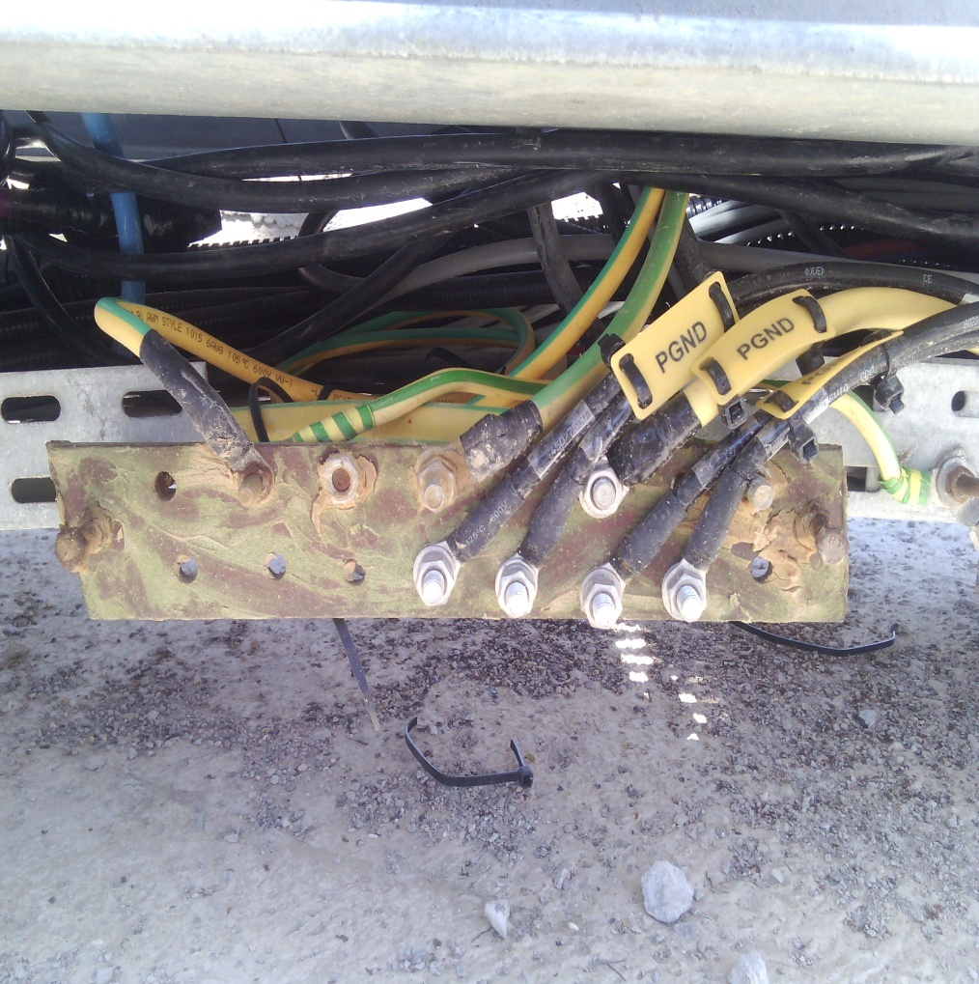
Grounding / Grounding Bar (Indoor and/or Outdoor)
Paste the Picture here

Slide 14
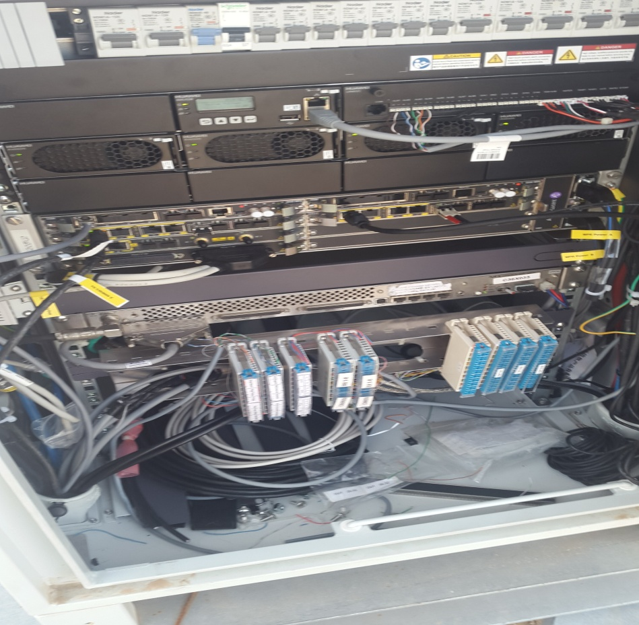
Power Supply
Paste the Picture here

Slide 15
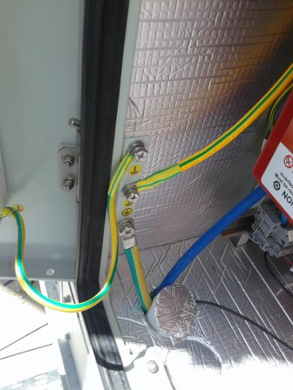
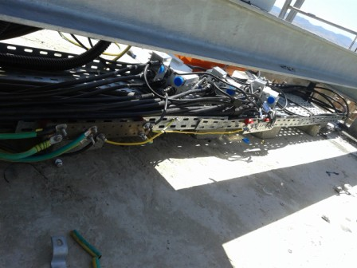
Grounding Rack Battery

Slide 16
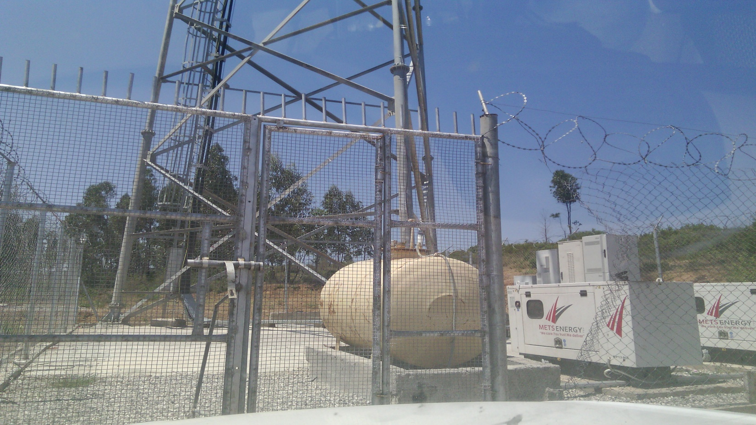
Antennas
Paste the Picture here

Slide 17
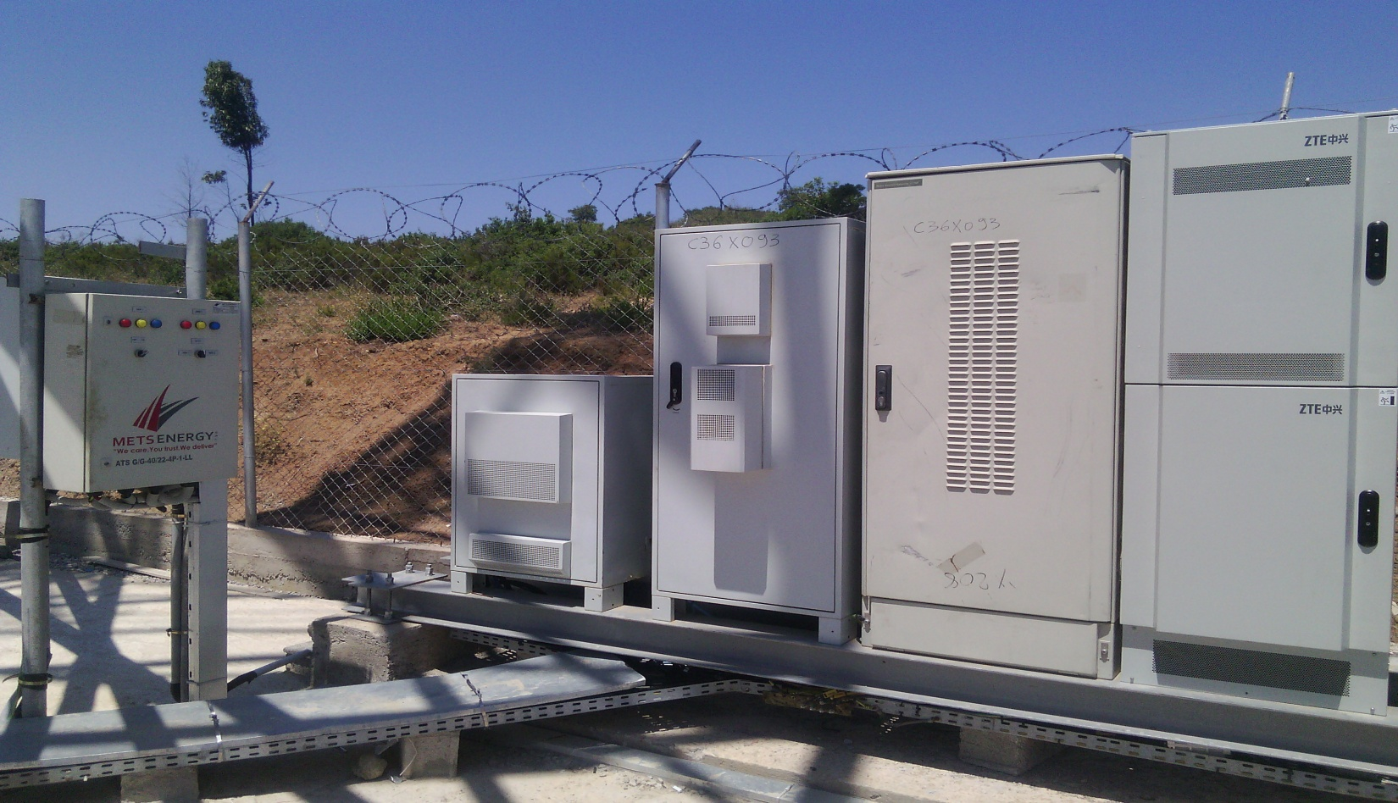
Cleanup
Paste the Picture here

Slide 18

View Génarale
Paste the Picture here

Slide 19
Notes:
Les antennes sont desinstallés d’un autre site avec le même code site O13X131

