Slide 1

Antenna Swap Report
Project Name: | Ooredoo Algeria LTE Project
Site Code: | AL1604
Site Name: | Comité immeuble Ennadhour
Site Engineer | Zouhaier Barrouta
Subcontractor: | MGNIC
Operation Date: | 08/08/2016

Slide 2
Antenna Swap Report
Site ID | Sector | Old Antenna Type/SN | New Antenna Type/SN | Azimut (°) | HBA (m) from beginning of tower | M-Tilt |  | E-Tilt_900M |  | E-Tilt_1800M |  | E-Tilt_2100M
 |  |  |  |  |  | Before | After | Before | After | Before | After | Before | After
AL4999 | A | 80010292V02/SN:W0E4772673 | RV4PX310B1Q/SN:15CN103305911 | 340° | 47,23 | 0 | 0 | 6 | 6 | 6 | 6 | 4 | 4
 | B | 80010292V02/SN:W0E4878138 | RV4PX310B1Q/SN:15CN103332899 | 130° | 47,20 | 8 | 8 | 9 | 9 | 8 | 8 | 4 | 4
 | C | 80010292V02/SN:W0E4877961 | RV4PX310B1Q/SN:15CN103312824 | 260° | 47 | 0 | 0 | 4 | 4 | 5 | 5 | 4 | 4

Slide 3
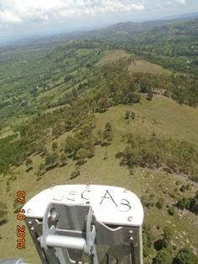
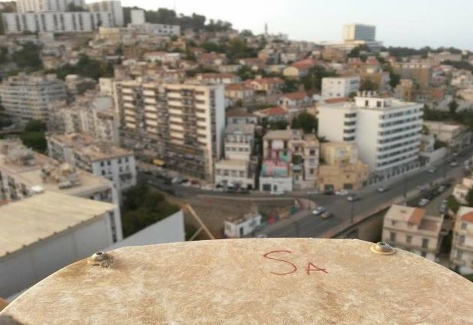
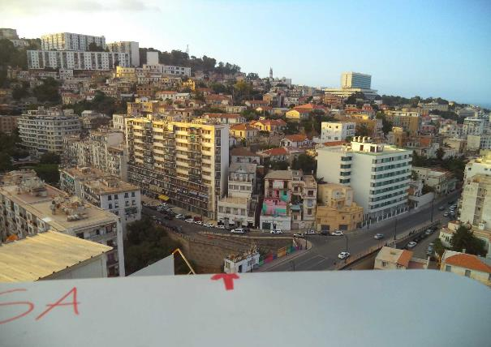
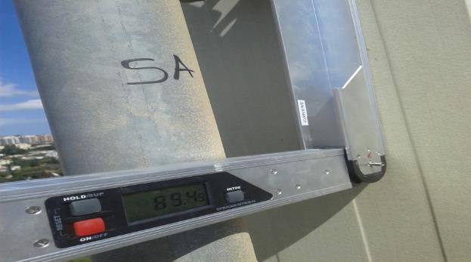
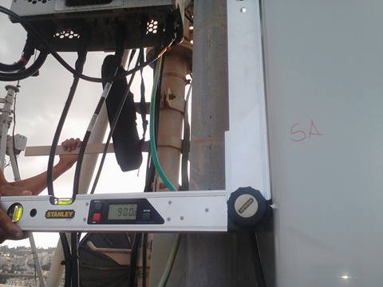
Sector A Antenna Swap
Before swap azimuth( °) |  | After swap azimuth( °)
Before swap Mechanical Tilt( °) |  | After swap Mechanical Tilt( °)

Slide 4
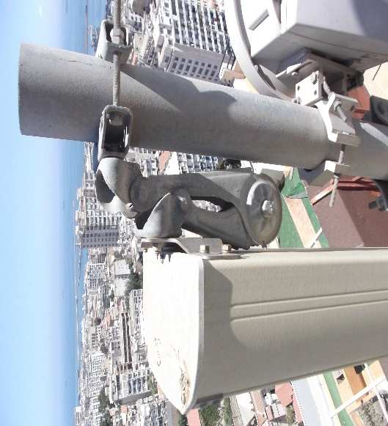
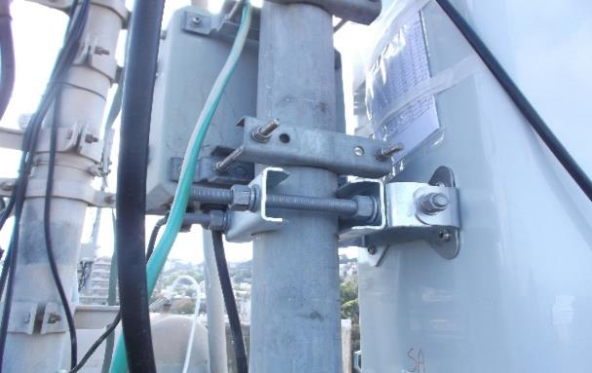
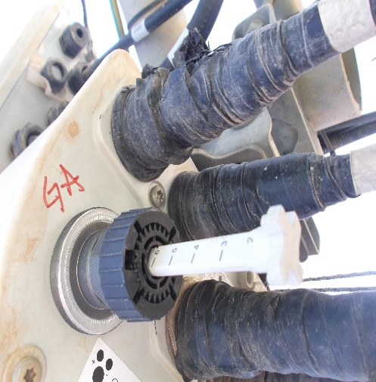
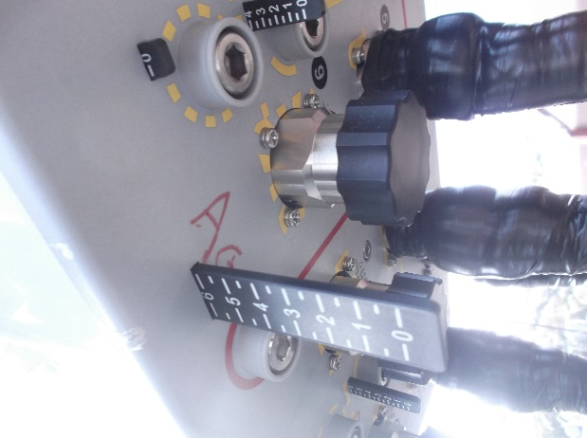
Sector A Antenna Swap
Before swap Mechanical Tilt( °) |  | After swap Mechanical Tilt( °)
Before swap 900M Electric Tilt( °) |  | After swap 900M Electric Tilt( °)

Slide 5
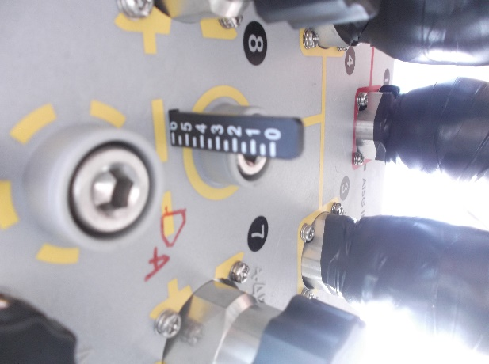
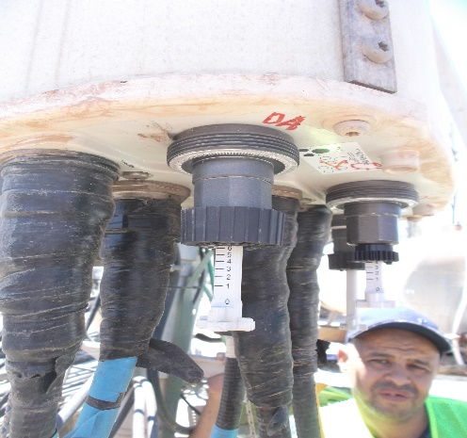
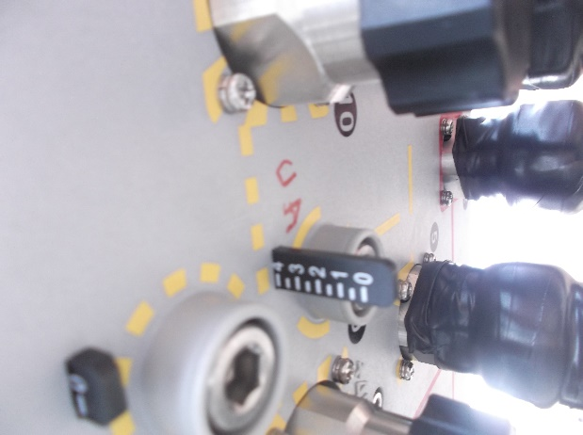
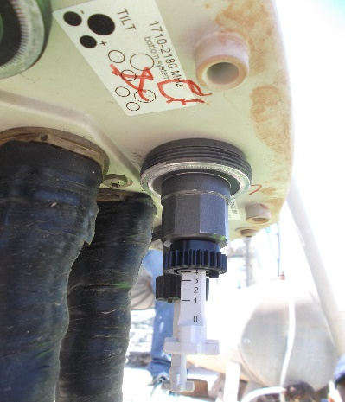
Sector A Antenna Swap
Before swap 1800M Electric Tilt( °) |  | After swap 1800M Electric Tilt( °)
Before swap 2100M Electric Tilt( °) |  | After swap 2100M Electric Tilt( °)

Slide 6
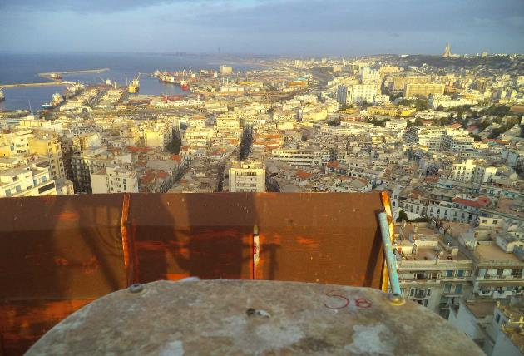
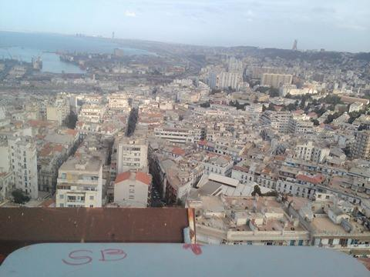
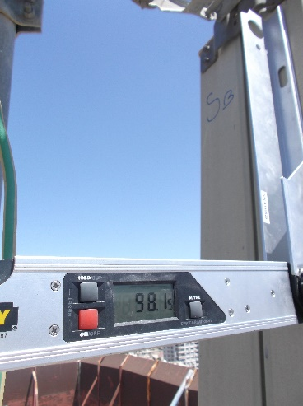
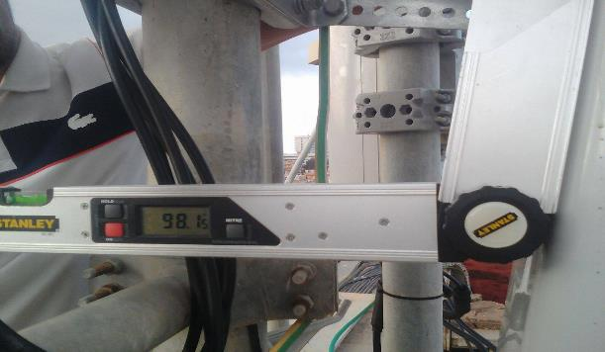
Sector B Antenna Swap
Before swap azimuth( °) |  | After swap azimuth( °)
Before swap Mechanical Tilt( °) |  | After swap Mechanical Tilt( °)

Slide 7
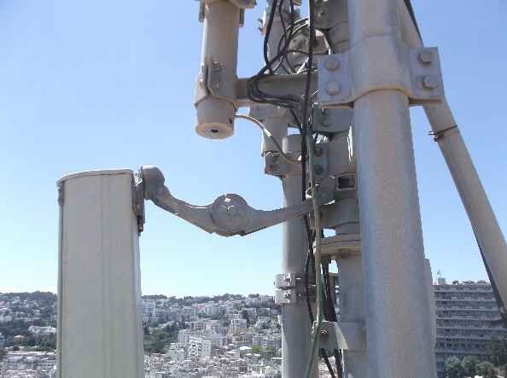
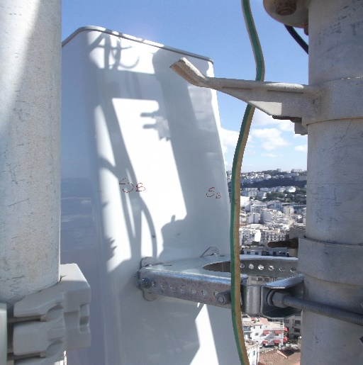
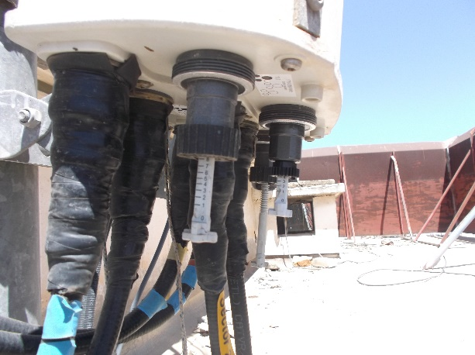
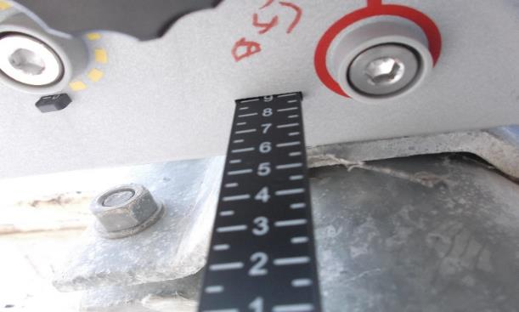
Sector B Antenna Swap
Before swap Mechanical Tilt( °) |  | After swap Mechanical Tilt( °)
Before swap 900M Electric Tilt( °) |  | After swap 900M Electric Tilt( °)

Slide 8
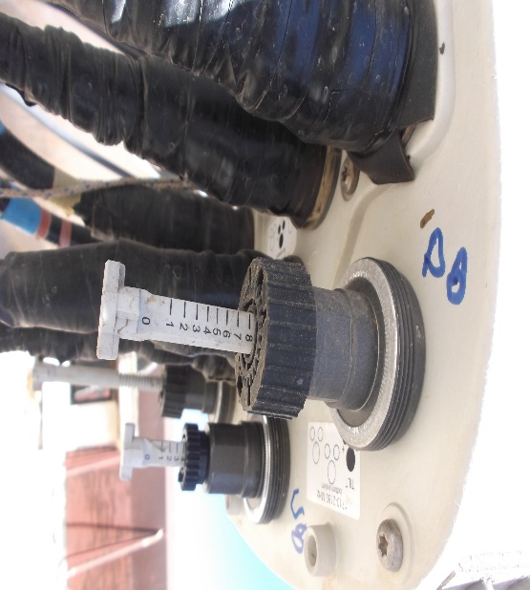
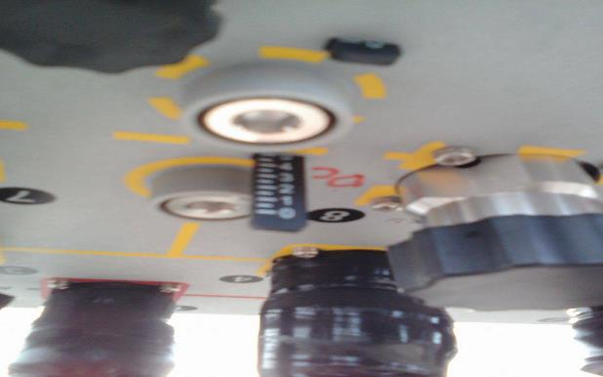
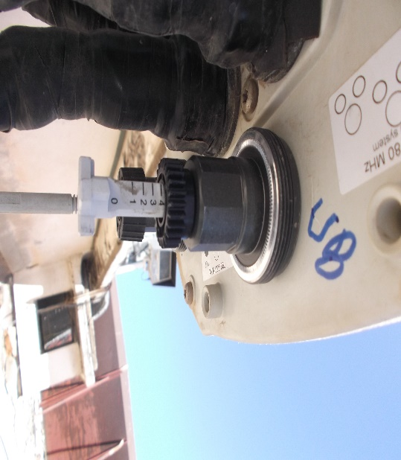
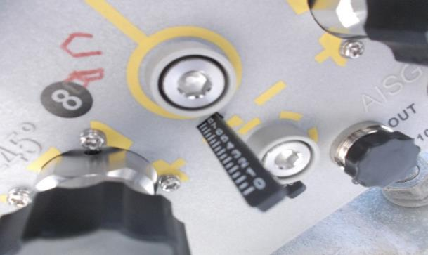
Sector B Antenna Swap
Before swap 1800M Electric Tilt( °) |  | After swap 1800M Electric Tilt( °)
Before swap 2100M Electric Tilt( °) |  | After swap 2100M Electric Tilt( °)

Slide 9
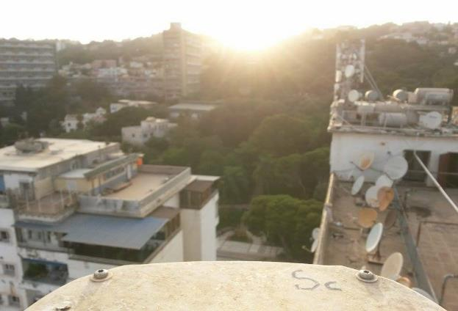
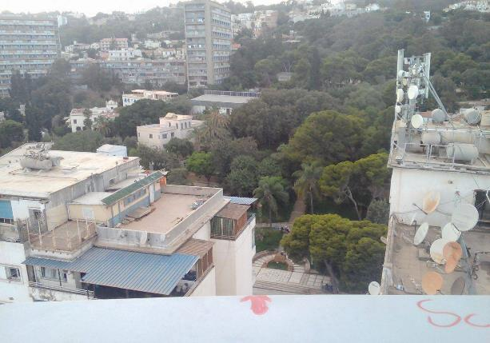
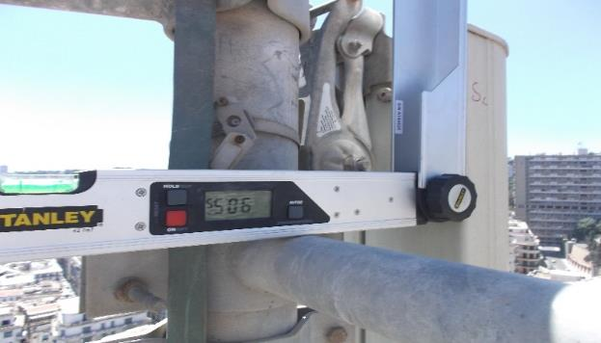
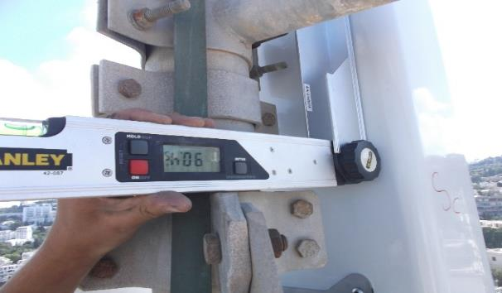
Sector C Antenna Swap
Before swap azimuth( °) |  | After swap azimuth( °)
Before swap Mechanical Tilt( °) |  | After swap Mechanical Tilt( °)

Slide 10
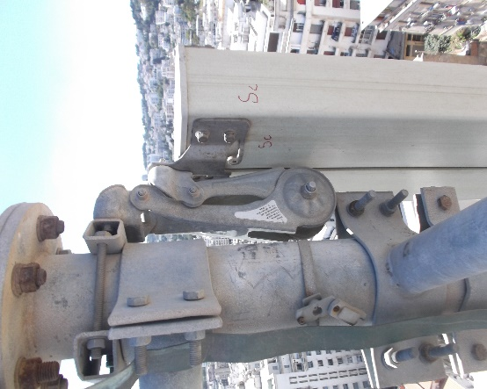
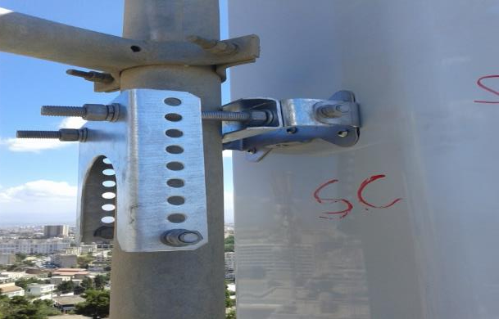
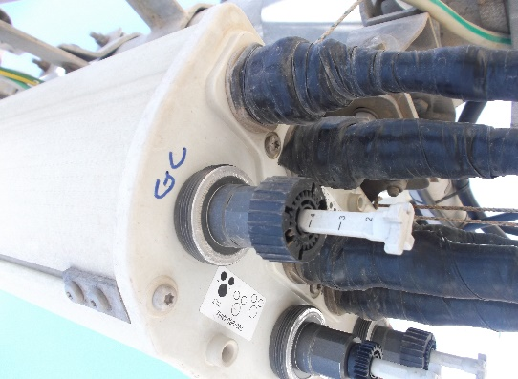
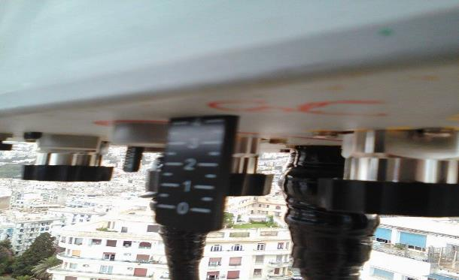
Sector C Antenna Swap
Before swap Mechanical Tilt( °) |  | After swap Mechanical Tilt( °)
Before swap 900M Electric Tilt( °) |  | After swap 900M Electric Tilt( °)

Slide 11
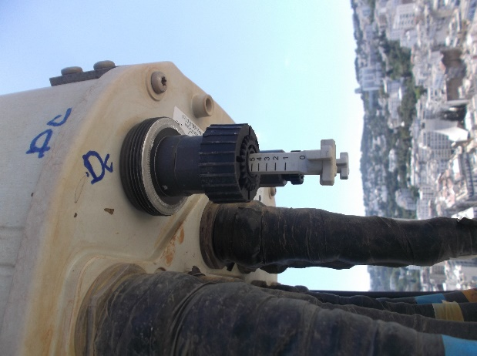
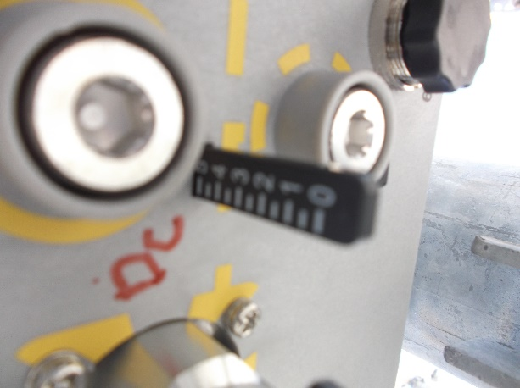
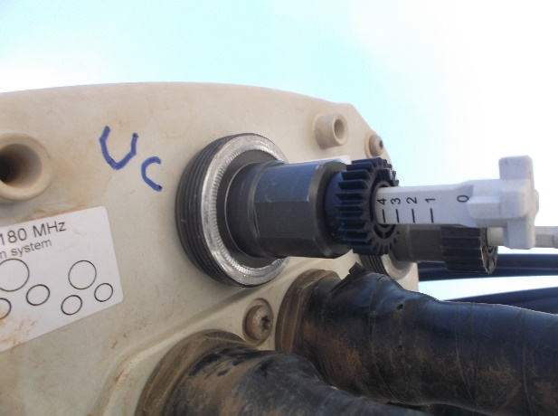
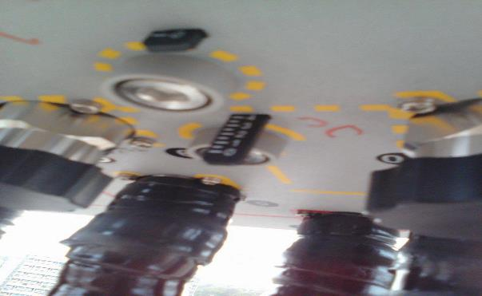
Sector C Antenna Swap
Before swap 1800M Electric Tilt( °) |  | After swap 1800M Electric Tilt( °)
Before swap 2100M Electric Tilt( °) |  | After swap 2100M Electric Tilt( °)

Slide 12
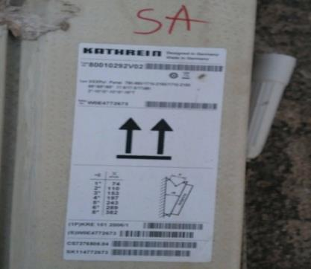
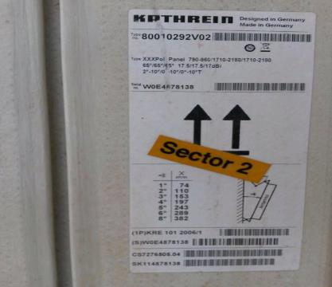
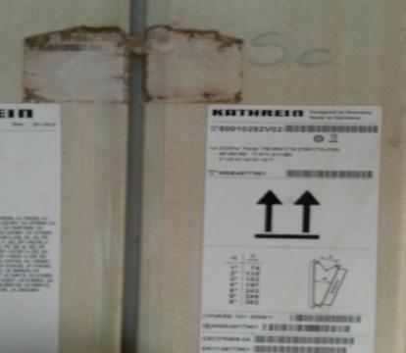
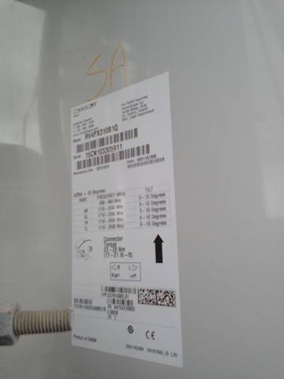
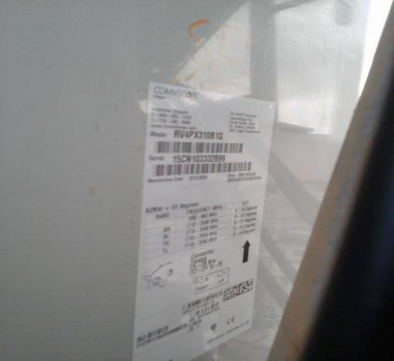
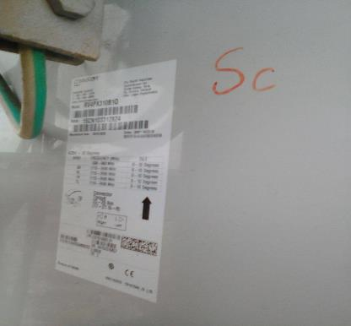
Antenna Type and SN
SectorA Before | SectorB Before | SectorC Before
SectorA After | SectorB After | SectorC After

Slide 13
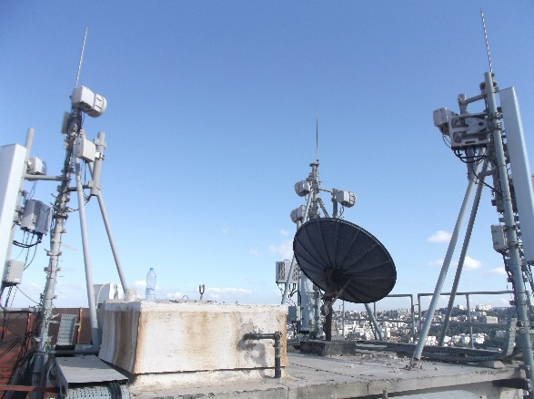
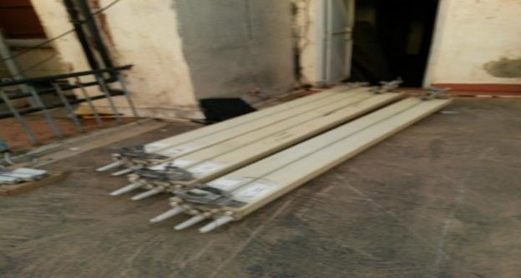
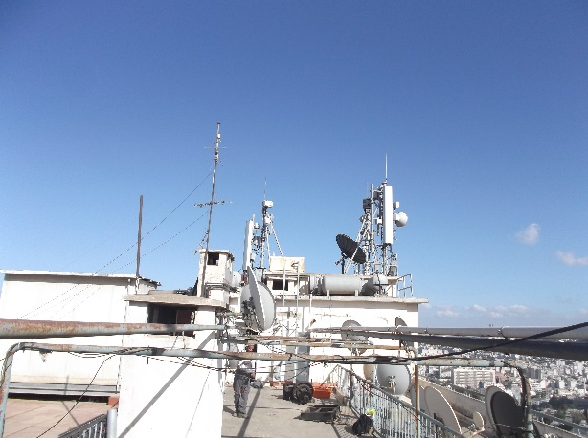
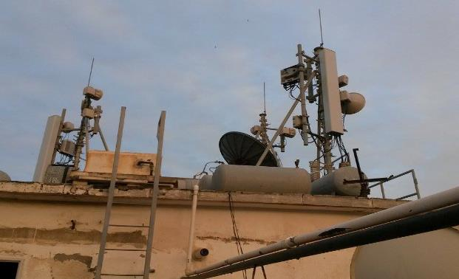
Site Clean Up
Before Swap | After Swap
Site General View
Before Swap | After Swap

Slide 14
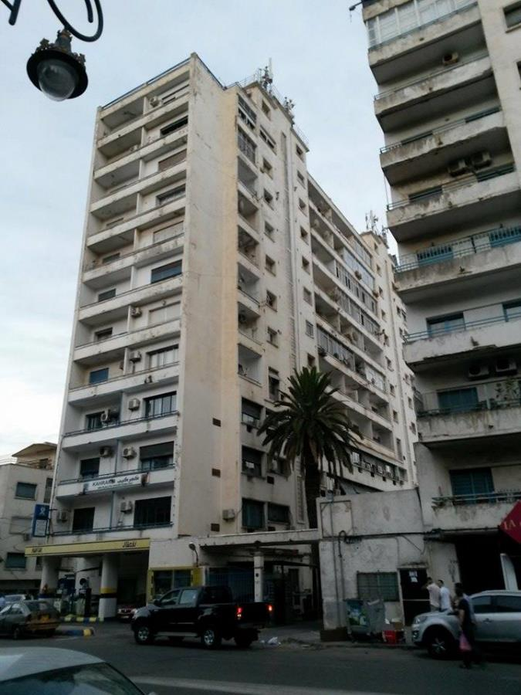
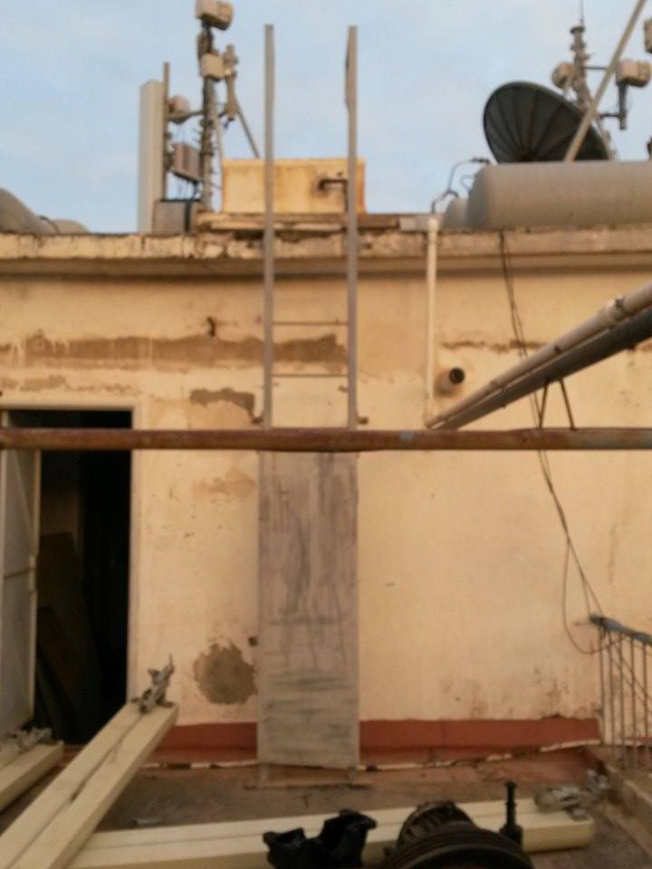
Site Access

Slide 15
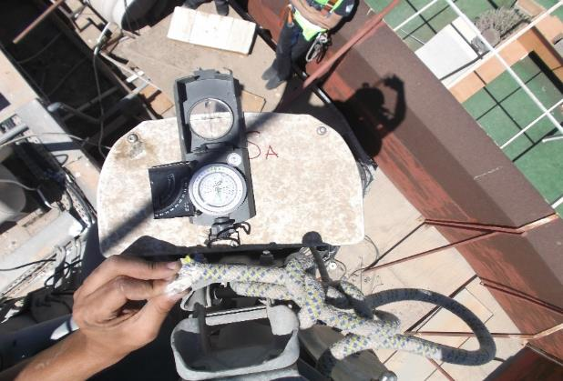



SectorA Before swap azimuth( °) |  | SectorA after swap azimuth( °)
SectorB Before swap azimuth( °) |  | SectorB after swap azimuth( °)

Slide 16


SectorC Before swap azimuth |  | SectorC after swap azimuth

Slide 17

Antenna Pole SectorA

Slide 18

Antenna Pole SectorB

Slide 19

Antenna Pole SectorC

Slide 20
THE END

