Slide 1

Antenna Swap Report
Project Name: | Ooredoo Algeria LTE Project
Site Code: | AL1683
Site Name: | Bir Morad Rais
Site Engineer | Mohamed Rhahlia
Subcontractor: | MGNIC
Operation Date: | 09/08/2016

Slide 2
Antenna Swap Report
Site ID | Sector | Old Antenna Type/SN | New Antenna Type/SN | Azimut (°) | HBA (m) from beginning of tower | M-Tilt |  | E-Tilt_900M |  | E-Tilt_1800M |  | E-Tilt_2100M
 |  |  |  |  |  | Before | After | Before | After | Before | After | Before | After
AL1683 | A | KATHREIN:80010292V02/SN:W0E4878123 | TYPE:RV4PX310B1Q SN:15CN102161833 | 0 | 6 | 3 | 3 | 4 | 4 | 4 | 4 | 4 | 4
 | B | KATHTHREIN;80010292V02/SN:W0E4772618 | TYPE:RV4PX310B1Q SN:15CN103324013 | 100 | 6 | 3 | 3 | 6 | 6 | 6 | 6 | 4 | 4
 | C | KATHREIN;80010292V02/SN:W0E4878066 | TYPE:RV4PX310B1Q SN:103305905 | 200 | 6 | 0 | 0 | 2 | 2 | 2 | 2 | 4 | 4

Slide 3
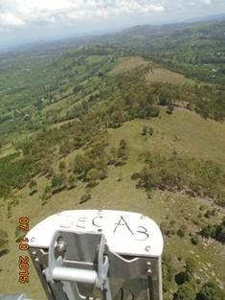
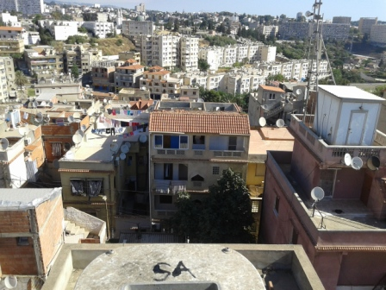
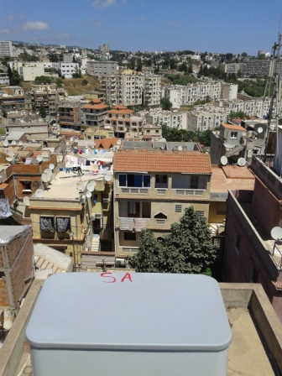
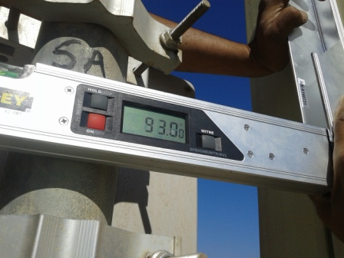
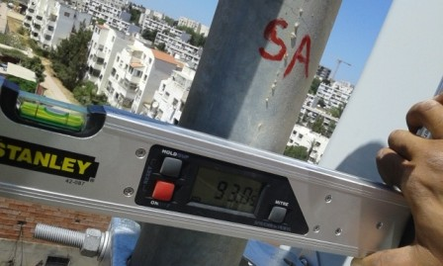
Sector A Antenna Swap
Before swap azimuth( 0 °) |  | After swap azimuth( 0 °)
Before swap Mechanical Tilt( 3 °) |  | After swap Mechanical Tilt( 3 °)

Slide 4
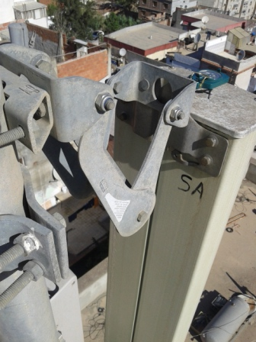
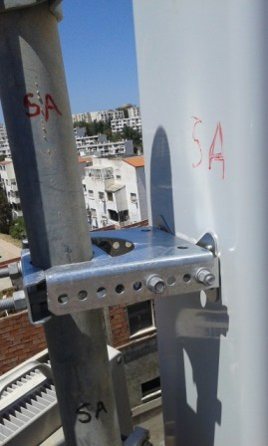
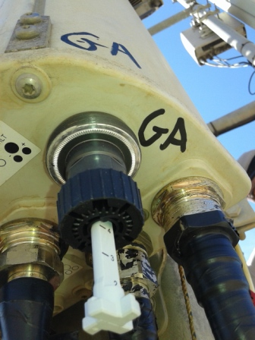
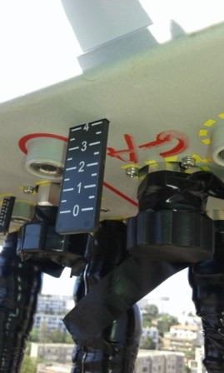
Sector A Antenna Swap
Before swap Mechanical Tilt( 3 °) |  | After swap Mechanical Tilt( 3 °)
Before swap 900M Electric Tilt( 4 °) |  | After swap 900M Electric Tilt( 4 °)

Slide 5
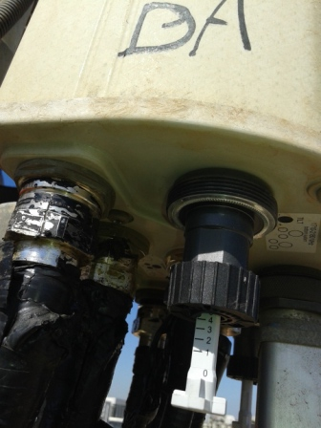
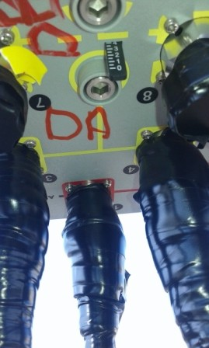
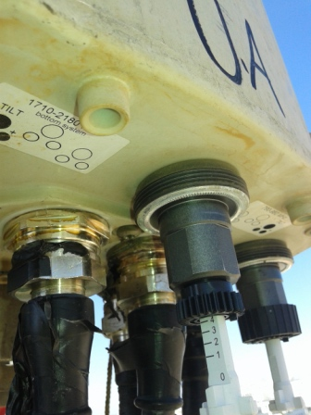
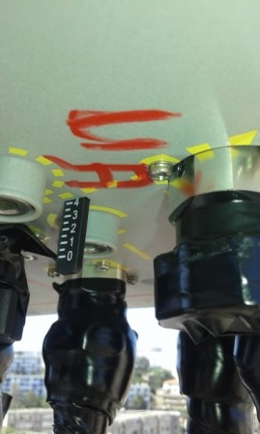
Sector A Antenna Swap
Before swap 1800M Electric Tilt( 4 °) |  | After swap 1800M Electric Tilt( 4 °)
Before swap 2100M Electric Tilt( 4 °) |  | After swap 2100M Electric Tilt( 4 °)

Slide 6
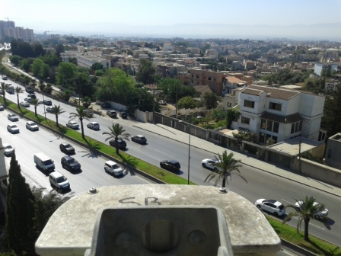
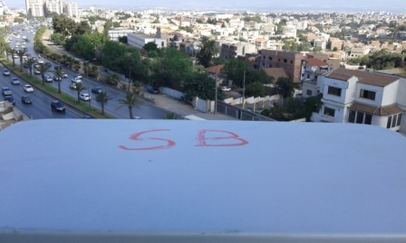
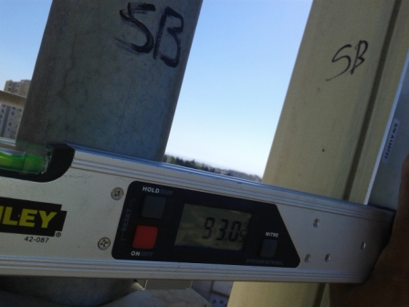
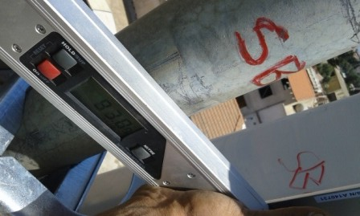
Sector B Antenna Swap
Before swap azimuth( 100 °) |  | After swap azimuth( 100 °)
Before swap Mechanical Tilt( 3°) |  | After swap Mechanical Tilt( 3 °)

Slide 7
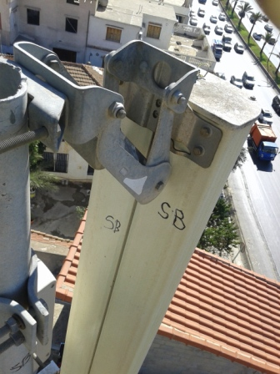
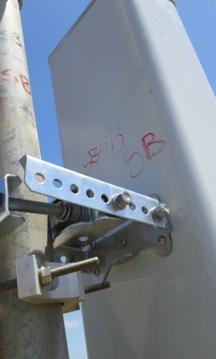
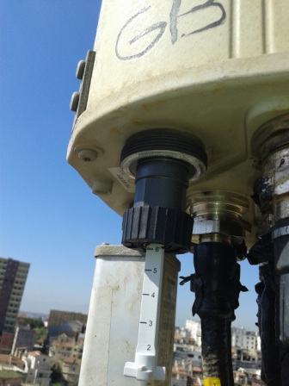
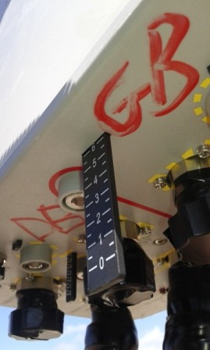
Sector B Antenna Swap
Before swap Mechanical Tilt( 3 °) |  | After swap Mechanical Tilt( 3 °)
Before swap 900M Electric Tilt( 6°) |  | After swap 900M Electric Tilt( 6 °)

Slide 8
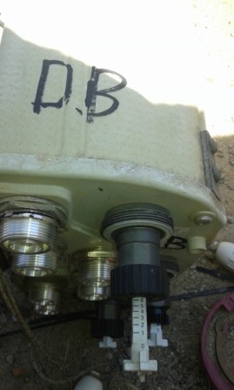
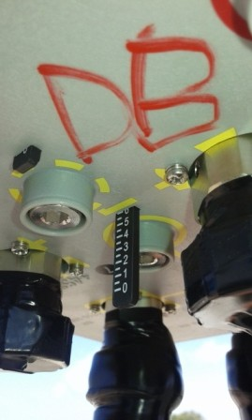
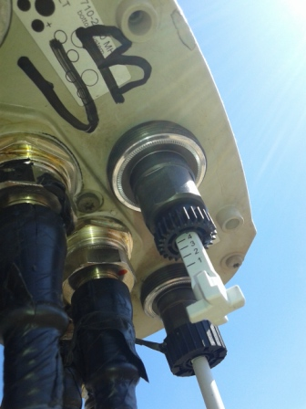
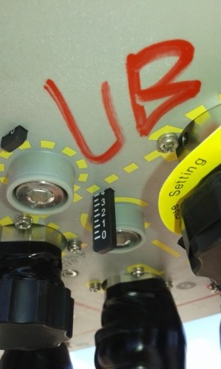
Sector B Antenna Swap
Before swap 1800M Electric Tilt( 6°) |  | After swap 1800M Electric Tilt( 6 °)
Before swap 2100M Electric Tilt( 4 °) |  | After swap 2100M Electric Tilt( 4°)

Slide 9
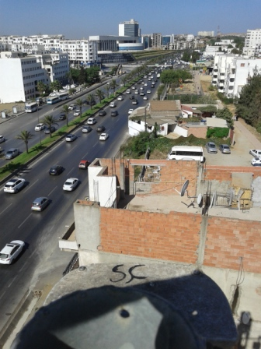
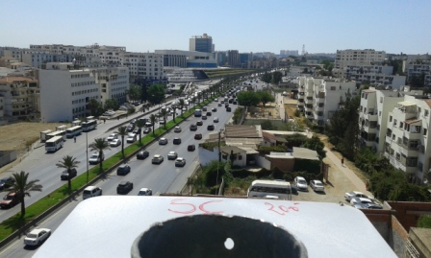
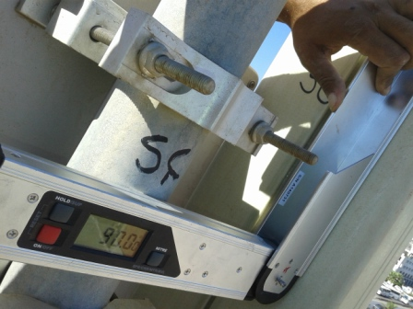
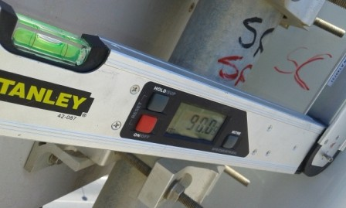
Sector C Antenna Swap
Before swap azimuth( 200 °) |  | After swap azimuth( 200 °)
Before swap Mechanical Tilt( 0 °) |  | After swap Mechanical Tilt( 0 °)

Slide 10
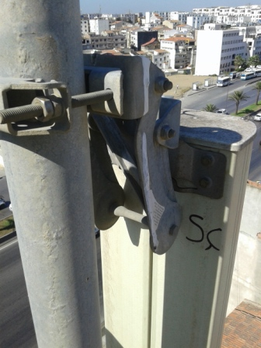
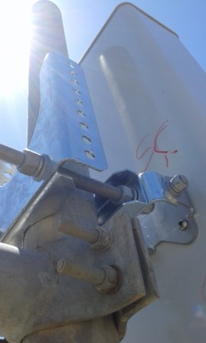
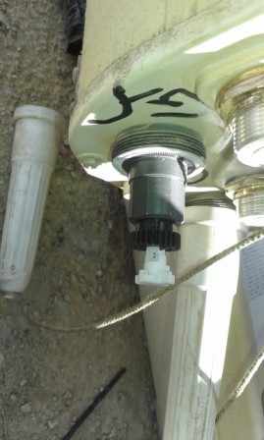
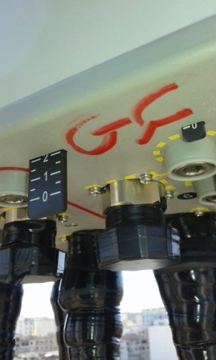
Sector C Antenna Swap
Before swap Mechanical Tilt( 0°) |  | After swap Mechanical Tilt( 0 °)
Before swap 900M Electric Tilt( 2 °) |  | After swap 900M Electric Tilt( 2 °)

Slide 11
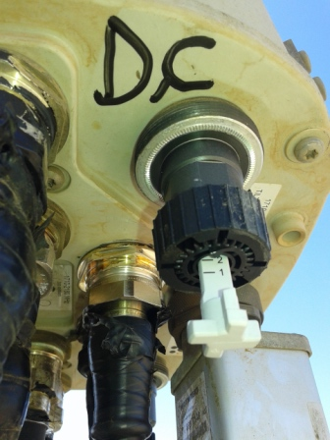
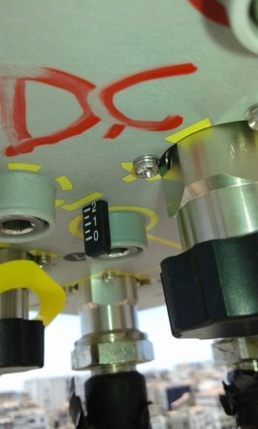
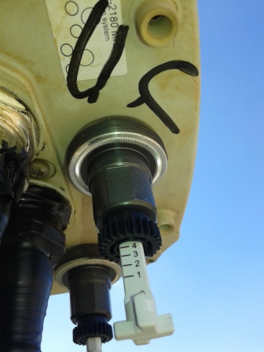
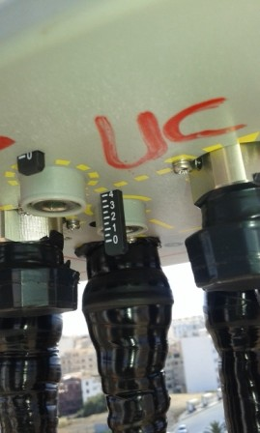
Sector C Antenna Swap
Before swap 1800M Electric Tilt( 2 °) |  | After swap 1800M Electric Tilt( 2°)
Before swap 2100M Electric Tilt( 4 °) |  | After swap 2100M Electric Tilt( 4°)

Slide 12
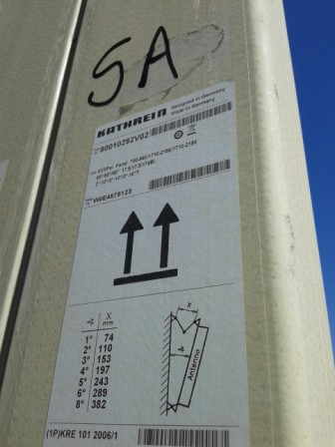
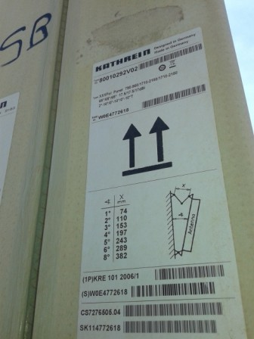
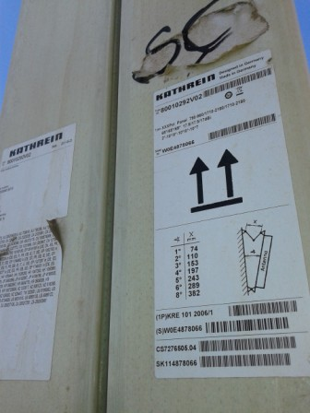
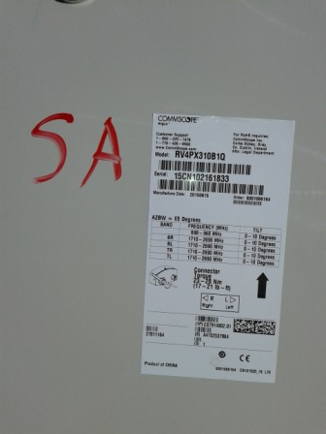
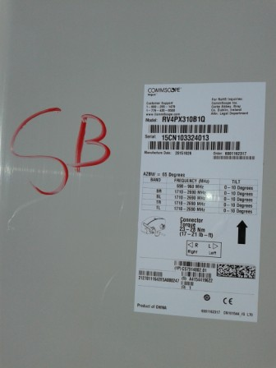
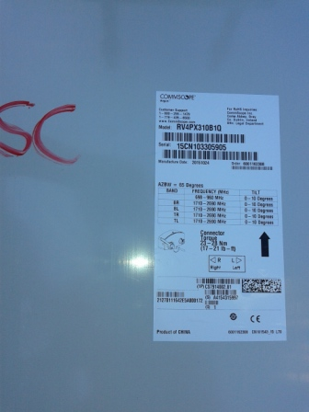
Antenna Type and SN
SectorA Before | SectorB Before | SectorC Before
SectorA After | SectorB After | SectorC After

Slide 13
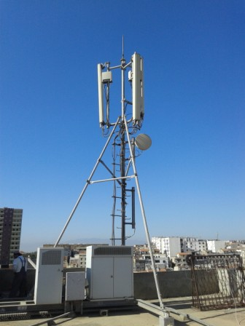
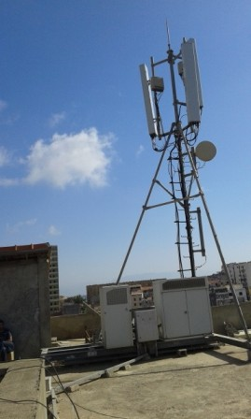
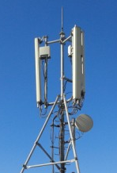
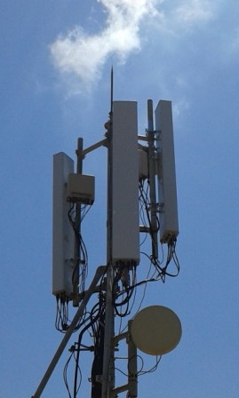
Site Clean Up
Before Swap | After Swap
Site General View
Before Swap | After Swap

Slide 14
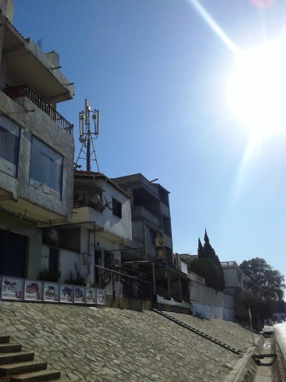
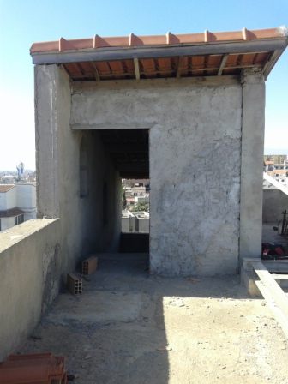
Site Access

Slide 15
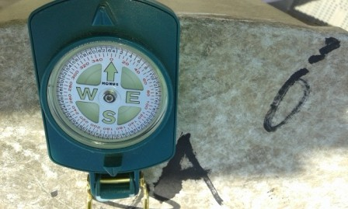



SectorA Before swap azimuth( 0 °) |  | SectorA after swap azimuth( °)
SectorB Before swap azimuth( 100°) |  | SectorB after swap azimuth( 100°)

Slide 16

SectorC Before swap azimuth |  | SectorC after swap azimuth

Slide 17
Antenna Pole SectorA

Slide 18

Antenna Pole SectorB

Slide 19

Antenna Pole SectorC

Slide 20
THE END

