Slide 1

Antenna Swap Report
Project Name: | Ooredoo Algeria LTE Project
Site Code: | AL5005
Site Name: | Petites Provinces
Site Engineer | Barrouta Zouhaier
Subcontractor: | MGNIC
Operation Date: | 07/08/2016

Slide 2
Antenna Swap Report
Site ID | Sector | Old Antenna Type/SN | New Antenna Type/SN | Azimut (°) | HBA (m) from beginning of tower | M-Tilt |  | E-Tilt_900M |  | E-Tilt_1800M |  | E-Tilt_2100M
 |  |  |  |  |  | Before | After | Before | After | Before | After | Before | After
AL5005 | A | KATHREIN/SN:80010622 | AIRGUS PENTA BANDE 15CN103305907 | ( 10 °) | 36 | 0 | 0 | X | X | 6 | 6 | 10 | 10
 | B | KATHREIN/SN:80010622 | AIRGUS PENTA BANDE 15CN103305900 | ( 160 °) | 36 | 5 | 5 | X | X | 5 | 5 | 8 | 8
 | C | KATHREIN/SN:80010622 | AIRGUS PENTA BANDE 15CN103305910 | ( 220 °) | 36 | 0 | 0 | X | X | 6 | 6 | 12 | 12

Slide 3
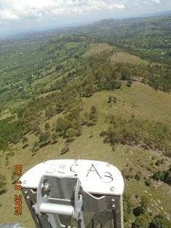
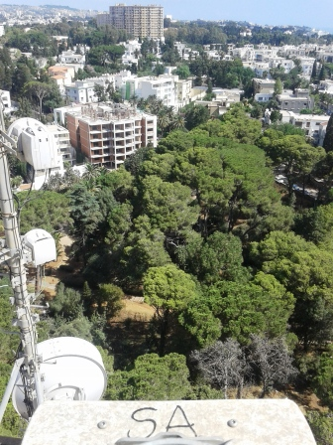
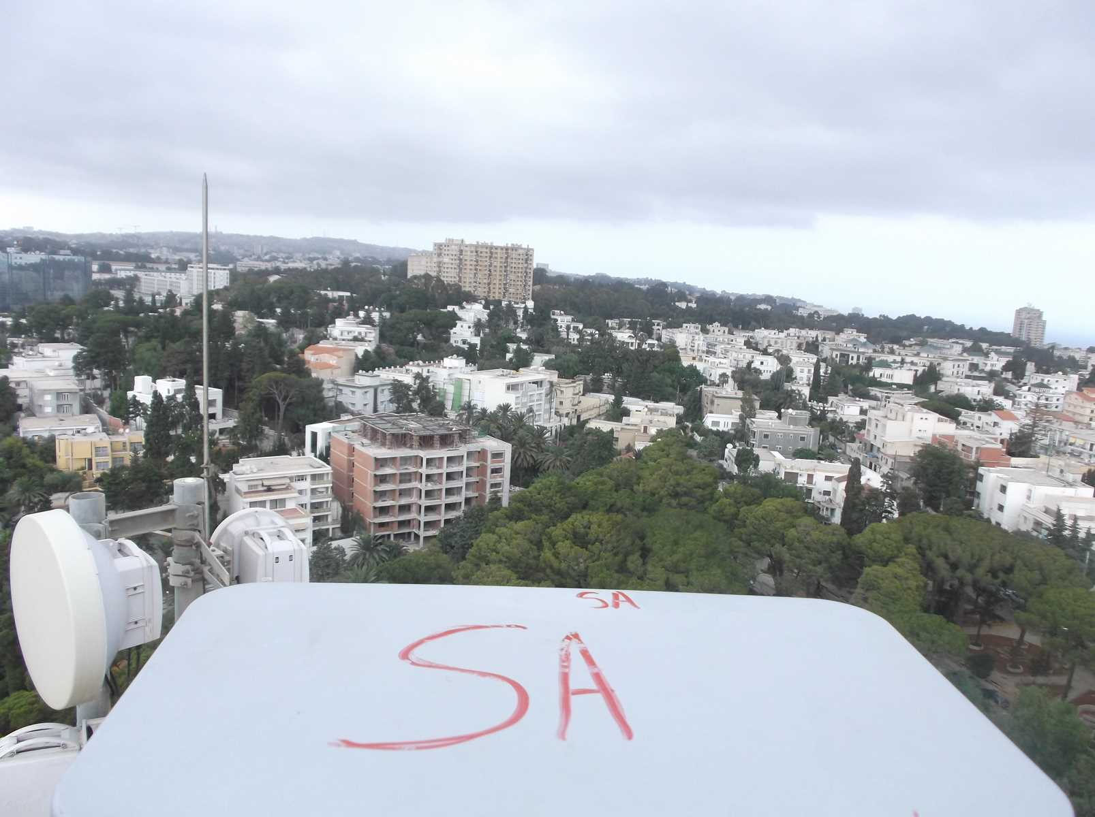
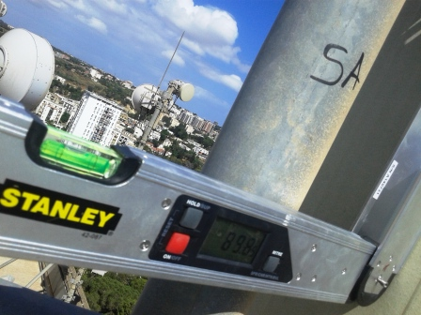
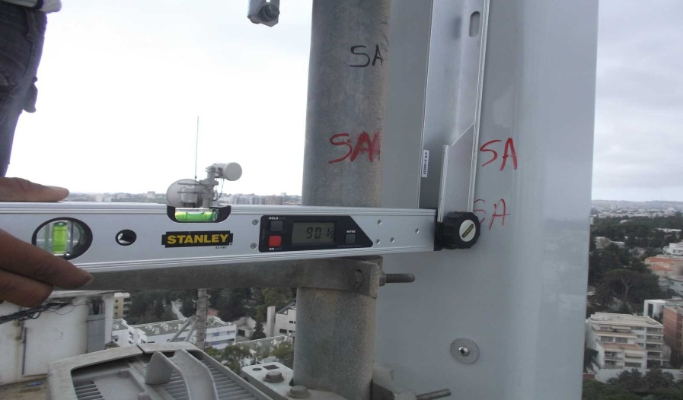
Sector A Antenna Swap
Before swap azimuth( 10 °) |  | After swap azimuth( 10 °)
Before swap Mechanical Tilt( 0 °) |  | After swap Mechanical Tilt( 0 °)

Slide 4
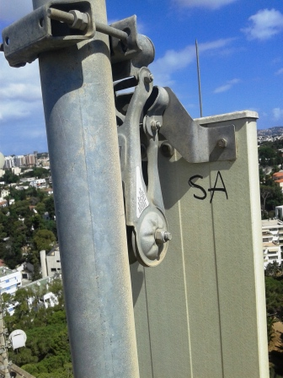
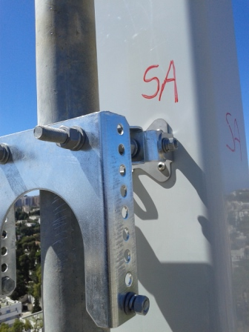
Sector A Antenna Swap
Before swap Mechanical Tilt( 0 °) |  | After swap Mechanical Tilt( 0 °)
Before swap 900M Electric Tilt( °) |  | After swap 900M Electric Tilt( °)

Slide 5
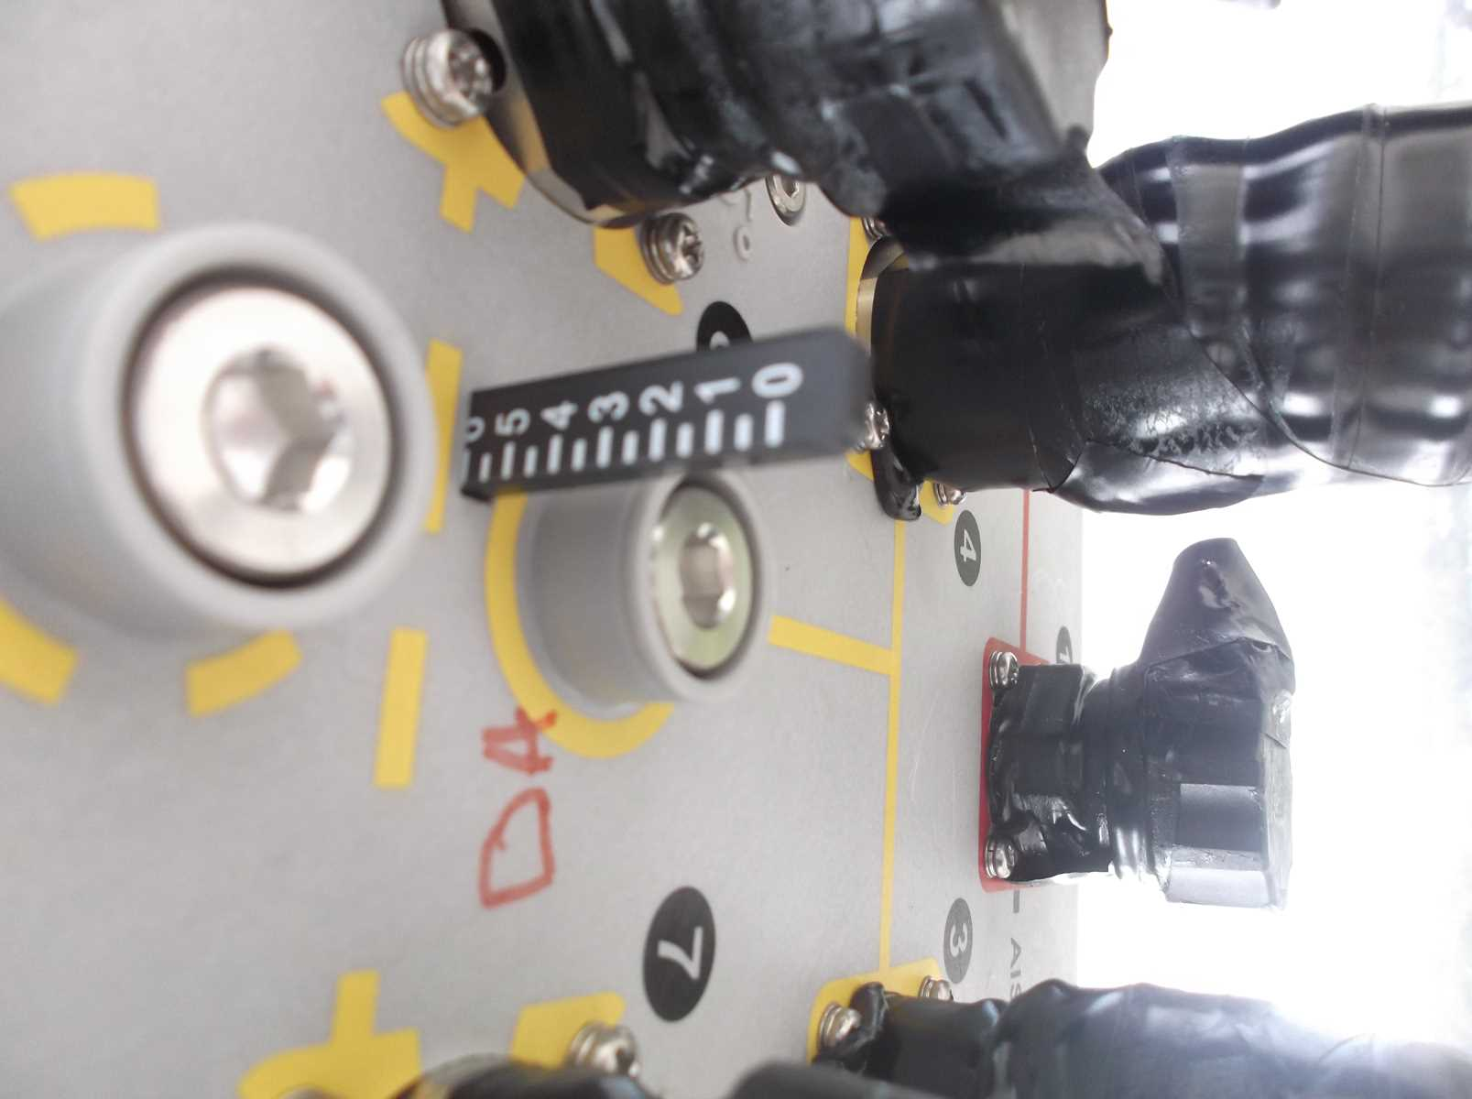
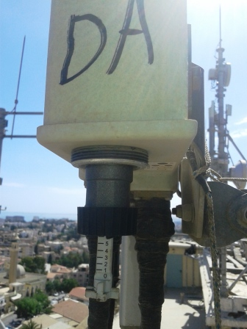
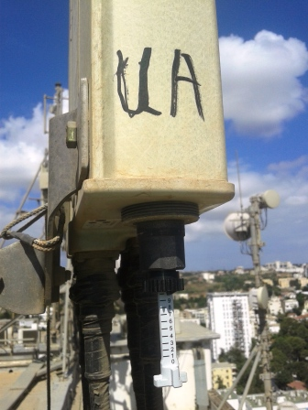
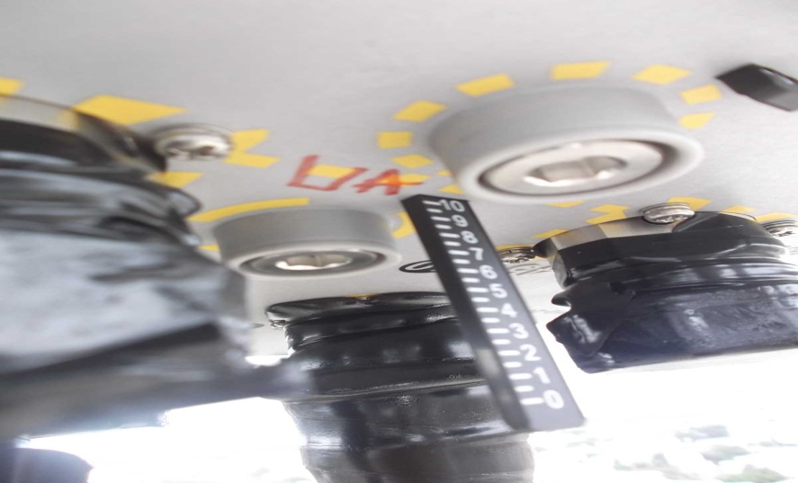
Sector A Antenna Swap
Before swap 1800M Electric Tilt( 6 °) |  | After swap 1800M Electric Tilt( 6 °)
Before swap 2100M Electric Tilt( 10 °) |  | After swap 2100M Electric Tilt( 10 °)

Slide 6
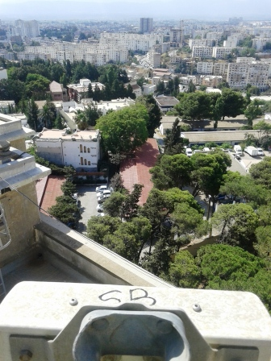
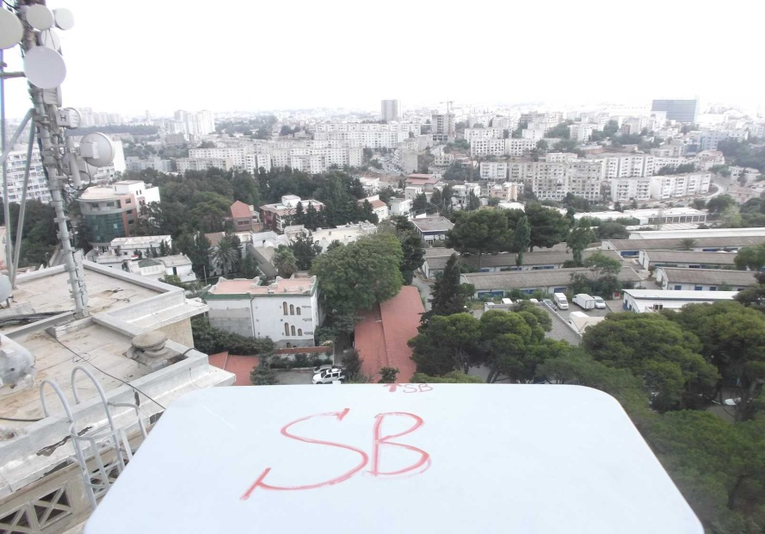
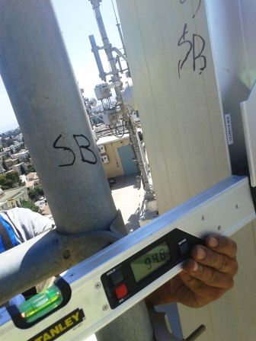
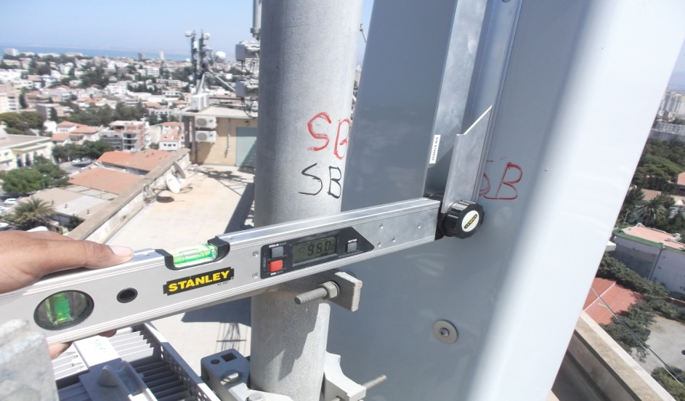
Sector B Antenna Swap
Before swap azimuth( 160°) |  | After swap azimuth( 160 °)
Before swap Mechanical Tilt( 5 °) |  | After swap Mechanical Tilt( 5 °)

Slide 7
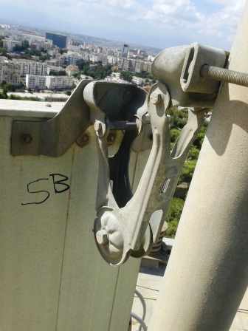
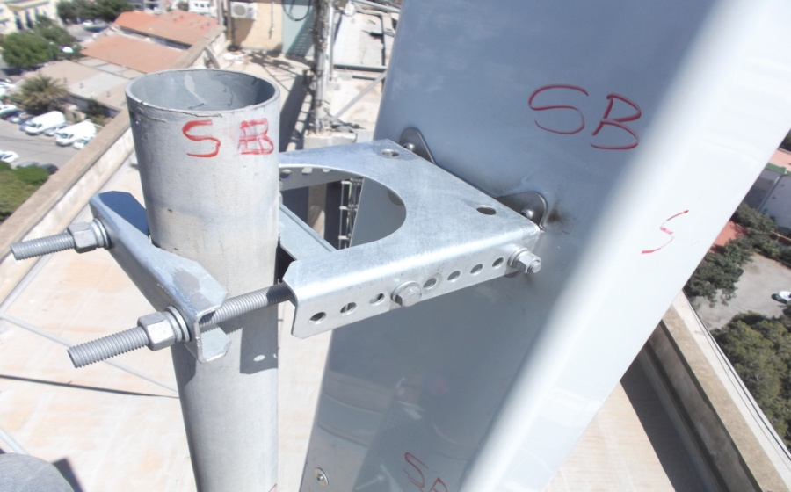
Sector B Antenna Swap
Before swap Mechanical Tilt( 5 °) |  | After swap Mechanical Tilt( 5 °)
Before swap 900M Electric Tilt( °) |  | After swap 900M Electric Tilt( °)

Slide 8
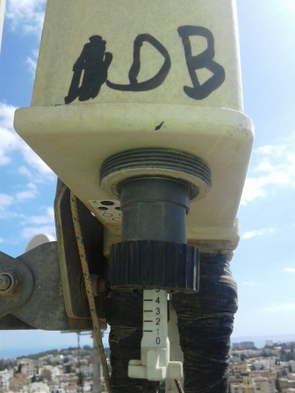
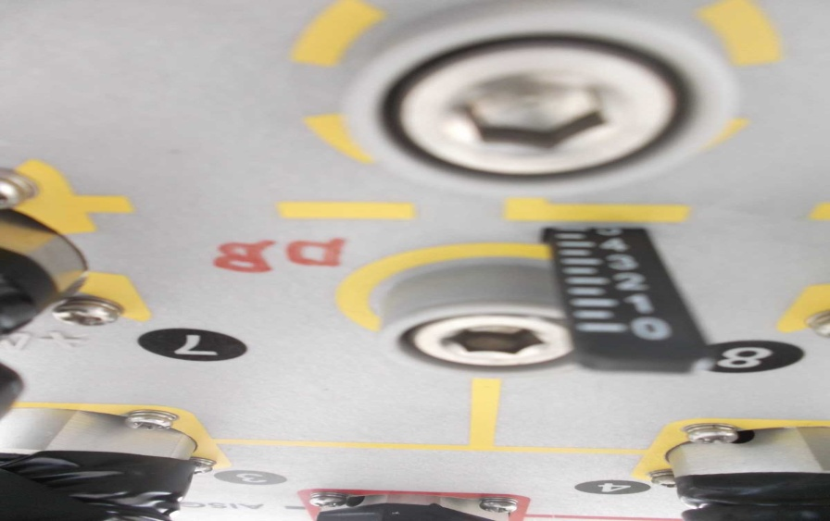
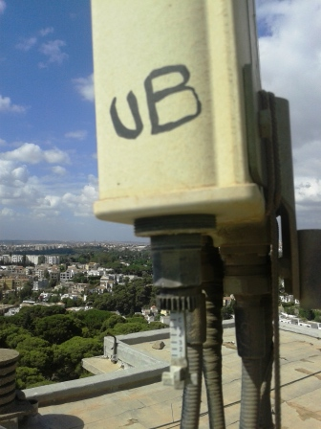
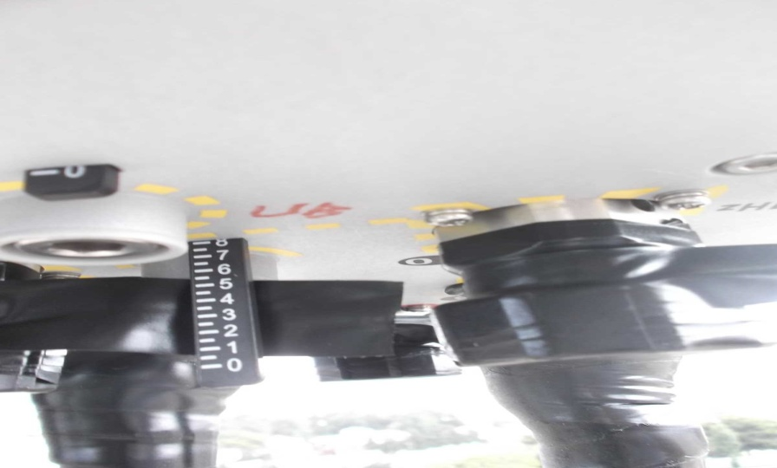
Sector B Antenna Swap
Before swap 1800M Electric Tilt( 5 °) |  | After swap 1800M Electric Tilt( 5 °)
Before swap 2100M Electric Tilt( 8 °) |  | After swap 2100M Electric Tilt( 8°)

Slide 9
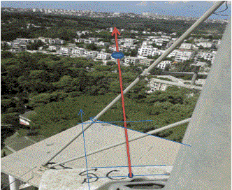
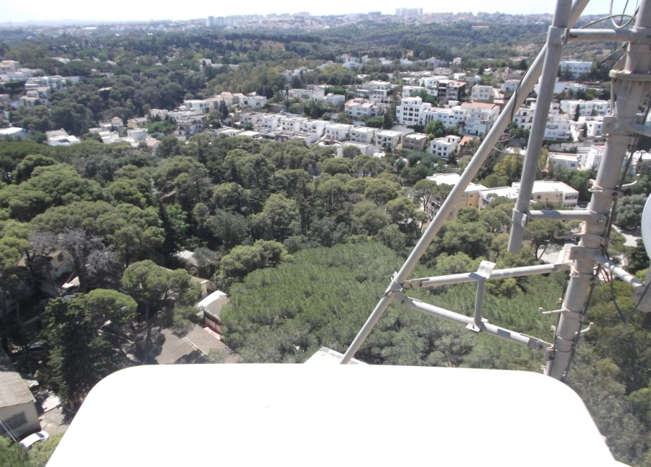
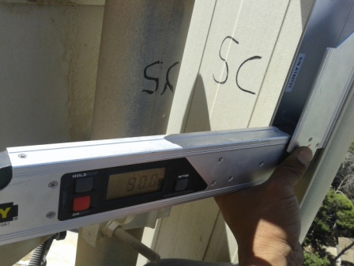
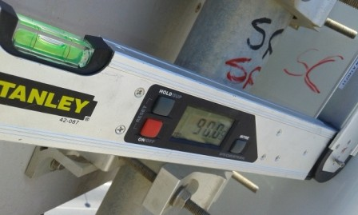
Sector C Antenna Swap
Before swap azimuth( 220 °) |  | After swap azimuth( 220 °)
Before swap Mechanical Tilt( 0 °) |  | After swap Mechanical Tilt( 0 °)

Slide 10
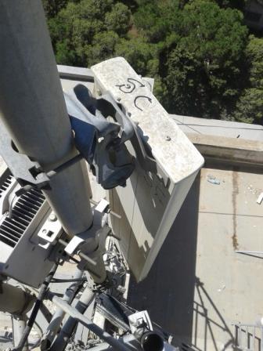
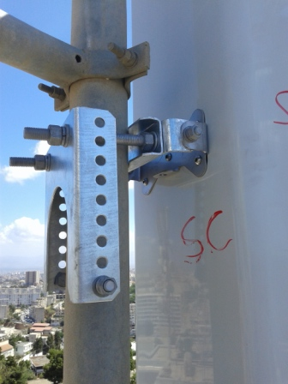
Sector C Antenna Swap
Before swap Mechanical Tilt( 0 °) |  | After swap Mechanical Tilt( 0 °)
Before swap 900M Electric Tilt( °) |  | After swap 900M Electric Tilt( °)

Slide 11
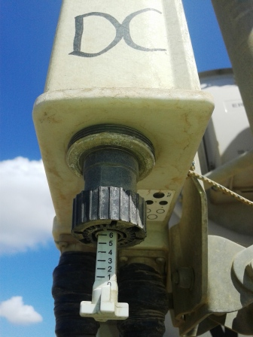
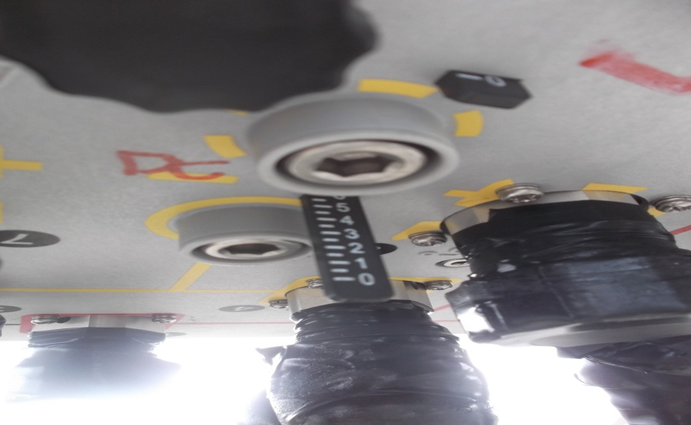
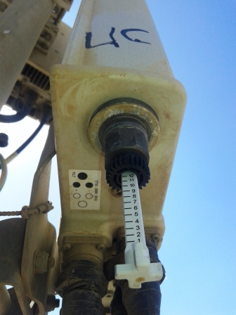
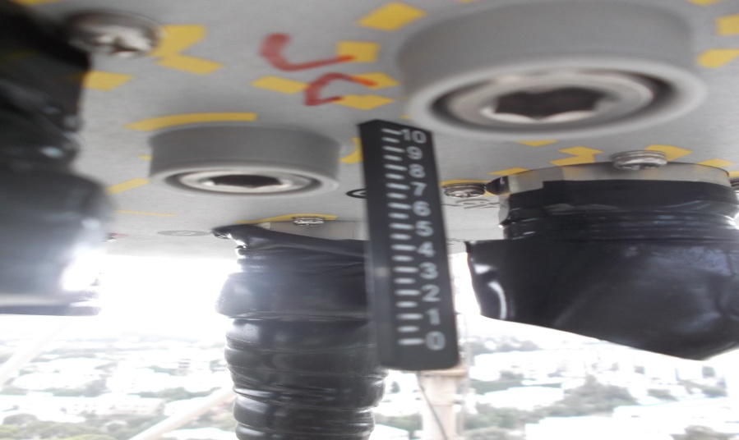
Sector C Antenna Swap
Before swap 1800M Electric Tilt( 6 °) |  | After swap 1800M Electric Tilt( 6 °)
Before swap 2100M Electric Tilt( 12 °) |  | After swap 2100M Electric Tilt( 10 °)

Slide 12
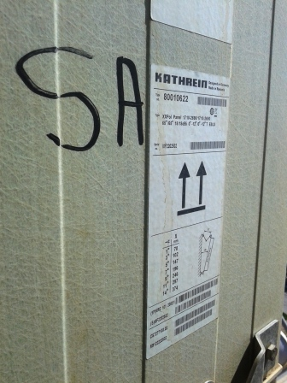
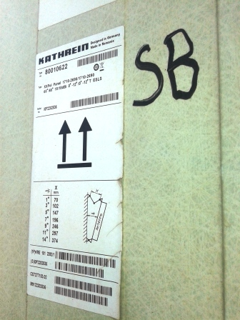
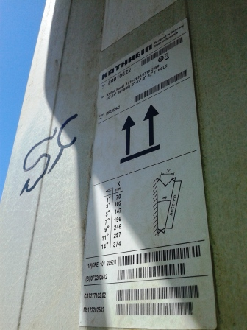
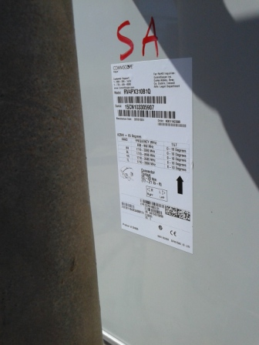
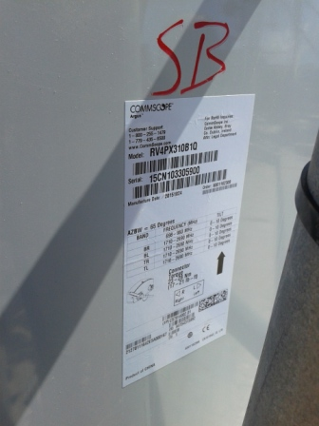
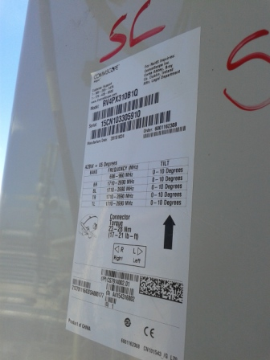
Antenna Type and SN
Sector A Before | Sector B Before | Sector C Before
Sector A After | Sector B After | Sector C After

Slide 13
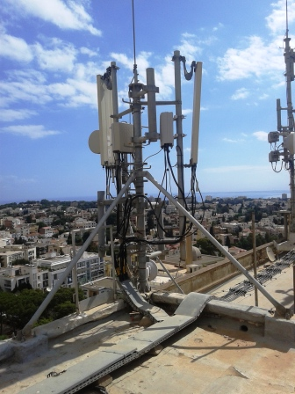
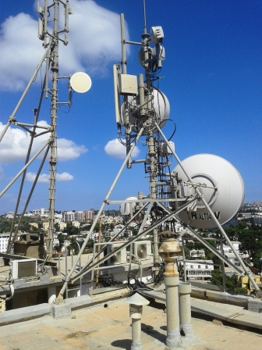
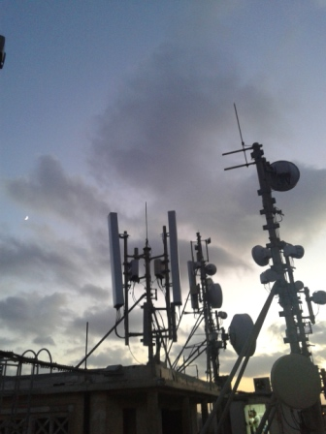
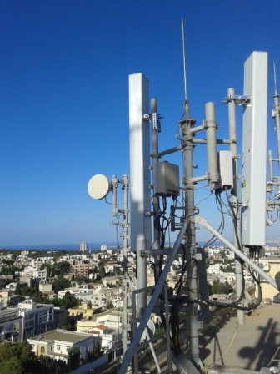
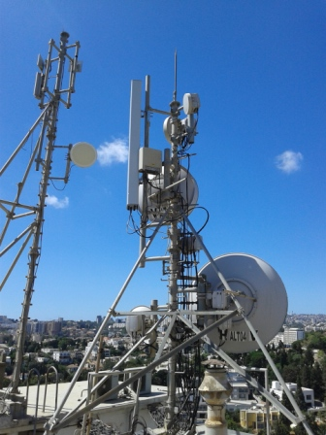
Site Clean Up
Before Swap | After Swap
Site General View
Before Swap | After Swap

Slide 14
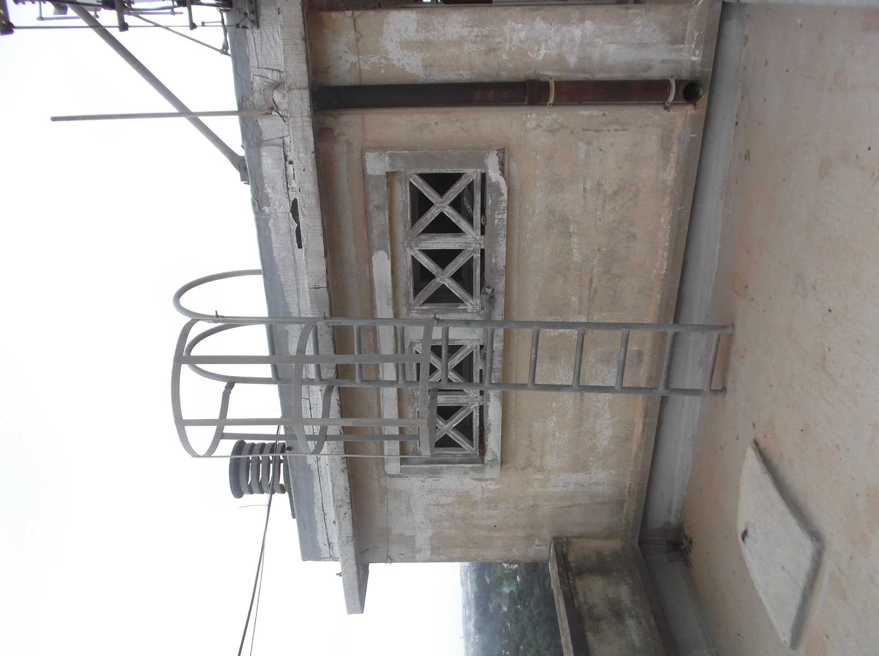
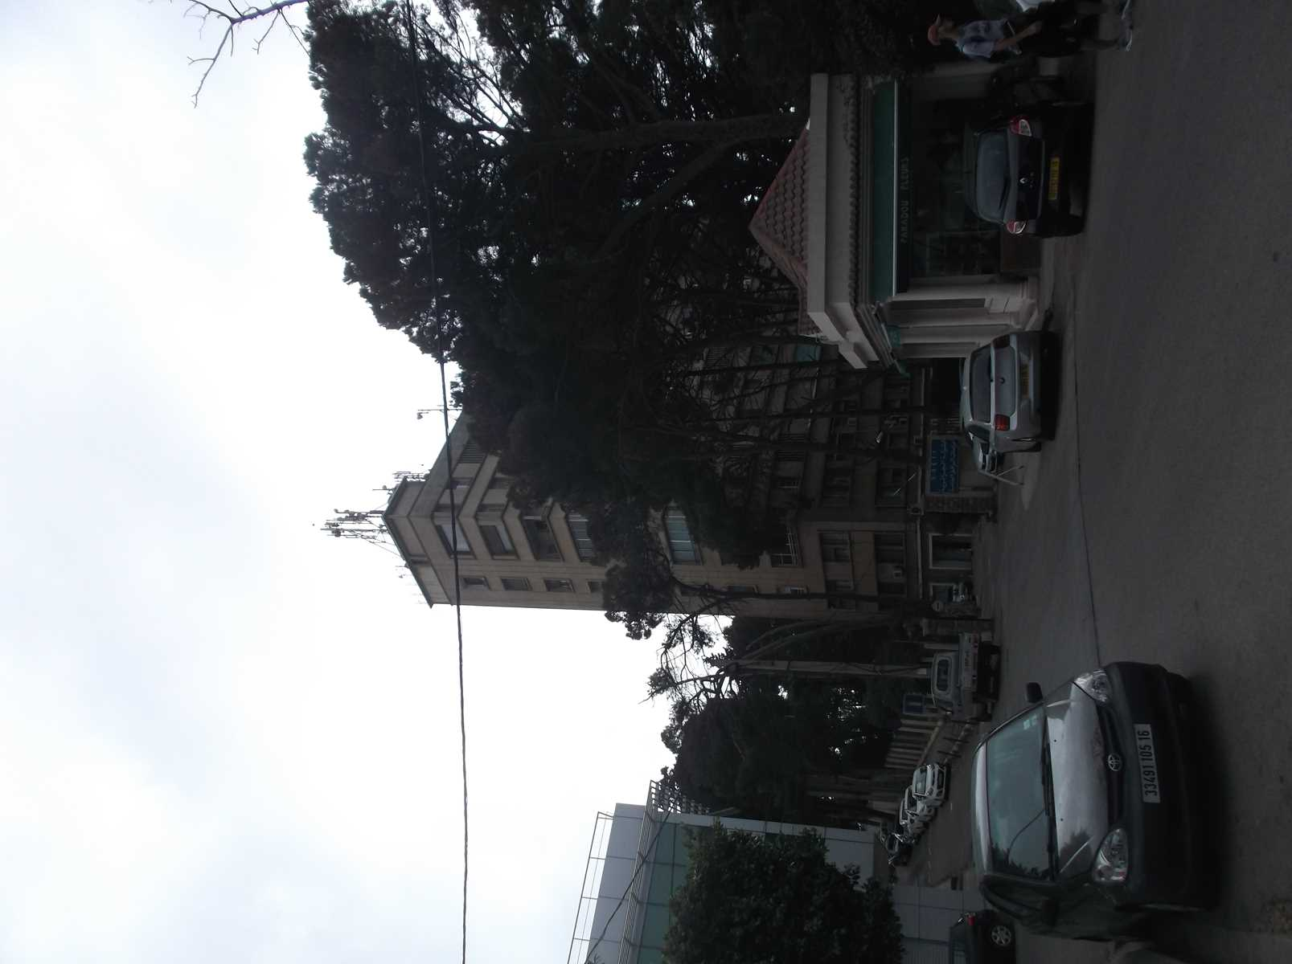
Site Access

Slide 15
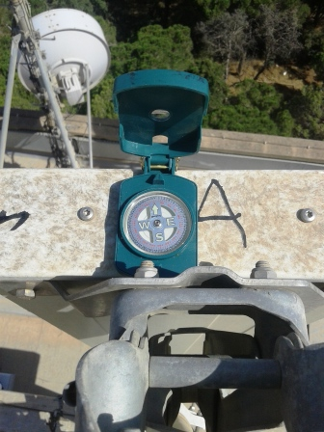
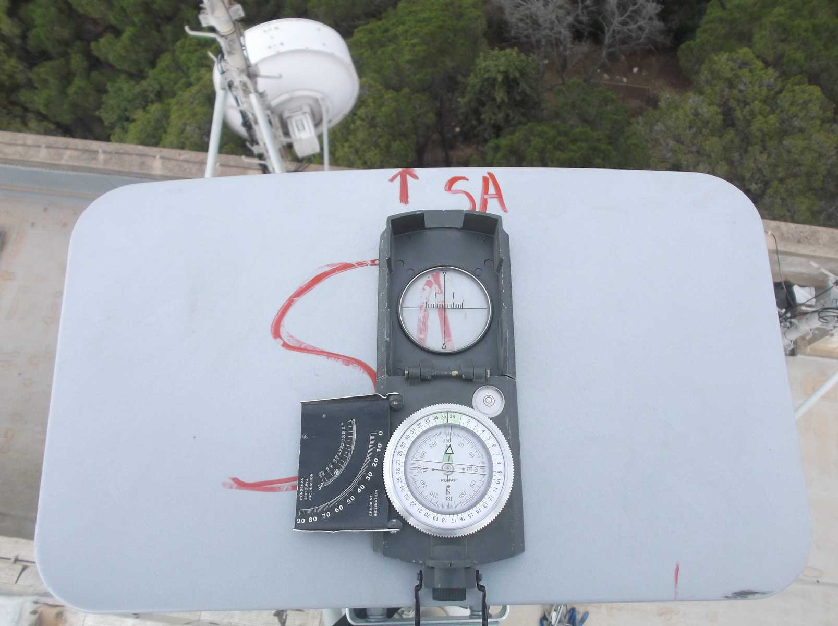
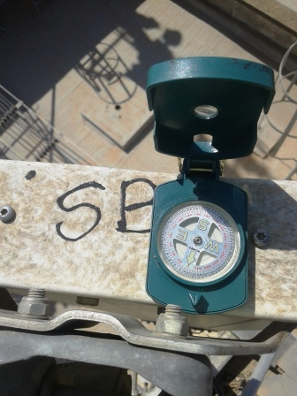
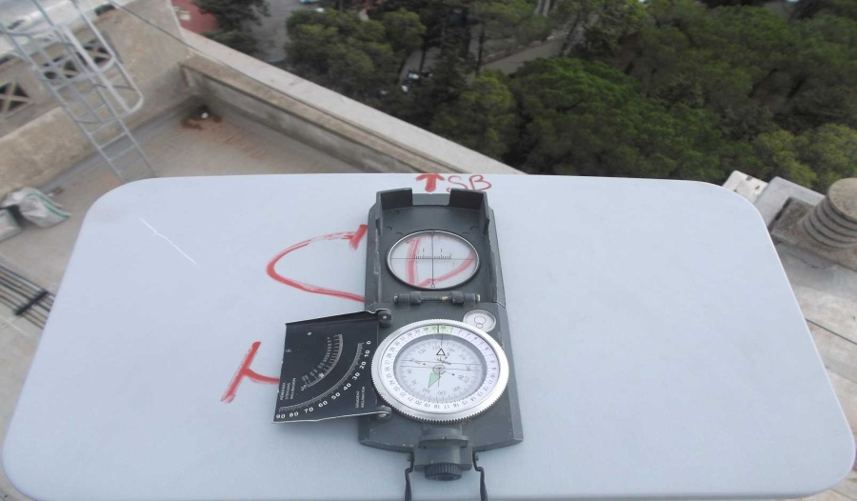
Sector A Before swap azimuth( 10 °) |  | Sector A after swap azimuth( 10 °)
Sector B Before swap azimuth( 160°) |  | Sector B after swap azimuth( 160 °)

Slide 16
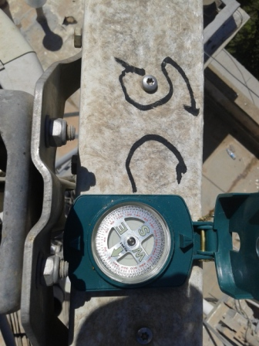
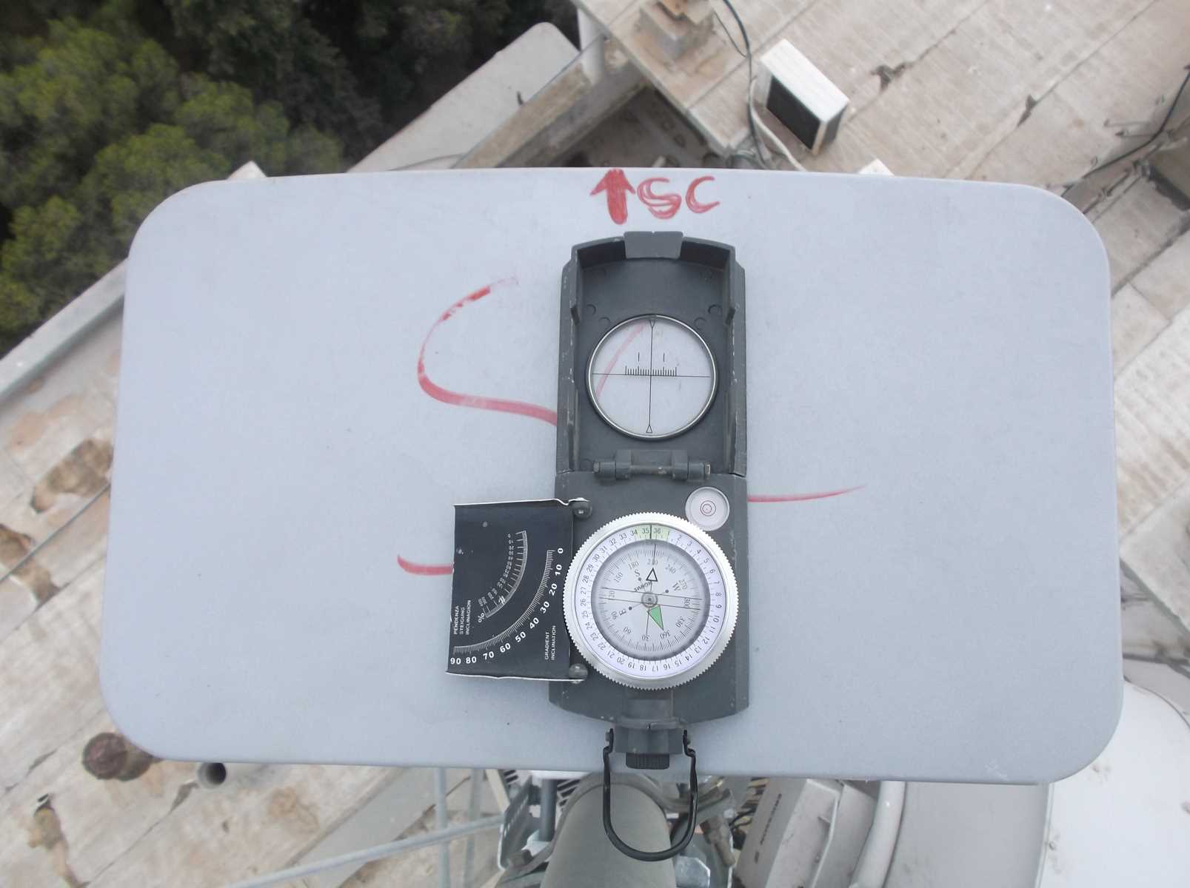
Sector C Before swap azimuth( 220 °) |  | Sector C after swap azimuth( 220 °)

Slide 17

Antenna Pole Sector A

Slide 18

Antenna Pole Sector B

Slide 19
Antenna Pole SectorC

Slide 20
THE END

