Slide 1

Antenna Swap Report
Project Name: | Ooredoo Algeria LTE Project
Site Code: | AL5938
Site Name: | BIR KHADEM
Site Engineer | MOHAMED RHAHLIA
Subcontractor: | MGNIC
Operation Date: | 10/08/2016

Slide 2
Antenna Swap Report
Site ID | Sector | Old Antenna Type/SN | New Antenna Type/SN | Azimut (°) | HBA (m) from beginning of tower | M-Tilt |  | E-Tilt_900M |  | E-Tilt_1800M |  | E-Tilt_2100M
 |  |  |  |  |  | Before | After | Before | After | Before | After | Before | After
AL5938 | A | Kathrein80010692/SN:W0F0398877 | RX4PX310B1Q SN:15CN102161838 | 330 | 9 | 0 | 0 | 4 | 4 | 4 | 4 | 4 | 4
 | B | Kathrein80010692/SN:W0F0509639 | RX4PX310B1Q SN:15CN102161830 | 60 | 9 | 0 | 0 | 5 | 5 | 5 | 5 | 4 | 4
 | C | Kathrein80010692/SN:W0F0402127 | RX4PX310B1Q SN:15CN103305901 | 200 | 9 | 0 | 0 | 6 | 6 | 6 | 6 | 6 | 6

Slide 3
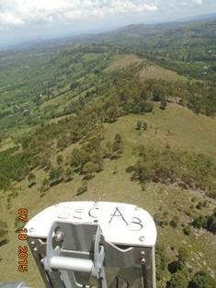
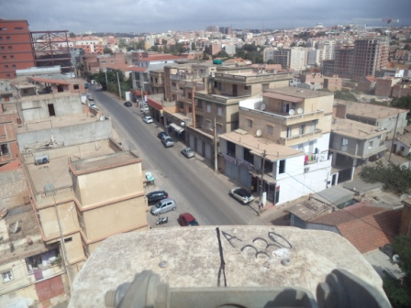
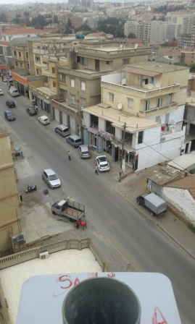
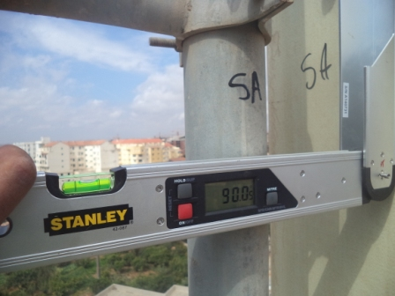
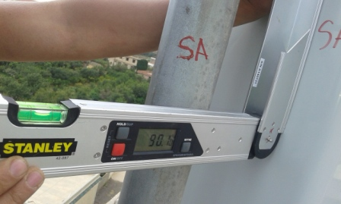
Sector A Antenna Swap
Before swap azimuth( 330 °) |  | After swap azimuth( 330 °)
Before swap Mechanical Tilt( 0 °) |  | After swap Mechanical Tilt( 0 °)

Slide 4
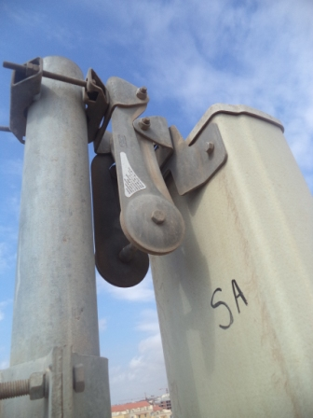
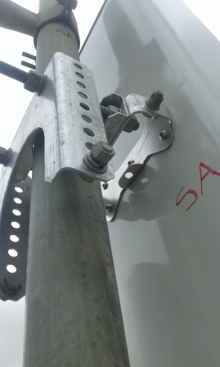
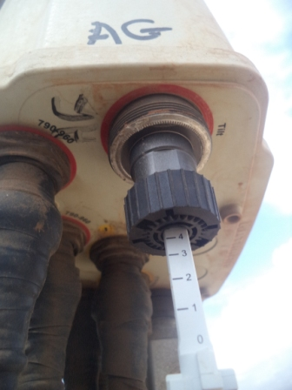
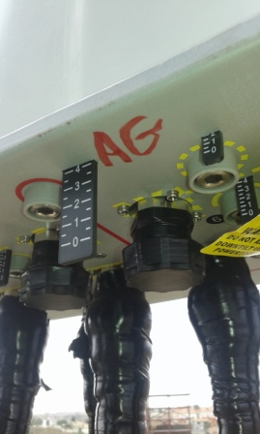
Sector A Antenna Swap
Before swap Mechanical Tilt( 0 °) |  | After swap Mechanical Tilt( 0°)
Before swap 900M Electric Tilt( 4 °) |  | After swap 900M Electric Tilt( 4 °)

Slide 5
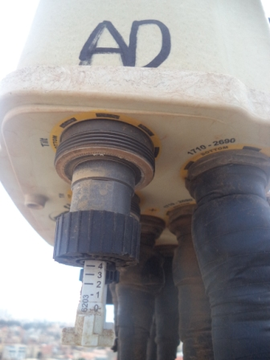
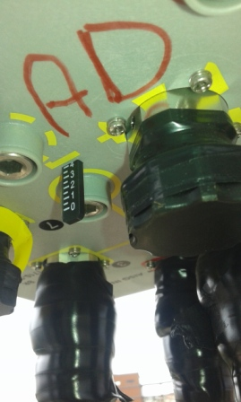
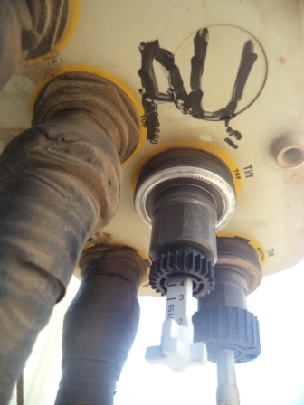
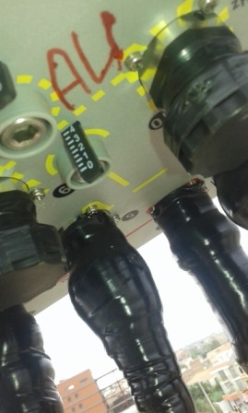
Sector A Antenna Swap
Before swap 1800M Electric Tilt( 4 °) |  | After swap 1800M Electric Tilt( 4 °)
Before swap 2100M Electric Tilt( 4 °) |  | After swap 2100M Electric Tilt( 4 °)

Slide 6
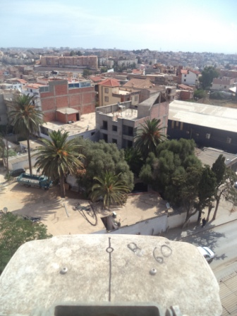
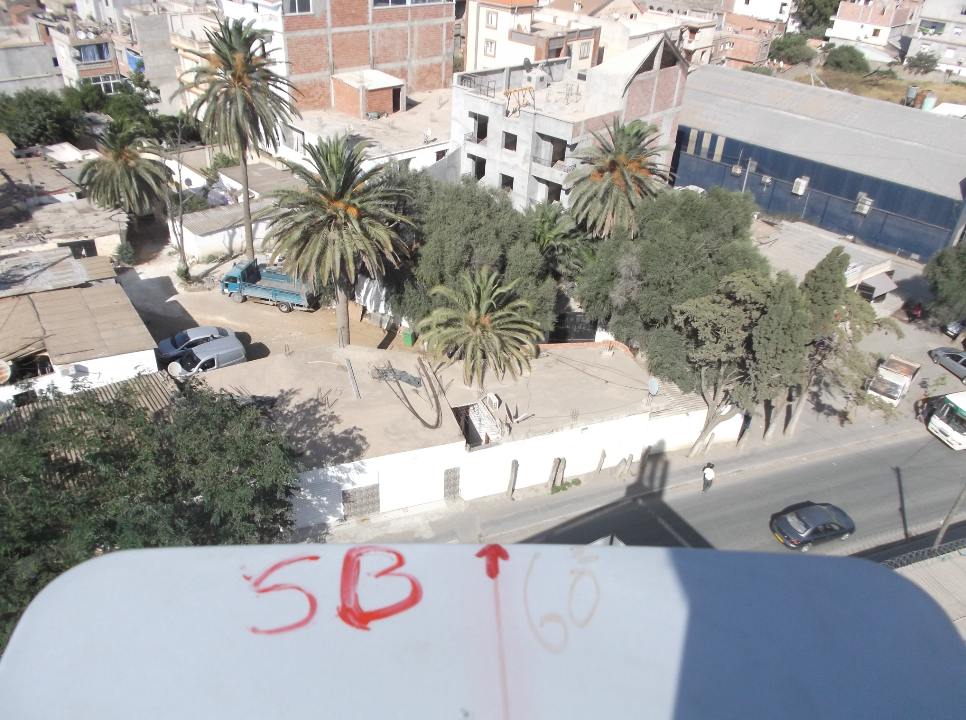
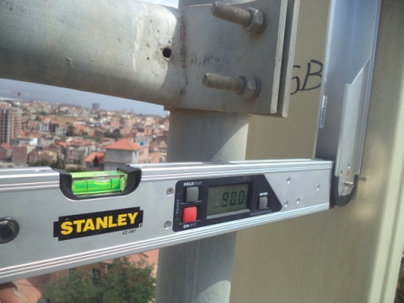
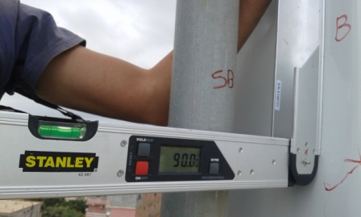
Sector B Antenna Swap
Before swap azimuth( 60 °) |  | After swap azimuth( 60 °)
Before swap Mechanical Tilt( 0 °) |  | After swap Mechanical Tilt( 0 °)

Slide 7
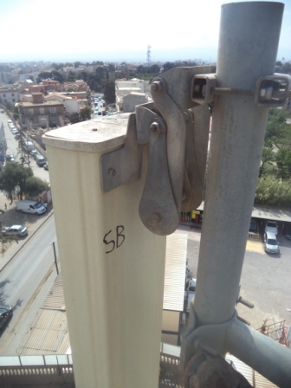
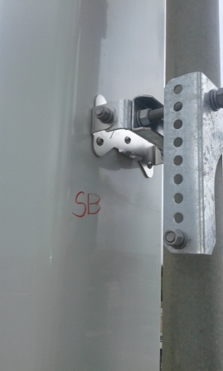
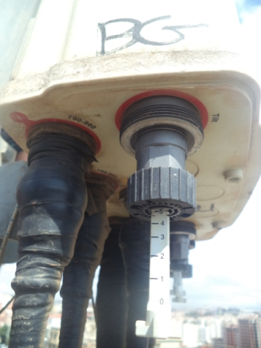
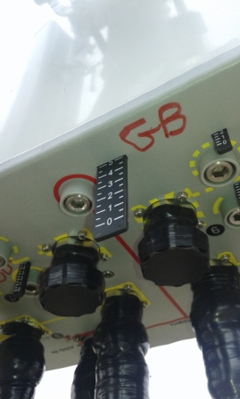
Sector B Antenna Swap
Before swap Mechanical Tilt( 0 °) |  | After swap Mechanical Tilt( 0 °)
Before swap 900M Electric Tilt( 5 °) |  | After swap 900M Electric Tilt( 5 °)

Slide 8
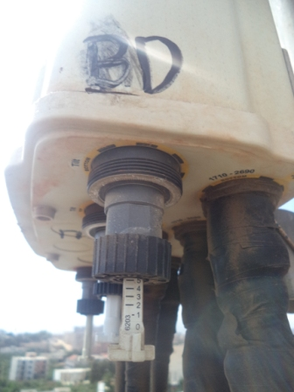
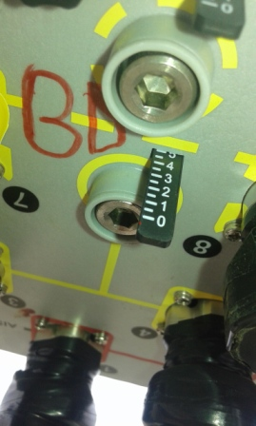
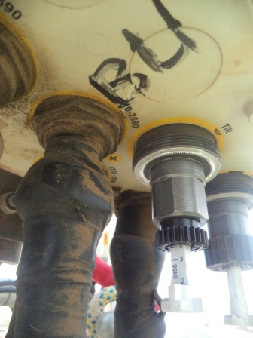
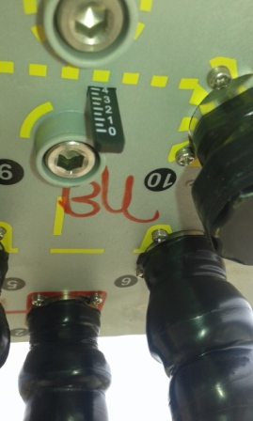
Sector B Antenna Swap
Before swap 1800M Electric Tilt( 5 °) |  | After swap 1800M Electric Tilt( 5 °)
Before swap 2100M Electric Tilt( 4 °) |  | After swap 2100M Electric Tilt( 4 °)

Slide 9
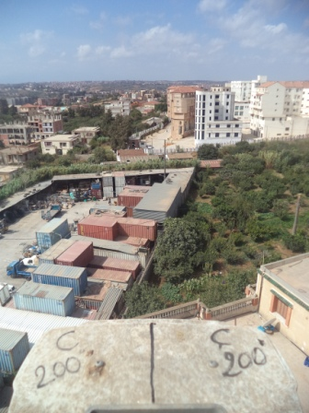
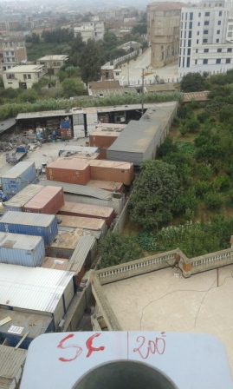
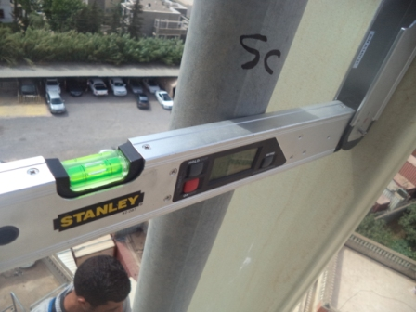
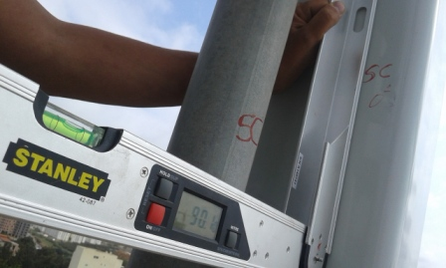
Sector C Antenna Swap
Before swap azimuth( 200°) |  | After swap azimuth( 200°)
Before swap Mechanical Tilt( 0 °) |  | After swap Mechanical Tilt( 0 °)

Slide 10
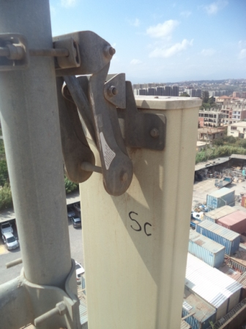
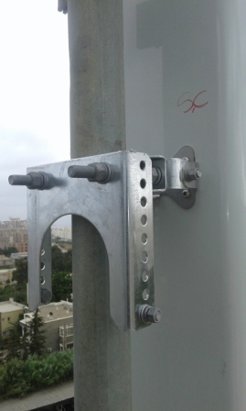
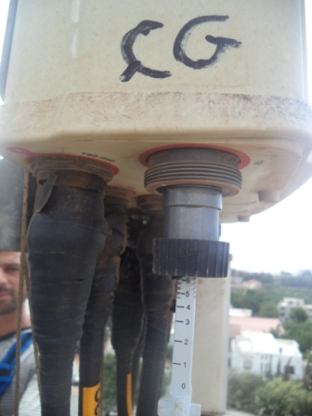
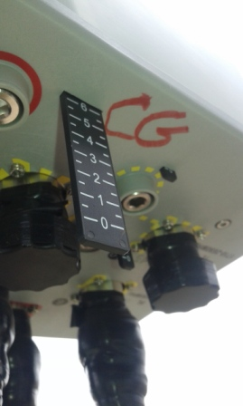
Sector C Antenna Swap
Before swap Mechanical Tilt( 0 °) |  | After swap Mechanical Tilt( 0°)
Before swap 900M Electric Tilt( 6 °) |  | After swap 900M Electric Tilt( 6 °)

Slide 11
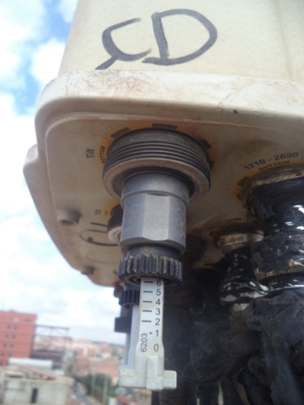
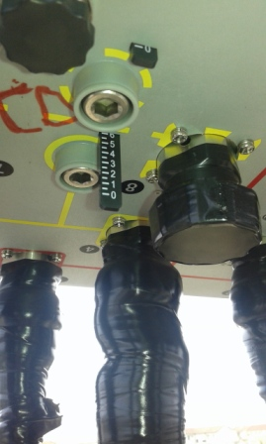
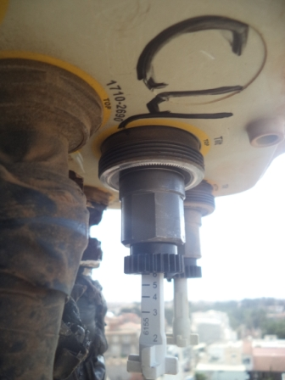
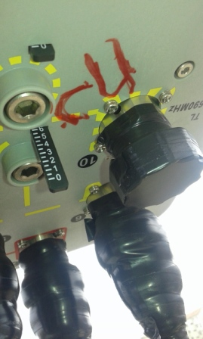
Sector C Antenna Swap
Before swap 1800M Electric Tilt( 6 °) |  | After swap 1800M Electric Tilt( 6°)
Before swap 2100M Electric Tilt( 6 °) |  | After swap 2100M Electric Tilt( 6°)

Slide 12
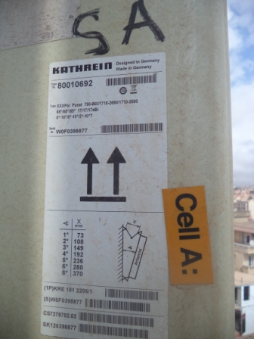
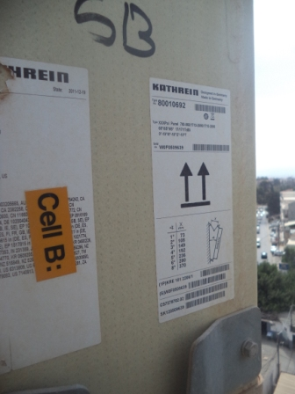
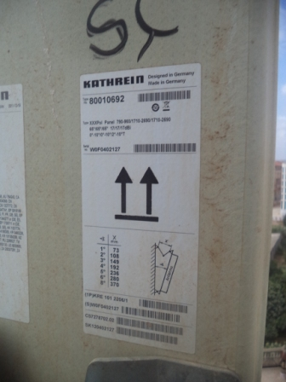
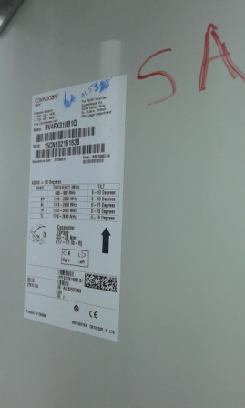
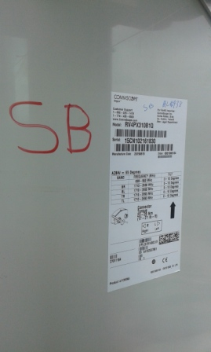
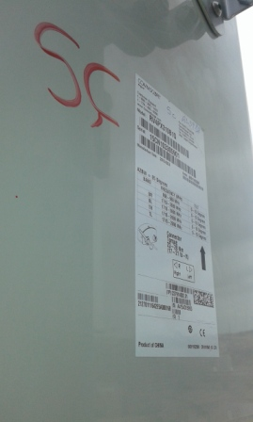
Antenna Type and SN
SectorA Before | SectorB Before | SectorC Before
SectorA After | SectorB After | SectorC After

Slide 13
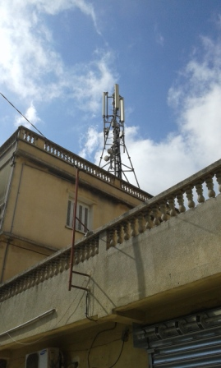
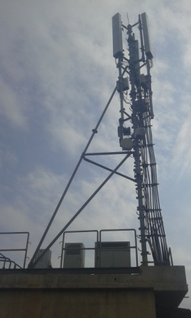
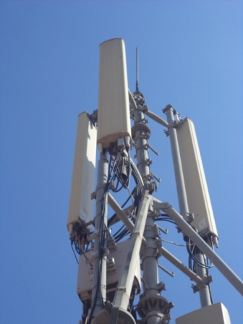
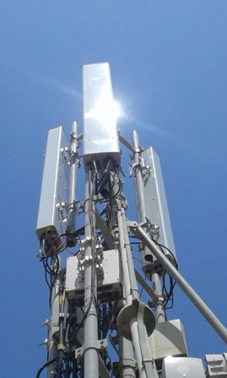
Site Clean Up
Before Swap | After Swap
Site General View
Before Swap | After Swap

Slide 14
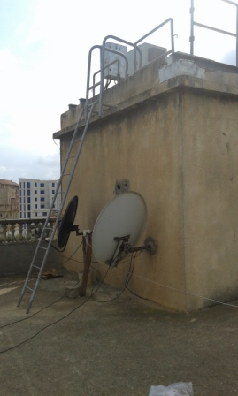
Site Access

Slide 15
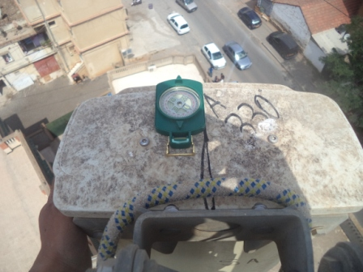
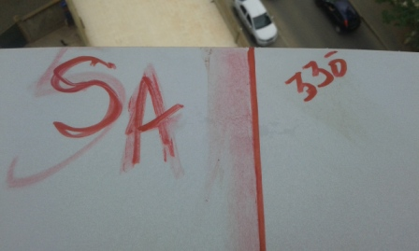


We can’t put compass cause of the wind
SectorA Before swap azimuth( 330 °) |  | SectorA after swap azimuth( °)
SectorB Before swap azimuth( 60 °) |  | SectorB after swap azimuth( 60 °)

Slide 16


We can’t put compass cause of the wind
SectorC Before swap azimuth |  | SectorC after swap azimuth

Slide 17

Antenna Pole SectorA

Slide 18

Antenna Pole SectorB

Slide 19

Antenna Pole SectorC

Slide 20
THE END

