Slide 1


OTA 2G&3G Modernization Project
Site Photos
Subcontractor: ********
Site ID: A17X033
Installation/Swap Date: 20/06/*2016
Name: HAICHEUR HADJER
Department: Documentation (OTA Project)
Mail: haicheur.hadjer@zte.com.cn

Slide 2
Work Done ( Please to list bellow the work items done on the site)
….

Slide 3
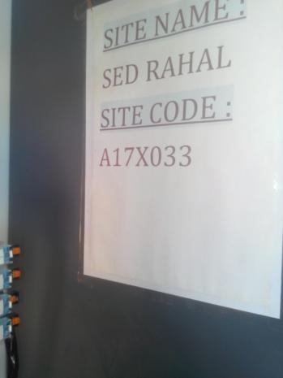
Site Identification
Paste the Picture here

Slide 4
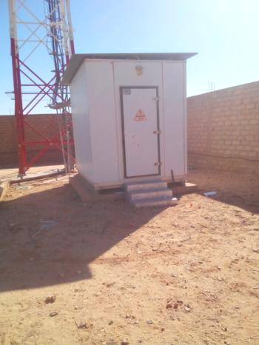
Site View outdoor
Paste the Picture here

Slide 5
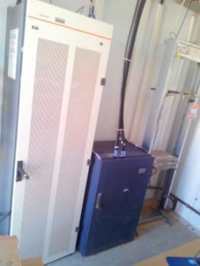
Site View Indoor
Paste the Picture here

Slide 6
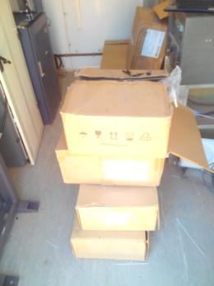
Equipments delivered
Paste the Picture here

Slide 7
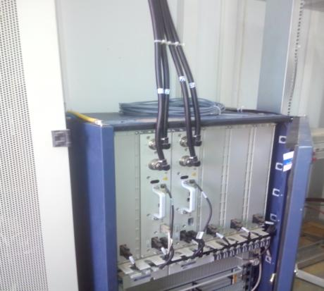
BTS/NodeB Cabinet
Paste the Picture here

Slide 8
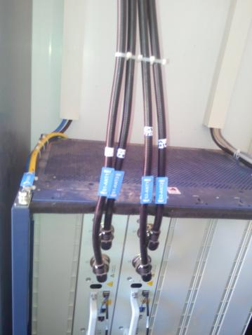
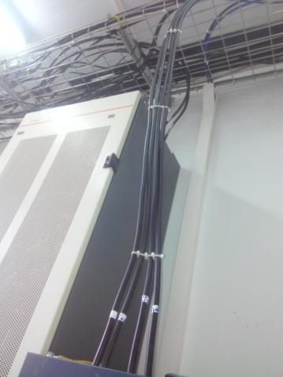
Indoor Jumpers + label
Paste the Picture here

Slide 9
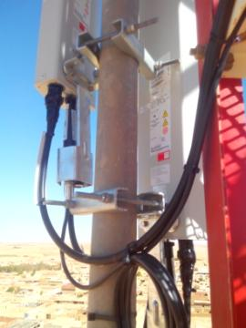
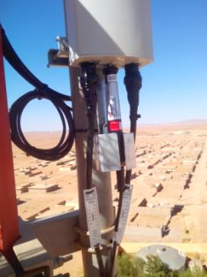
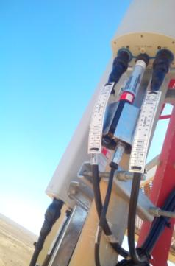
Outdoor Jumpers

Slide 10

Outdoor Jumpers
Paste the Picture here

Slide 11
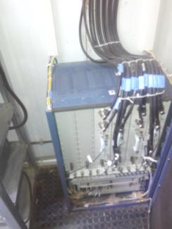
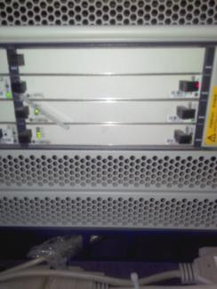
BBU (Connectivity and labeling)

Slide 12
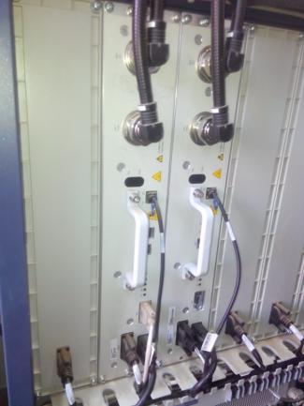
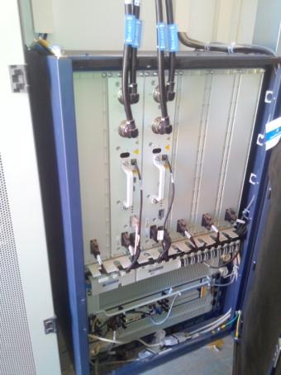
RSU/RRU

Slide 13
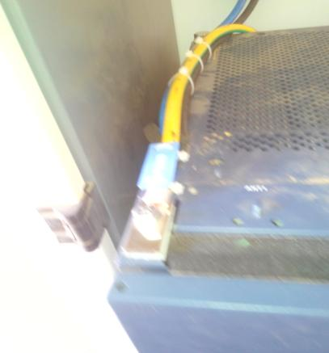
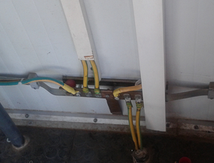
Grounding / Grounding Bar (Indoor and/or Outdoor)
Paste the Picture here

Slide 14
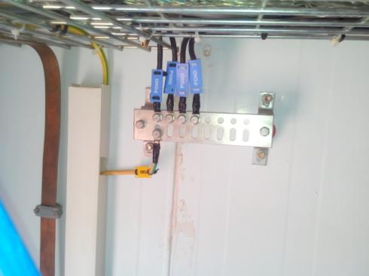
Grounding / Grounding Bar (Indoor and/or Outdoor)
Paste the Picture here

Slide 15
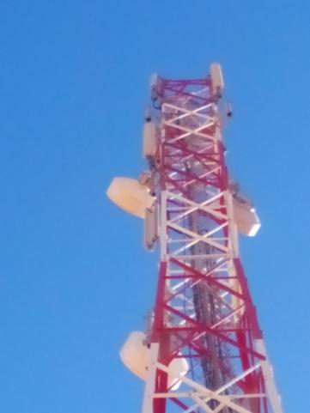
Antennas
Paste the Picture here

Slide 16
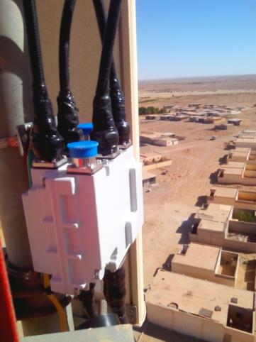

Antenna Sector 1 (Feeder,Waterproofing,label)
Paste the Picture here

Slide 17

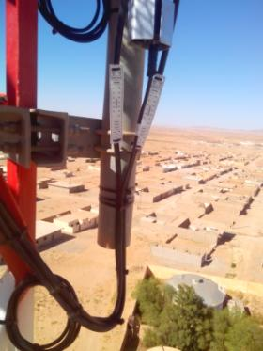
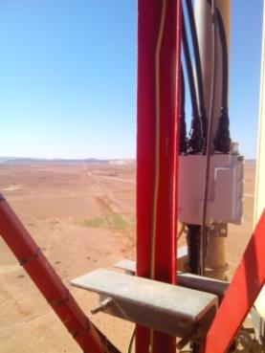
Antenna Sector 2(Feeder,Waterproofing,label)
Paste the Picture here

Slide 18

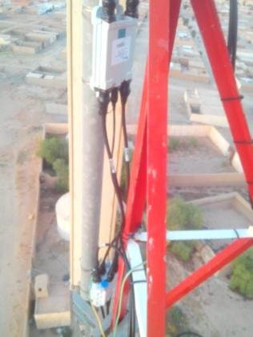
Antenna Bracket
Paste the Picture here

Slide 19
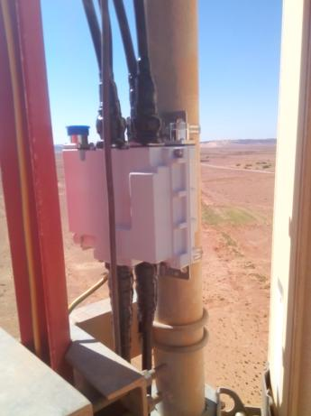

Triplexer S1 S2 S3(Waterproofing+Label)
Paste the Picture here

Slide 20
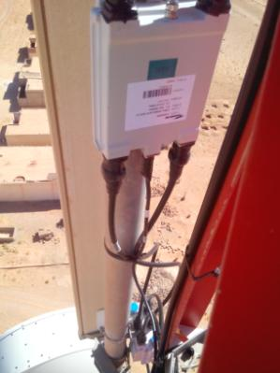
TMA
Paste the Picture here

Slide 21
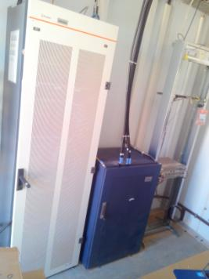

Cleanup
Paste the Picture here

Slide 22
Others
Paste the Picture here

