Slide 1


OTA 2G&3G Modernization Project
Site Photos
Subcontractor: ********
Site ID: A17X067
Installation/Swap Date: 02/07/2016
Name: HAICHEUR HADJER
Department: Documentation (OTA Project)
Mail: haicheur.hadjer@zte.com.cn

Slide 2
Work Done ( Please to list bellow the work items done on the site)
….

Slide 3
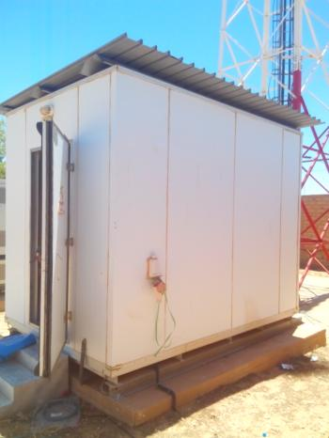
Site View outdoor
Paste the Picture here

Slide 4
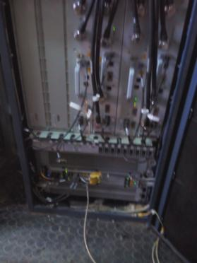
Site View Indoor
Paste the Picture here

Slide 5
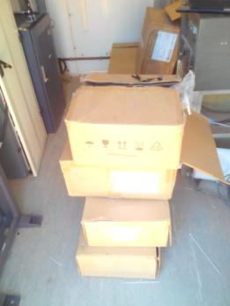
Equipments delivered
Paste the Picture here

Slide 6
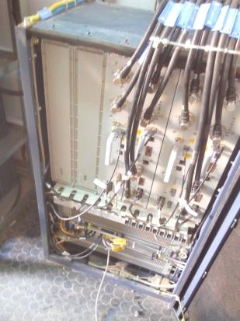
BTS/NodeB Cabinet
Paste the Picture here

Slide 7
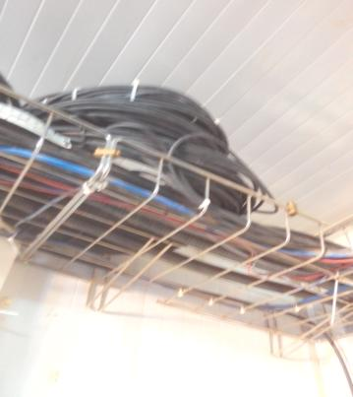
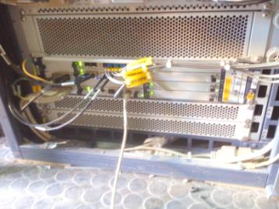
Indoor Jumpers + label
Paste the Picture here

Slide 8
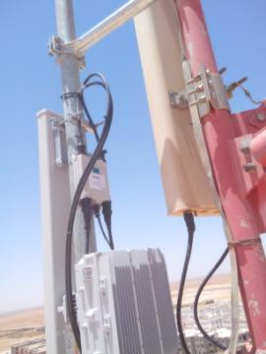
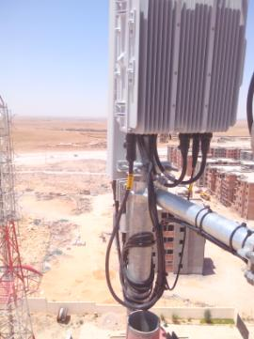
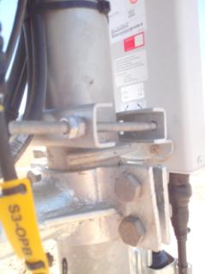
Outdoor Jumpers

Slide 9
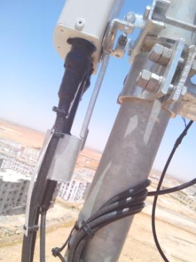
Outdoor Jumpers
Paste the Picture here

Slide 10
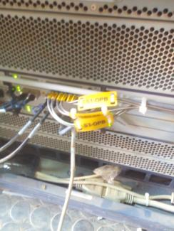
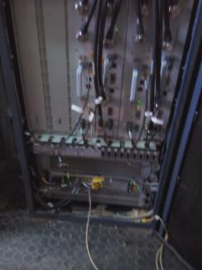
BBU (Connectivity and labeling)

Slide 11
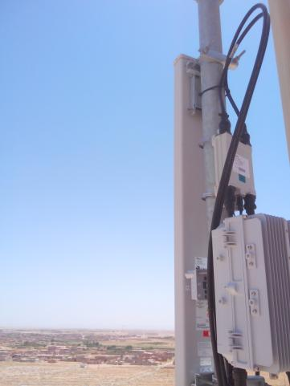
Antennas
Paste the Picture here

Slide 12
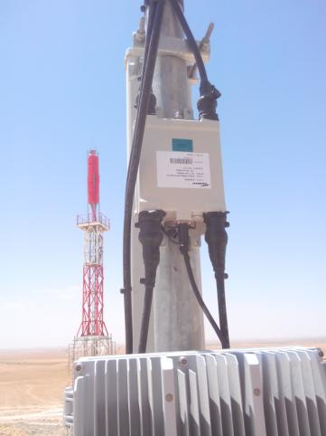
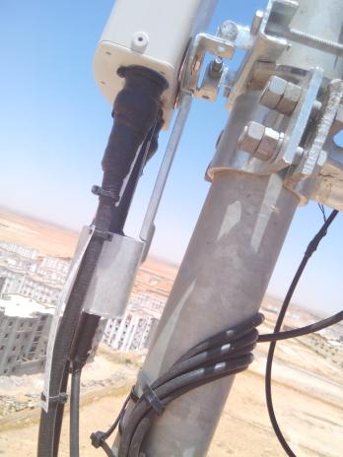
Antenna Sector 1 (Feeder,Waterproofing,label)
Paste the Picture here

Slide 13
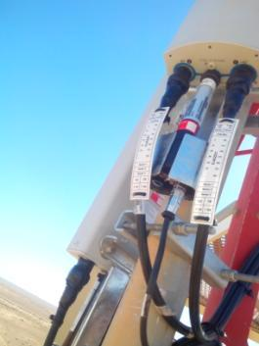
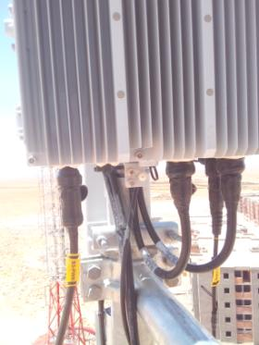

Antenna Sector 2(Feeder,Waterproofing,label)
Paste the Picture here

Slide 14


Antenna Bracket
Paste the Picture here

Slide 15
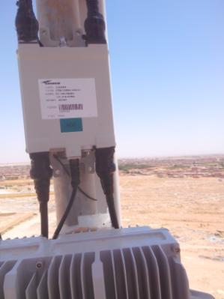
TMA
Paste the Picture here

Slide 16
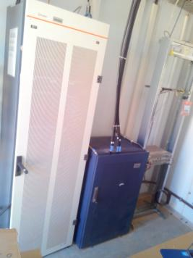
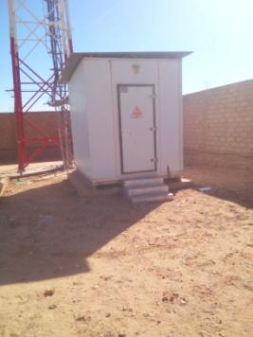
Cleanup
Paste the Picture here

Slide 17
Others
Paste the Picture here

