Slide 1


POWER SUPPLY INSTALLATION Subcontractor: MGNIC Site ID: O29X134 Installation/Swap Date: 08/06/2016
Name: HAICHEUR HADJER
Department: Documentation (OTA Project)
Mail: haicheur.hadjer@zte.com.cn

Slide 2
Work Done ( Please to list bellow the work items done on the site)
Site View Indoor
Site View Indoor after
Equipments delivered
New position View
Transmission Equipment
After power supply
Power Supply Before
Batteries Grounding
Cable labeling Before

Slide 3
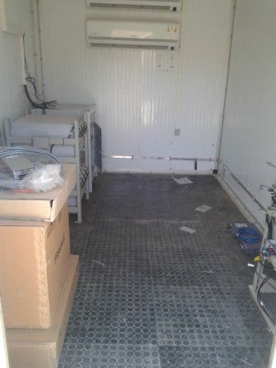
Site View indoor
Paste the Picture here

Slide 4
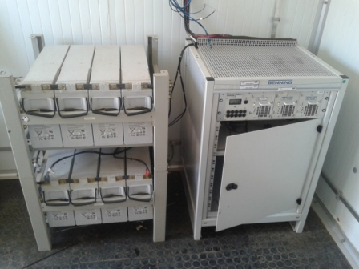
New position View

Slide 5
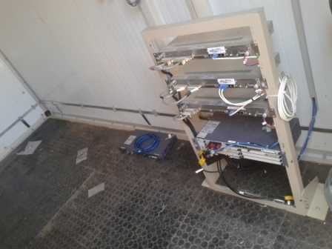
Transmission Equipment
Paste the Picture here

Slide 6
After power supply
Paste the Picture here

Slide 7
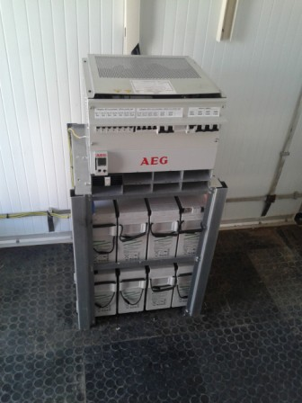
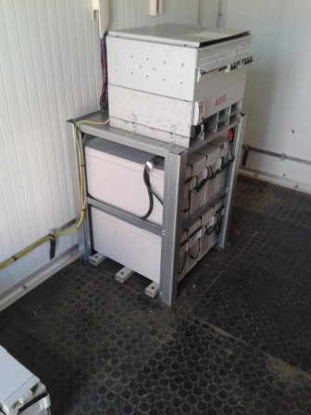
Power Supply Before
Paste the Picture here

Slide 8
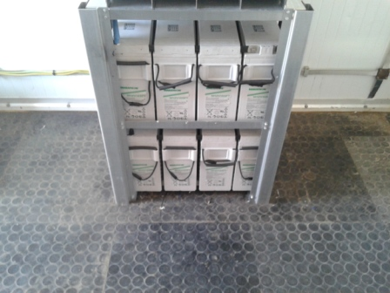
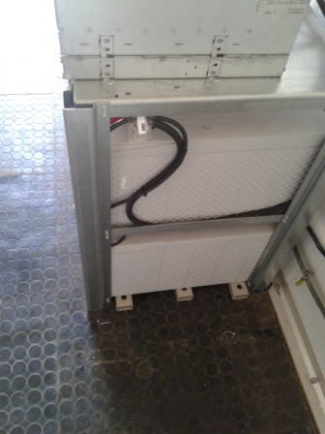
Batteries Grounding

Slide 9
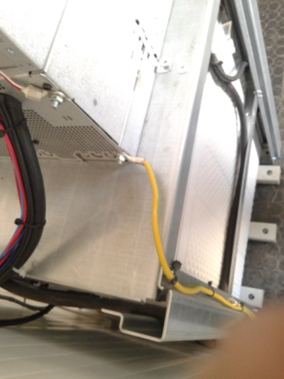
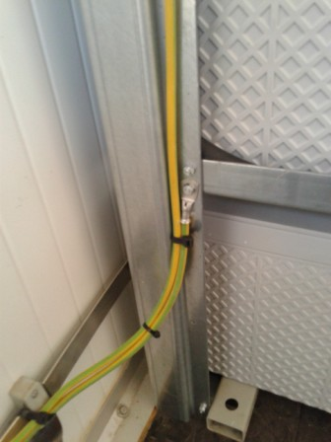
Bar Grounding

Slide 10
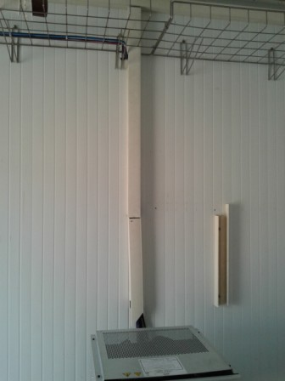
New Position Labeling
Paste the Picture here

Slide 11
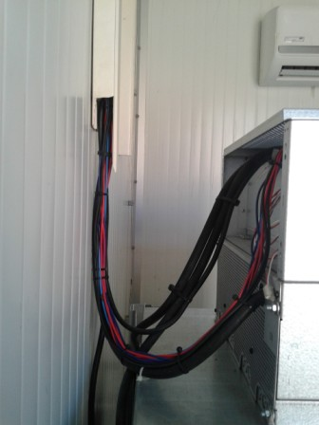
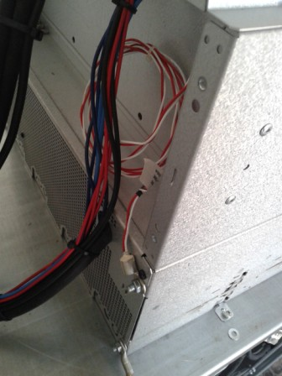
Cable labeling Before

Slide 12
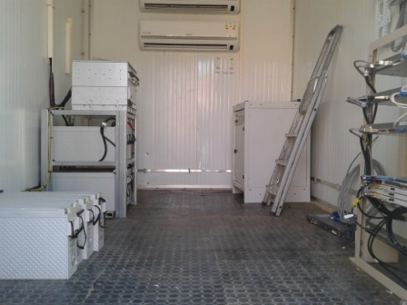
General view Before

Slide 13
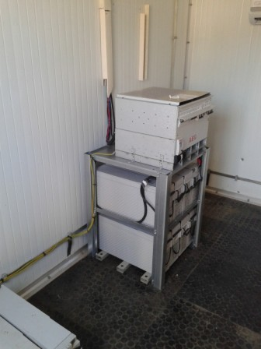
Cleanup
Paste the Picture here

Slide 14
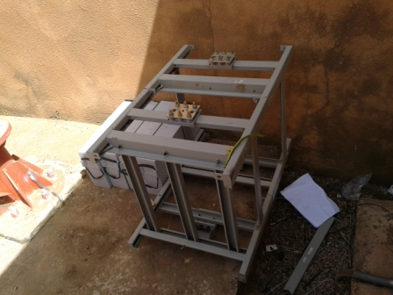
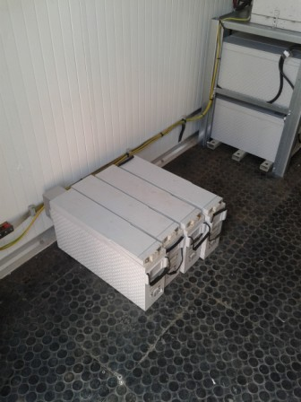
Rack Dismounted

